Slide 1
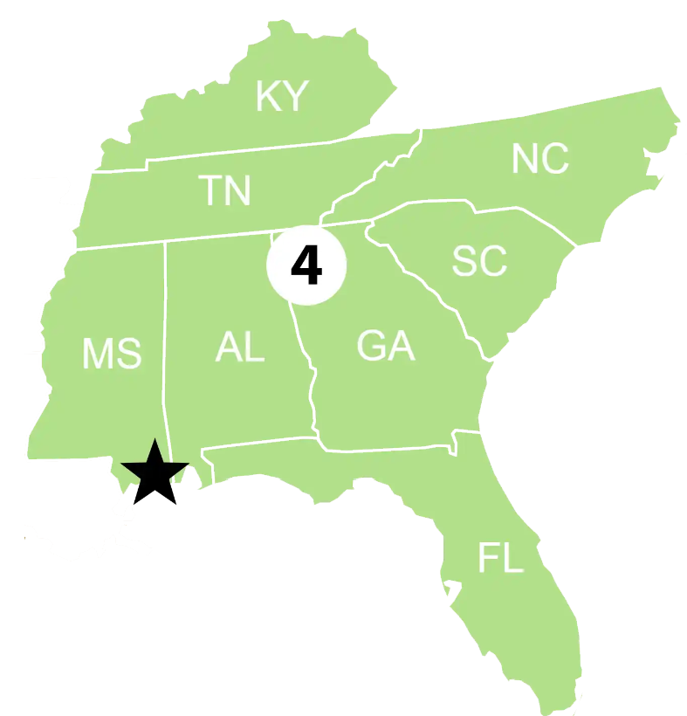
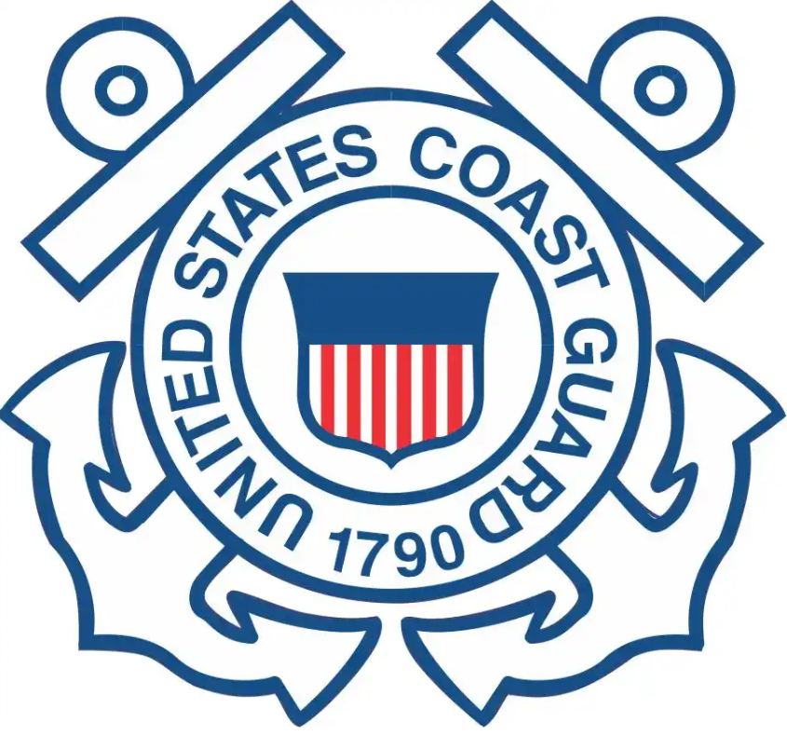
Sector (Ohio Valley)
Federalized cases:
Oil Event TN River MM 11-12, MSU Paducah KY: 01/26/2024-Current
RP is First Marine (Shipyard) owned by Western Rivers Boat Management, Inc.
Old single skin barge with 12 cargo tanks not certificated to not hold or contain any oil products or waste.
Approximately 245,800 gallons were removed. Tank cleaning operations have commenced.
Notable cases or engagements:
Clean Waterways Cincinnati on April 9-11
FEMA Homeland Security Exercise and Evaluation Program on May 8
SOHV GIUE at Transmontaigne Louisville on May 23
Biggest RRT-related concerns in your AOR:
Our primary concern is shipyards and fleeting areas dumping slop oil into unregulated barges. Sector has established over flights and a team to document areas on the rivers that could potentially store products illegally. This team will conduct follow up visits and inspections into these areas.

