Slide 1
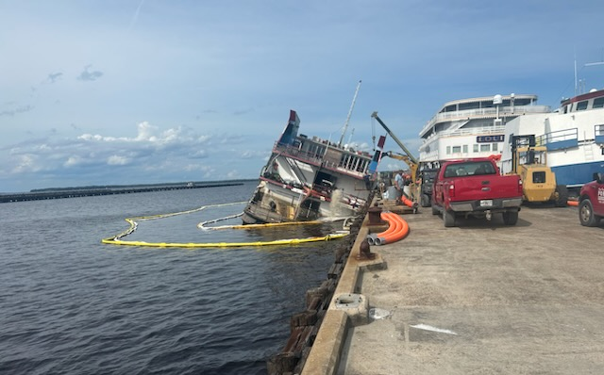
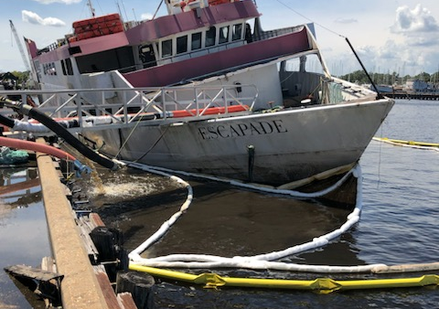
M/V ESCAPADE
Located at Clay County Port in Green Cove Springs.
Abandoned for several years, owner has fled the country
24AUG2023: M/V became partially submerged
27AUG2023: Sector IMD received NRC report of sheening from partially submerged vessel
28AUG2023: IMD/DEP met with Reynolds Yacht/Clay County Port issued NOFI
31AUG2023: Clay County Port Inc unanimously agreed to take action to mitigate threat of pollution, although tanks were previously being pumped out, a potential of approx. 100-200 gallons of residual diesel remains
13SEP2023: After completing temp repairs efforts to refloat were commenced, efforts to refloat have been impeded by discoveries of compromised areas of the hull.
A/D & Reserve components of IMD continue to monitor progress of salvage and offer guidance/reimbursement information to port operators.
IMD continues to collaborate/communicate with port personnel, contractors (AJ Smith Construction), DEP, D7 DRAT, D7 Legal, SCC & CG Intel on incident.

Slide 2
Resources
AJ Smith Construction: 2 Personnel
Guy Thomas Diving: 3 Personnel
Clay County Port Inc.: 7-10 personnel
01 18 ton mobile crane
01 fork lift/front end loader
02 8” pumps
03 6” pumps
01 4” pumps
03 3” pumps
02 2” pumps

