Slide 1
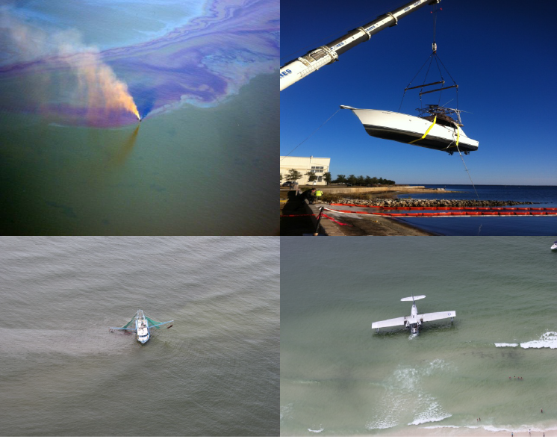
Sector Mobile Incident Management Division
New Leadership:
Response Department Head: CDR Joseph Smith
  Joseph.L.Smith1@uscg.mil
IMD Chief: LT Casey Brutus
  Casey.L.Brutus@uscg.mil
MSSR: CWO Duskin Deichl
  duskin.a.deichl@uscg.mil

Slide 2
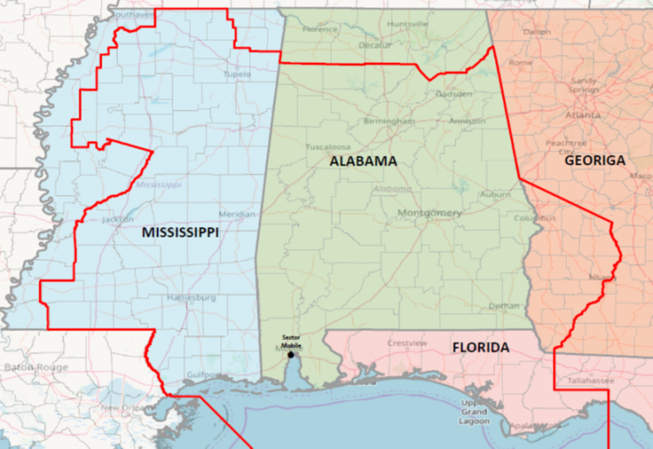
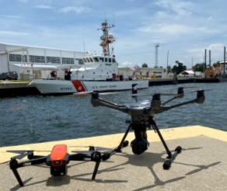
Fiscal Year Figures
Fiscal Year | NRC Notifications | Federal Projects | Enforcement Amount | Potential Discharge (gal) | Actual Discharge (gal)
2022 | 180 | 9 | $6,500 | 1.4M | 4,442
2023 | 155 | 5 | $7,550 | 26,308 | 8,358

Slide 3
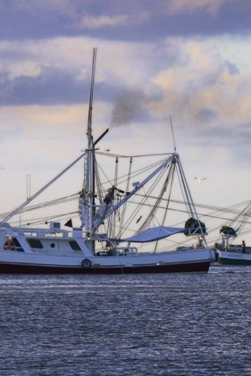
Shrimping Vessels in the Gulf of Mexico
60% of federalized cases this calendar year came from shrimp boats.
On average over 2000 gallons of product is recovered and over $13,000 of funding from the Oil Spill Liability Trust Fund is used on each case.
Why so prevalent?
  75.6% of total domestic shrimp landings come from the Gulf of Mexico
  46 USC 4502 (f) outlines how examination requirements differ for fishing vessels operating within 3 nautical miles of the coast

