Slide 1
Department for Environmental Protection
Emergency Response Branch Overview

Slide 2
DEP Emergency Response Team

Slide 3
HISTORY
ERT was created by the cabinet after KRS 224.01-400 was passed on July 15, 1980 by the KY State Legislature.

Slide 4
HISTORY
1978 – Secretary’s Office
1980 – Division of Water / Field Ops
2004 – DEP Commissioners Office
2008 – Division of Environmental Program Support
2018 – Division of Waste Management
Notes:
Organizational history overview. Initially organized within the Cabinet’s Secretary’s Office (OOS) but transition to DEP Division of Water upon passing of KRS 224.01-400 in 1980.

Slide 5
Statutory Authority: KRS 224.1-400(14)
Establish Contingency Plan
Provide for efficient, coordinated, and effective action to minimize damage to the air, land, and waters of the Commonwealth from the release of hazardous substance, pollutant, or contaminant
Notes:
Statutory authority and mandate

Slide 6
Statutory Authority: KRS 224.1-400(14)
In every case where action required under this section is not being adequately taken or the identity of the person responsible for the release or threatened release is unknown, the cabinet or its agent may contain, remove, or dispose of the HSPC or take any other action consistent with this section, including but not limited to, issuance of an emergency order as provided by KRS 224.10-410 to the person possessing, controlling, or responsible for the release or threatened release as necessary for the protection of the environment and public health, safety, or welfare.

Slide 7
Cabinet Organization
Energy & Environment Cabinet
Department for
Environmental Protection
Department of
Natural Resources
Division of Waste Management
Division of Forestry
Division of Water
Division of Oil & Gas
Division of Air Quality
Division of Mine Reclamation Enforcement
Division of Environmental Program Support (DEP Lab)
Notes:
Emergency Response Branch, although housed in the DEP Division of Waste Management, assists in the coordination of emergency / spill response actions for DEP and coordinates actions with DNR Divisions, such as abandoned oil & gas site releases, mining related discharges/releases, or assisting with particulate air monitoring during heavy wildland fire events.
ERT also communicates and collaborates with the EEC Office of Energy Policy (power outages impacting critical infrastructure and grant identification); EEC Public Service Commission (natural gas pipeline incidents); Nature Preserve (identification of sensitive and/or endangered species or habitats)

Slide 8
Organization
Energy & Environment Cabinet
Department for
Environmental Protection
Division of Waste Management
Emergency Response Branch
Notes:
The ERB participates in weekly cabinet, department and divisional staff meetings to ensure timely communication of issues / concerns the various agencies and to leadership (cabinet, department and division)
Funding:
- Funding received from all three primary divisions (Air, Water, & Waste) and also from HWMF and PSTEAF

Slide 9
Responsibilities
Coordinate response to environmental emergency
Coordinate response to natural & man-made disasters
Coordinate response actions with
Federal
State
Local
Notes:
Department response for environmental emergency:
Communicate and engage specific regulatory agencies housed within the department/cabinet and make notification with other state agencies with subject matter expertise or regulatory/statutory primacy.
Issue directive to responsible party and provide technical and operational oversight of response actions
Perform cost recovery
Natural & Man-made disasters:
Staff SEOC ESF-3 & ESF-10 positions
Implement downrange response actions
RP oversight
State lead actions (spill response, orphaned hazardous material container collection, etc.)
Perform cost recovery / reimbursement actions (RP or FEMA)
Coordinate response actions with
Federal (Primarily EPA, USCG)
State (KYEM, 41st CST, SFM, etc.)
Local (EMA, FD, PD)

Slide 10
Partnering State Agencies
EEC Office of Energy Policy
EEC Public Service Commission
CHFS – Public Health / Radiation Health
State Fire Marshal
Kentucky Division of Emergency Management
Kentucky Transportation Cabinet
Kentucky Department of Fish & Wildlife
Notes:
State agencies that the ERB regularly communicates and/or partners with during emergency or natural disaster response incidents.

Slide 11
Release Reporting
401 KAR 42:060 – UST System Release Reporting
KRS 224.1-400 – Environmental Emergencies
KRS 224.70-110 – General prohibition against water pollution
Notes:
UST Release Reporting
Unusual operating conditions, failed integrity testing, environmental release (recoverable free product, impact to surface waters, vapor intrusion)
Environmental Emergencies
Spill reporting requirements and reportable quantities outlined within 224.1-400

Slide 12
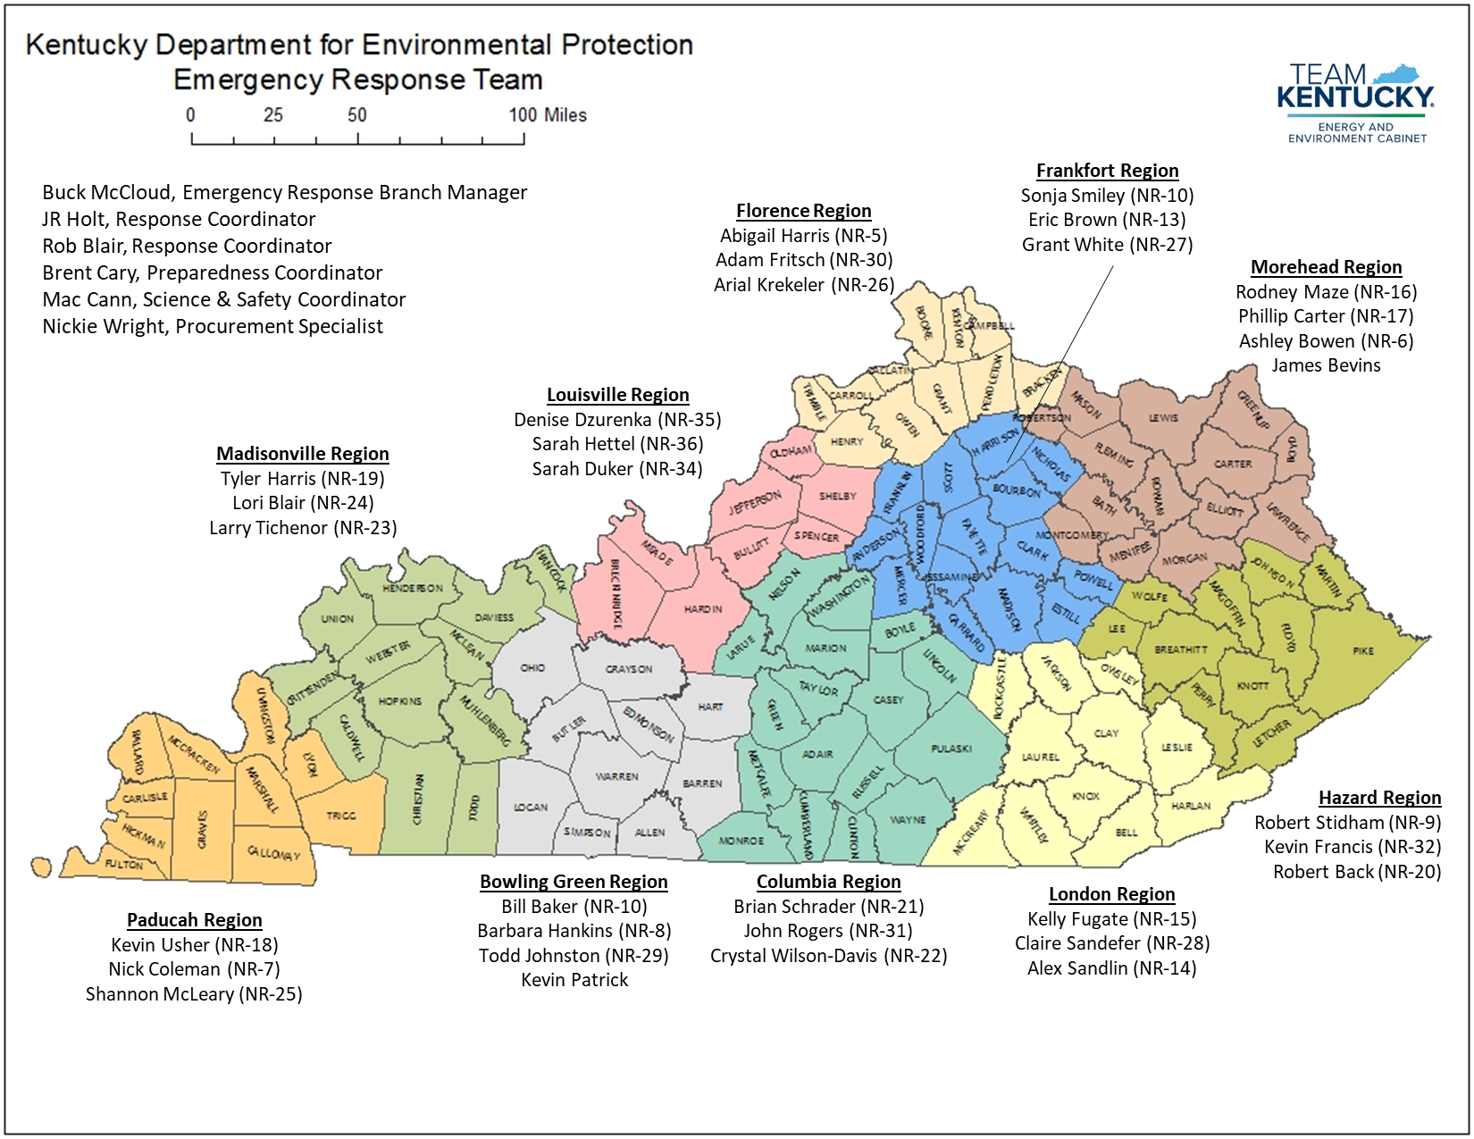
ERB Organization
Notes:
Emergency Response Branch
Manager / Response Coordinator
Response Coordinator (2)
Preparedness Coordinator
Science & Safety Coordinator
Procurement Specialist
Planning Coordinator (PT)
Regional Response Staff
10 Regions / 32 staff
Part-time volunteer positions
Primarily comprised of Divisional Field Operations compliance field staff
7 DOW FOB Staff
20 DWM Staff (19 FOB, 1 SFB, 1 RLA)
5 DAQ FOB Staff

Slide 13
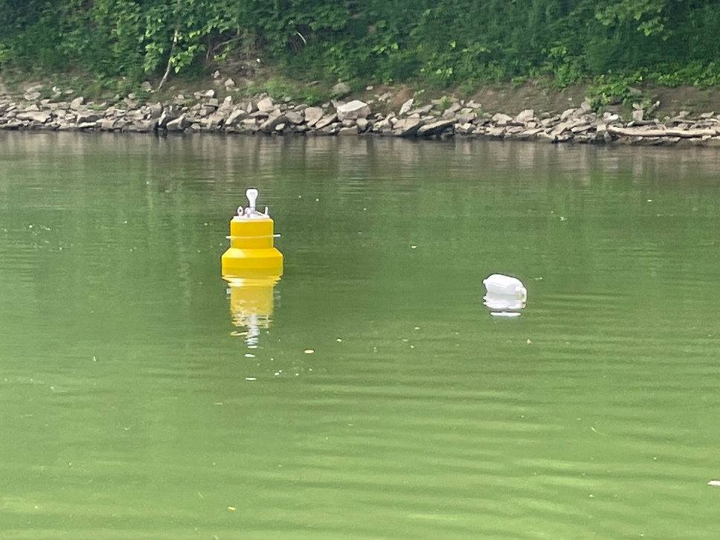
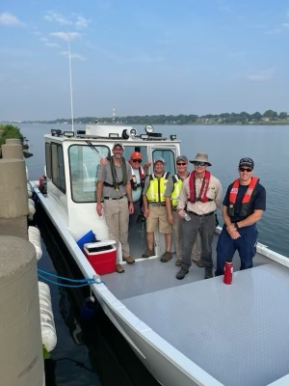
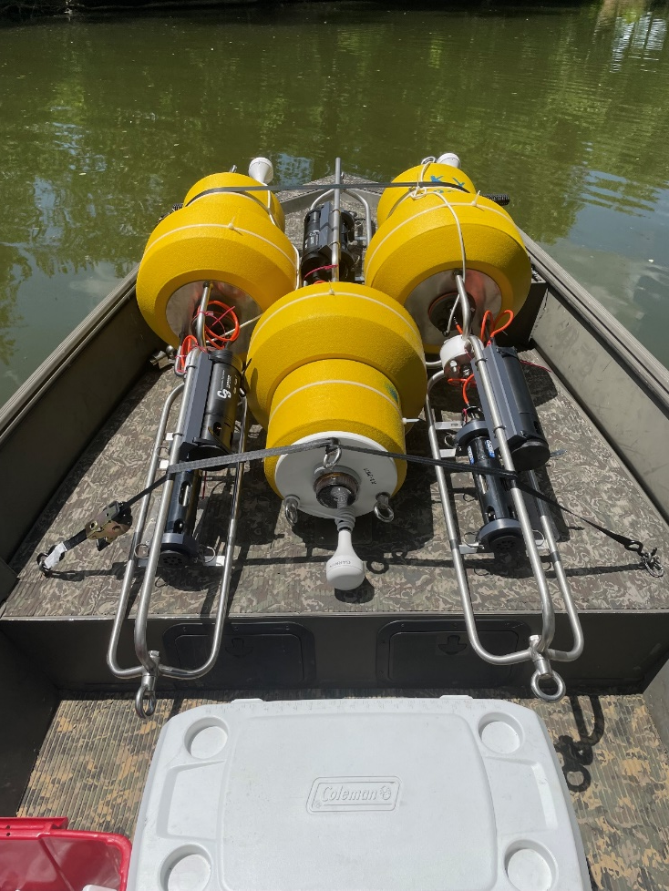
ERB Teams & Equipment
Notes:
3 boats
28 foot work boat
19 foot War Eagle aluminum center console
20 foot Sea Ark aluminum
Water Quality Monitoring Buoys – Petroleum Detection – telemetry / real-time monitoring & data (plume tracking)
3 - Boat Teams (Coxman & mate)
Air Monitoring Team (East & West)
Hapsite Team (East & West)
Chemical Support Team
Flood / Pump Team

Slide 14
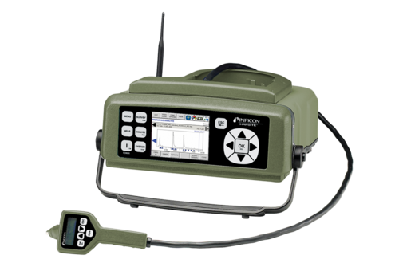
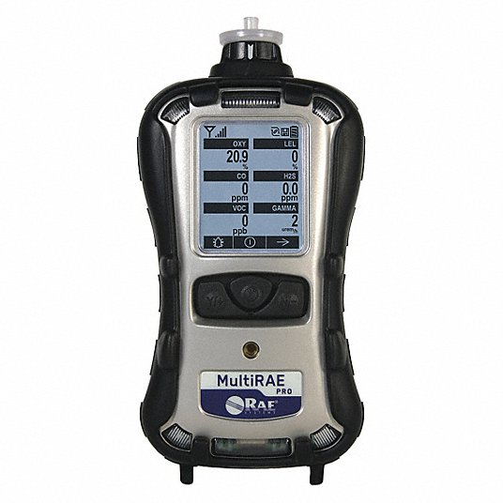
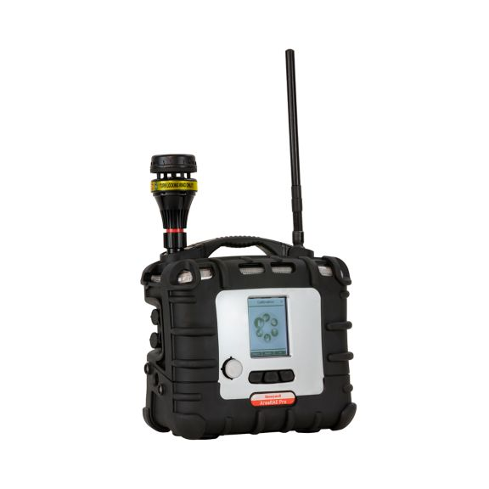
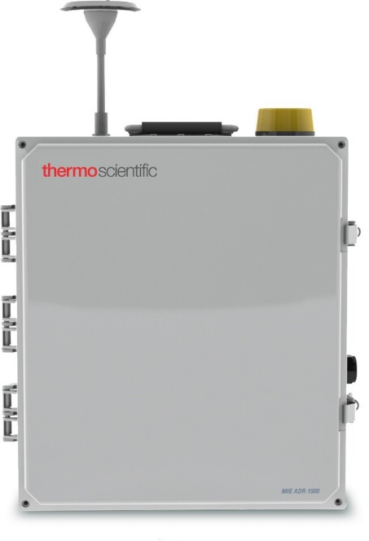
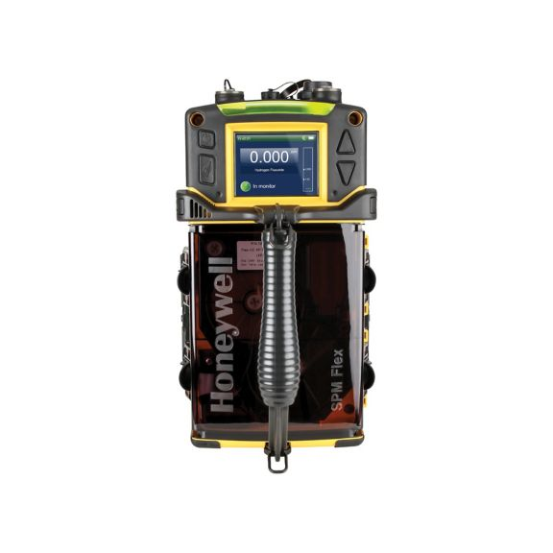
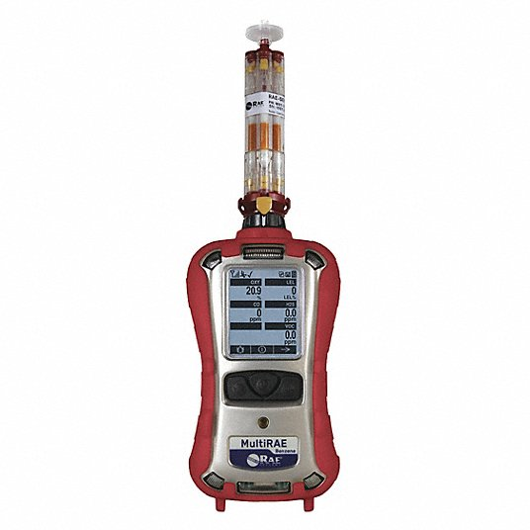
ERB Teams & Equipment
Notes:
AreaRAEs
(6) SPM Flex
(12) MultiRAEs
(2) BenzeneRAEs
(6) ADR 1500s
(1) HAPSITE w/ Thermal Desorber and Headspace Unit
(6) Field Sampling pumps
Field charging stations
Generators

Slide 15
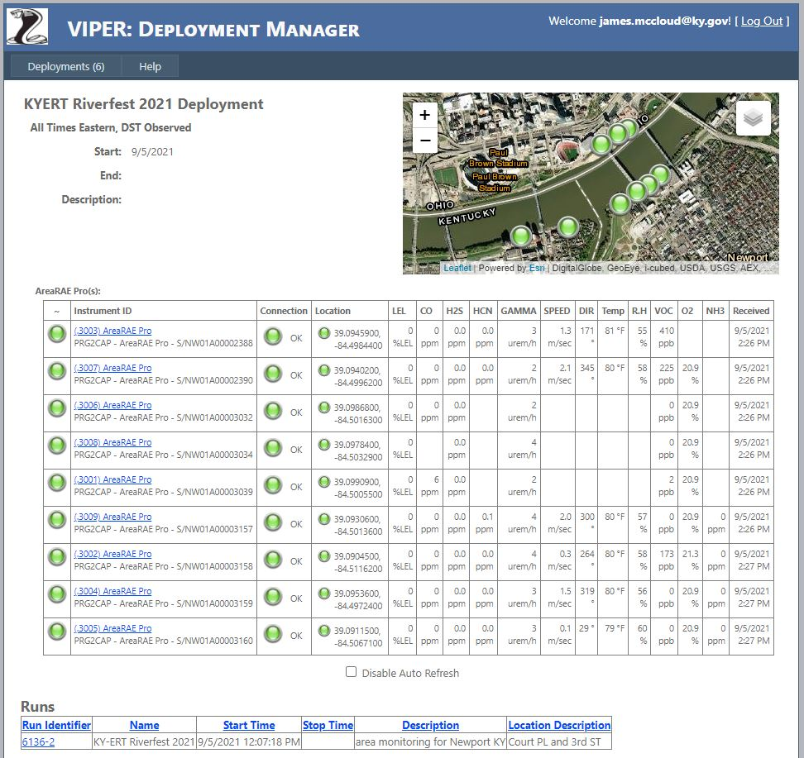
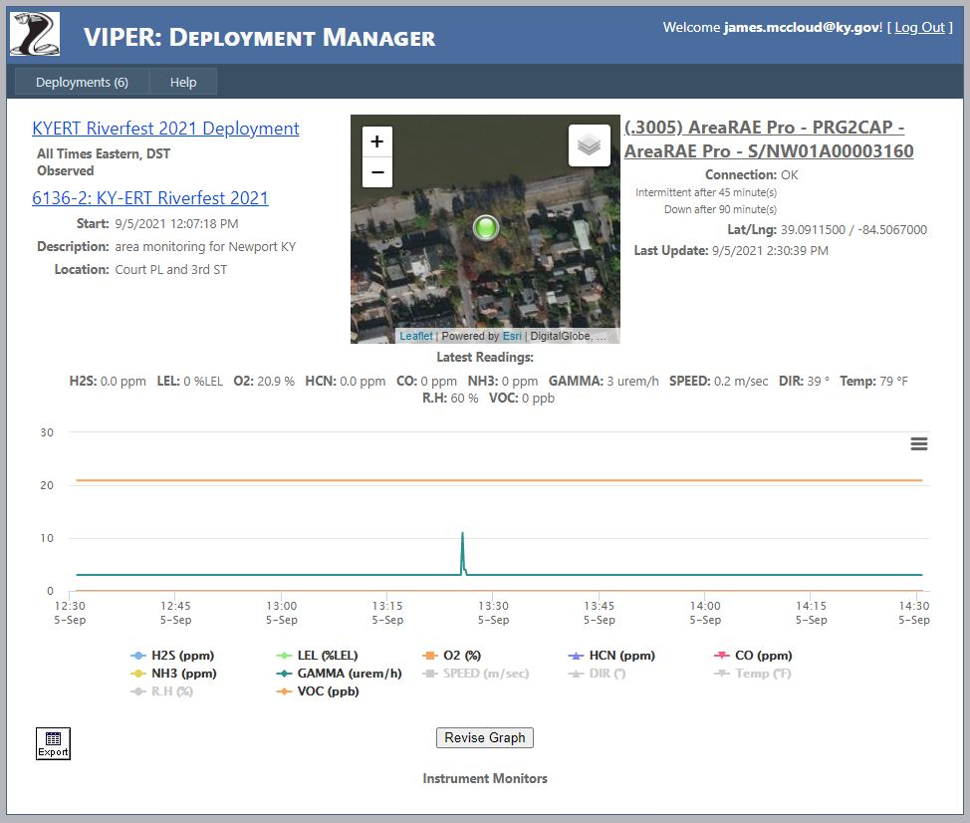
ERB Teams & Equipment
Notes:
USEPA VIPER

Slide 16
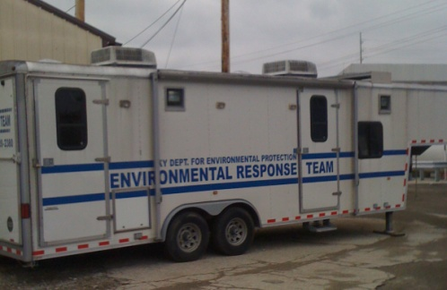
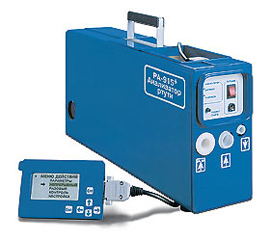
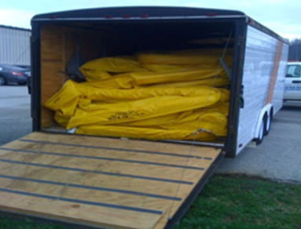
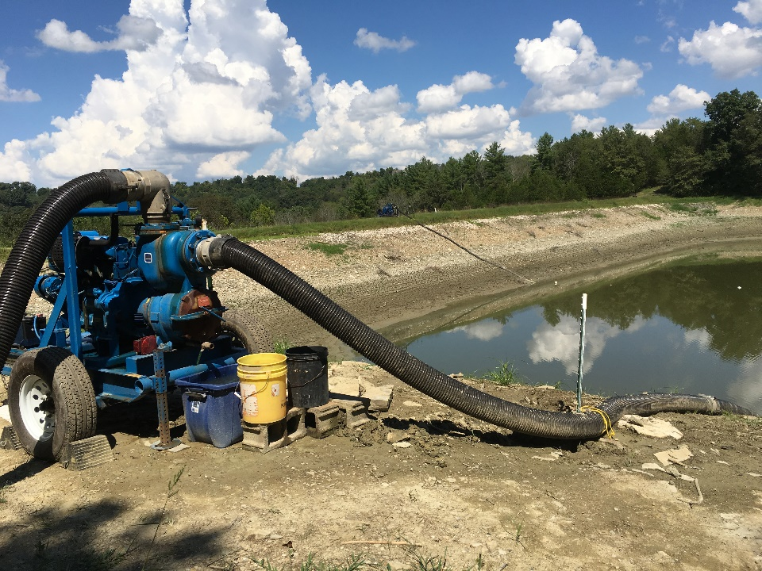
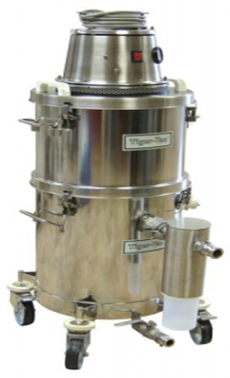
ERB Teams & Equipment
Notes:
1 ERT UTV (Kawasaki Mule)
1 Mobile Command Post
1 Rapid Deployment Trailer
3 Boom trailers (Somerset, Owensboro, Lexington)
2 Lumex 915 Lights
1 Mercury Vacuum
2 water pumps and ancillary equipment (rigid & collapsible piping, generators, adaptors, floats, etc.) – dedicated box trailer
FOB Support:
Aerial Drones
Water Drones (Bathymetric)
2 DWM FOB UTVs

Slide 17
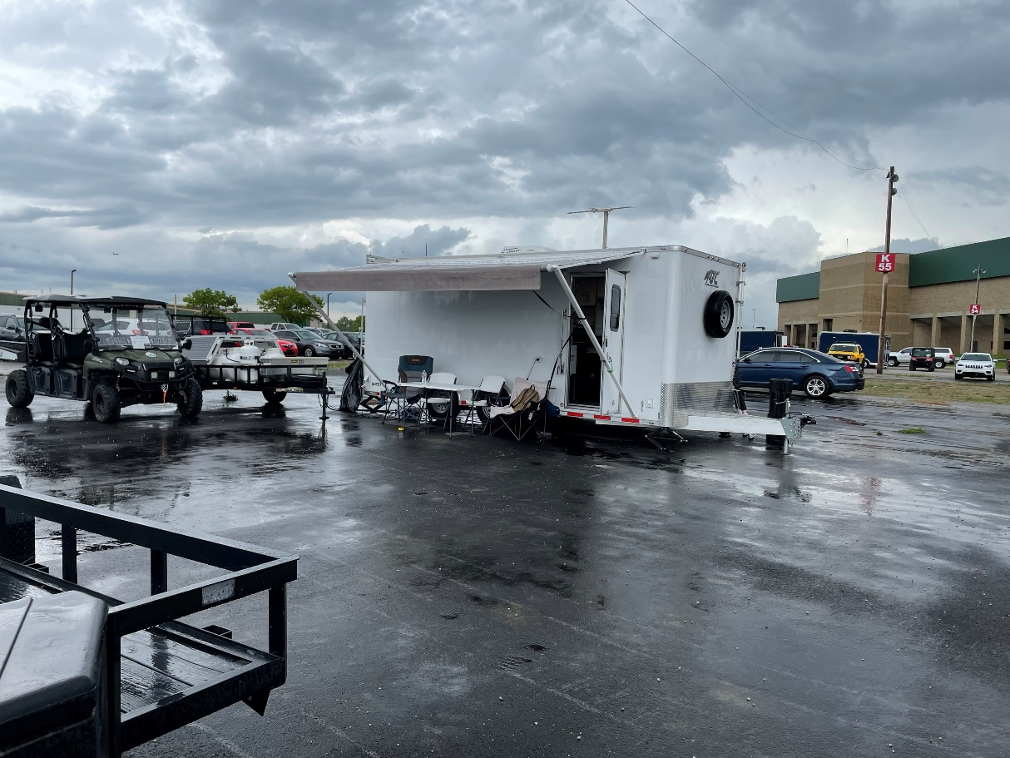
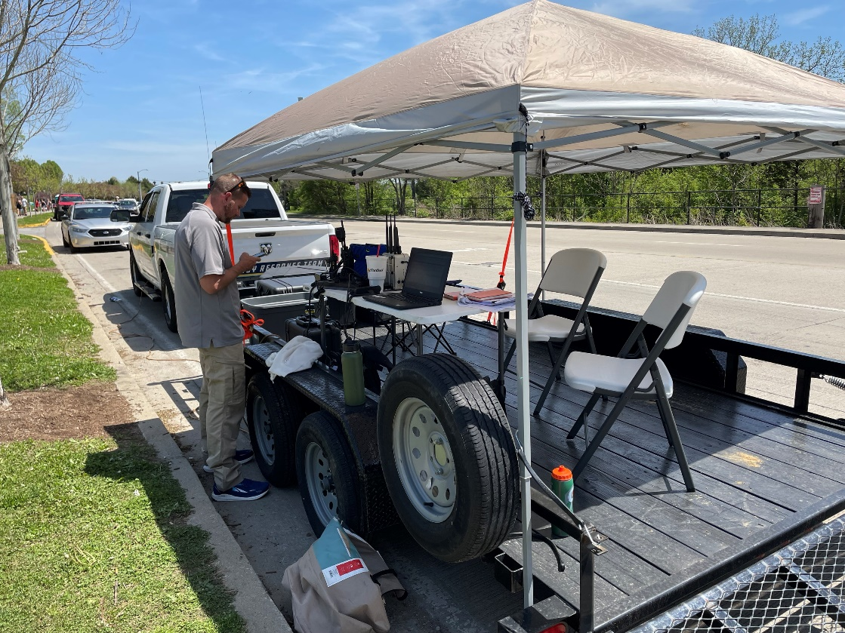
Special Events
Notes:
Breeders Cup – Keeneland
Thunder – Louisville
Derby – Louisville
Riverfest – Northern KY (Newport / Covington / Cincinnati)
Partnering agencies: Local EMAs, 41st CST, Louisville Metro Hazardous Incident Response Team (HIRT),

Slide 18
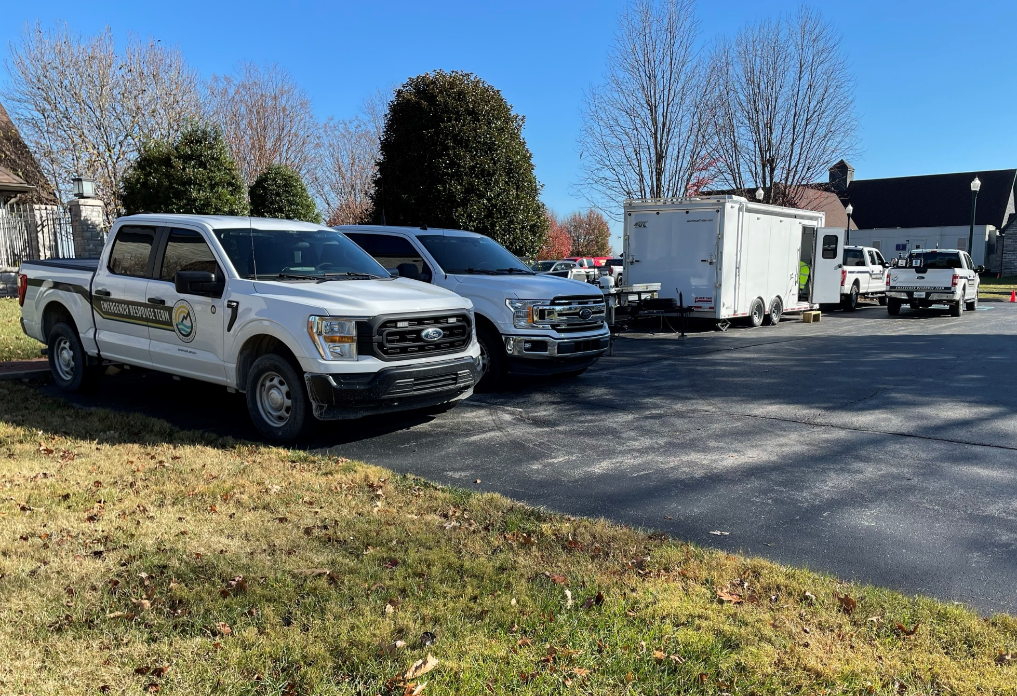
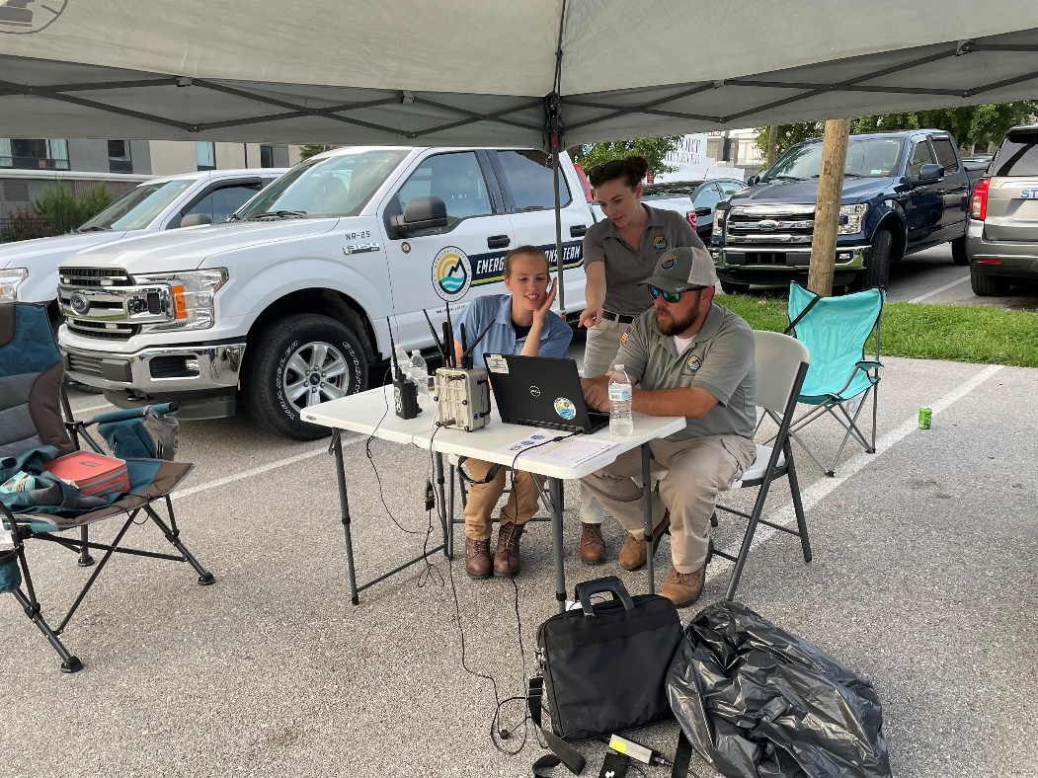
Special Events
Notes:
Breeders Cup – Keeneland
Thunder – Louisville
Derby – Louisville
Riverfest – Northern KY (Newport / Covington / Cincinnati)
Partnering agencies: Local EMAs, 41st CST, Louisville Metro Hazardous Incident Response Team (HIRT),

Slide 19
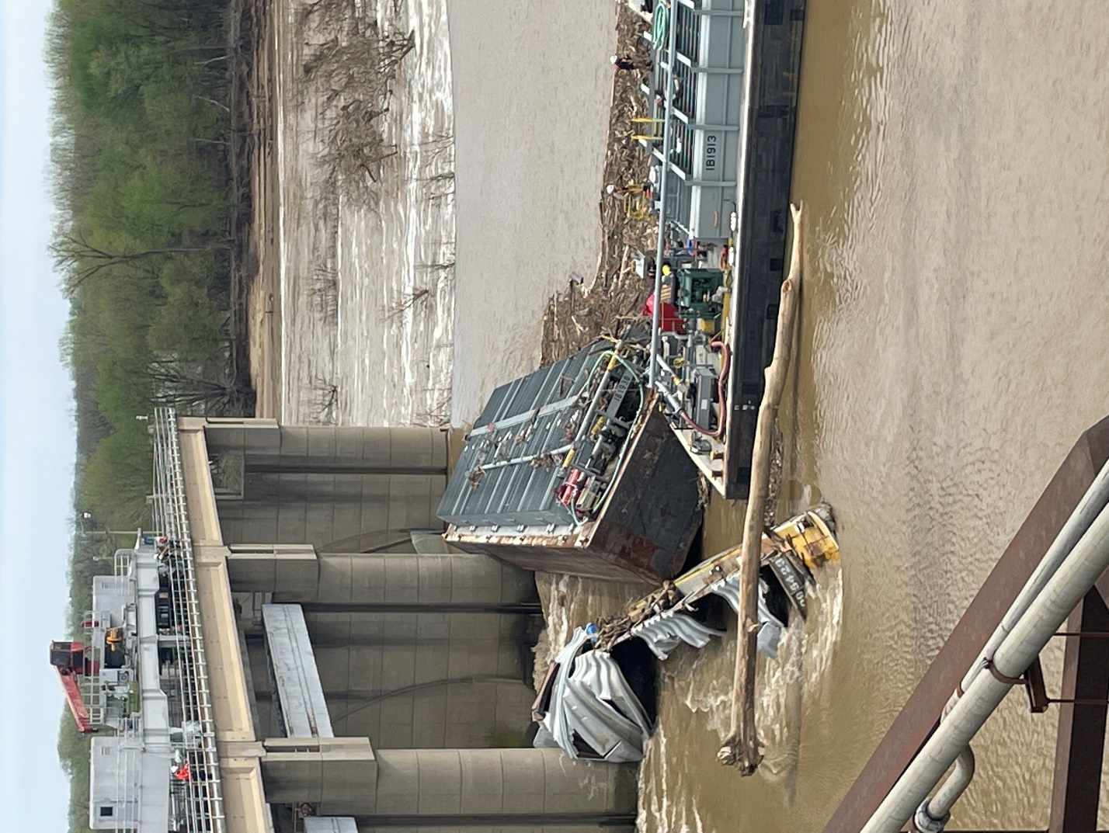
Response
Notes:
Methanol Barge
Bourbon Distillery Spills

Slide 20
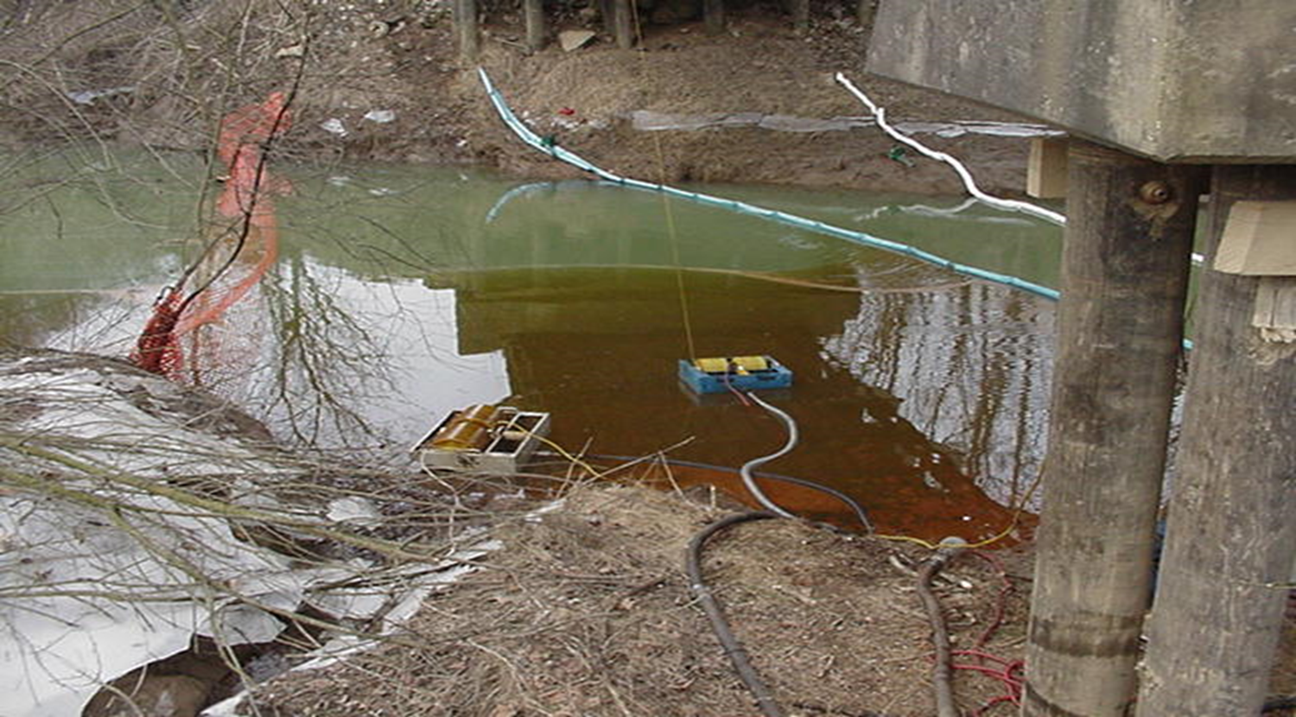
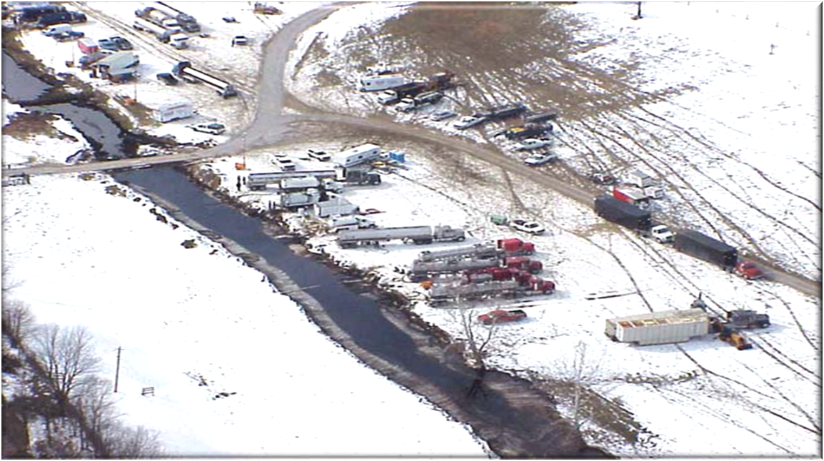
Response
Notes:
Tanker Spill
Pipeline Spill

Slide 21
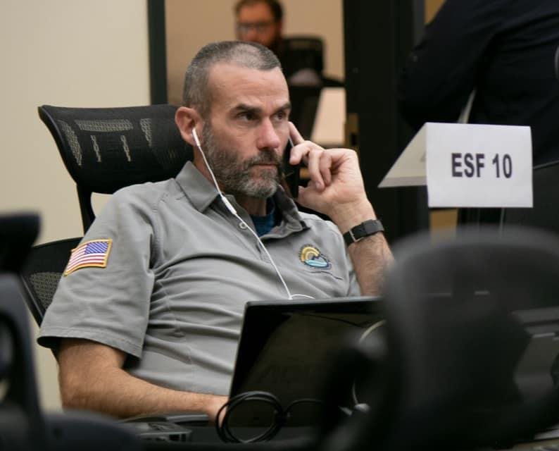
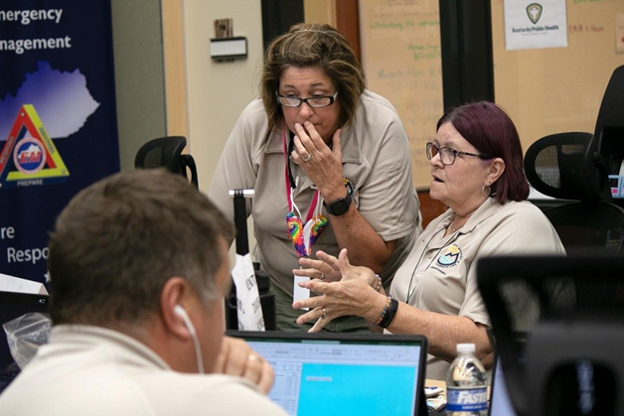
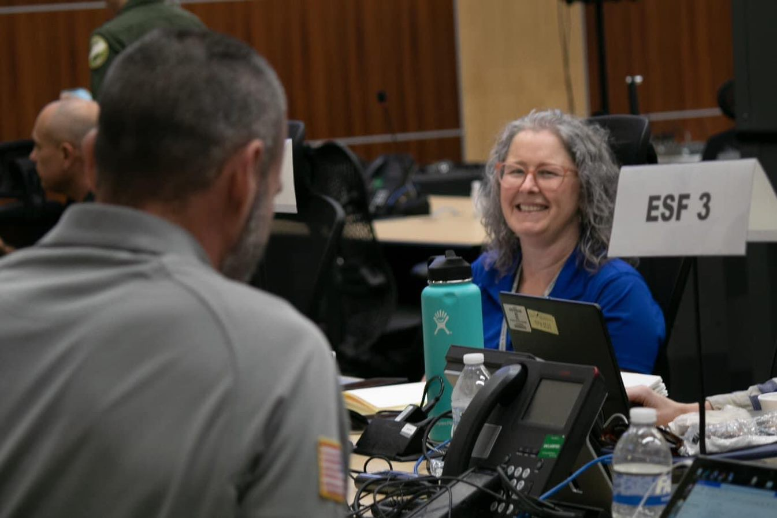
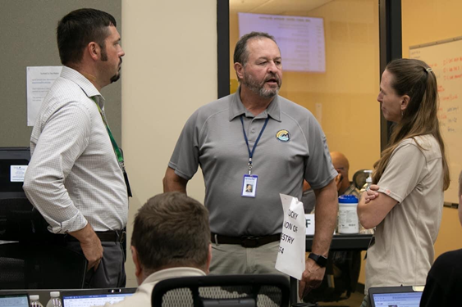
Natural Disasters
Notes:
SEOC Activation – ERT provides minimum of 2 personnel to man each activated ESF
ESF-3 (Public Works and Engineering)
ESF-10 (Oil and Hazardous Materials)

Slide 22
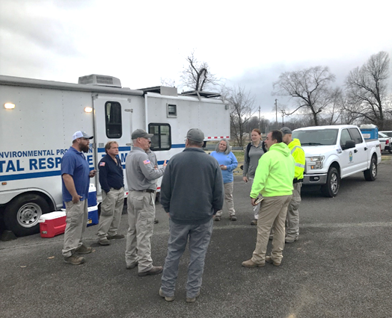
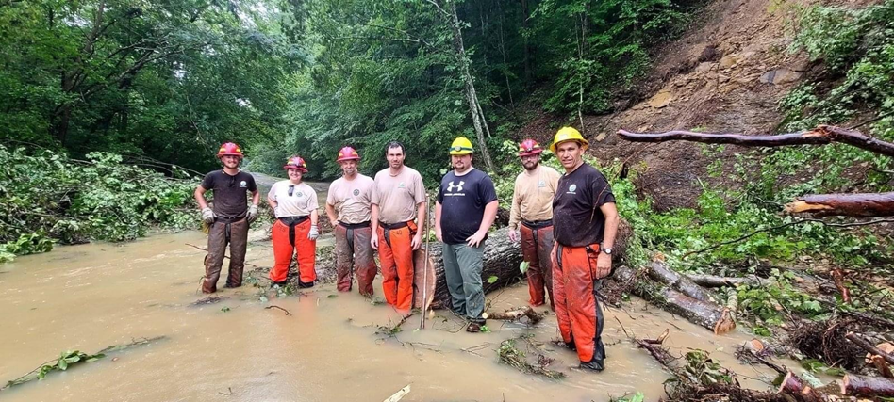
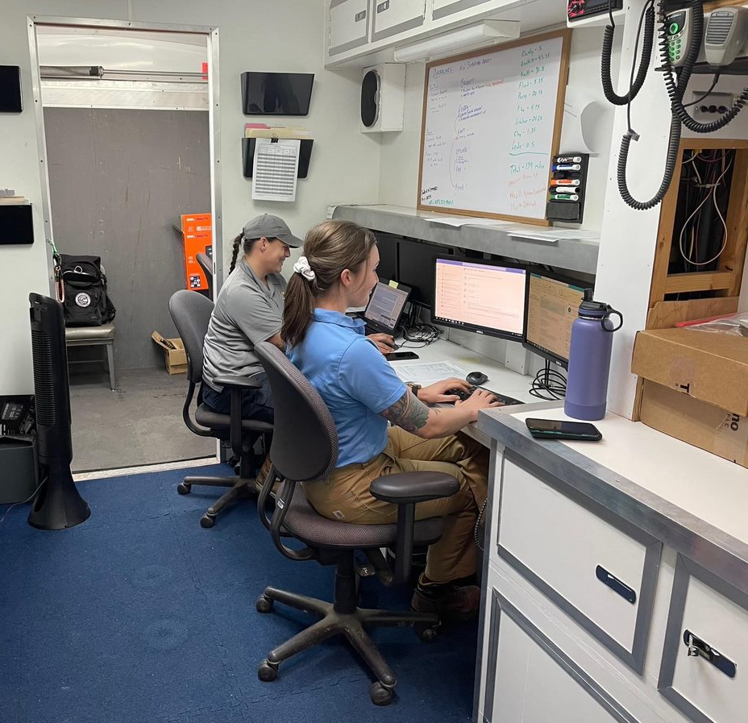
Natural Disasters
Notes:
ERT Roles of staff out in the field and what we did during these disasters.
West KY-
27 ERT personnel from across the state and 27 additional program staff (DWM, DOW and DAQ) from Bowling Green Regional Office, Madisonville Regional Office and Paducah Regional Office provided emergency response activities. Response activities continue 7 days a week with staffing drawdown after the initial response period (~4 weeks). Through pay period ending 01/15/2022, 5,308.75 man-hours, including 2,997 overtime hours, have been worked by 54 staff members during the first 36 days of response activities (12/11/2021 – 01/15/2022). As of 03/15/2022 payroll 3,060 overtime hours have been accrued by all DEP personnel in tornado response activities.
East Flood: Five (5) ERT reconnaissance teams each comprised of 2 responders initiated preliminary damage assessments to determine the extent and magnitude of the flood and areas in which removal actions would be required and to identify high priority / time critical removal and/or spill response actions.

Slide 23
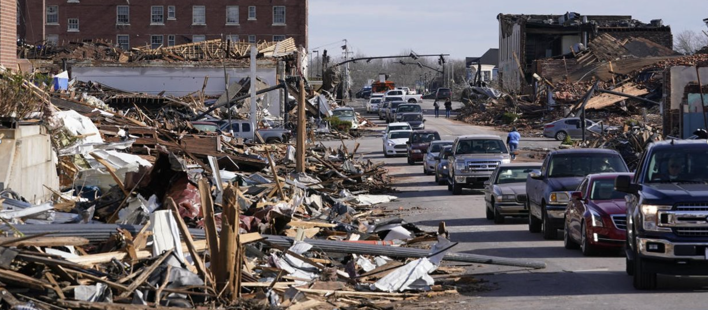
Natural Disasters
Western Kentucky Quad State Tornadoes
Notes:
On Friday, December 10, 2021, a strong low-pressure system tracked from Kansas City towards the Great Lakes region producing a significant severe weather event across the Midwest and Southeast. Several tornadoes were confirmed across the Midwest and Southeast. Preliminary reports indicated 52 tornadoes, 270 wind, and 20 hail reports across several states.

Slide 24
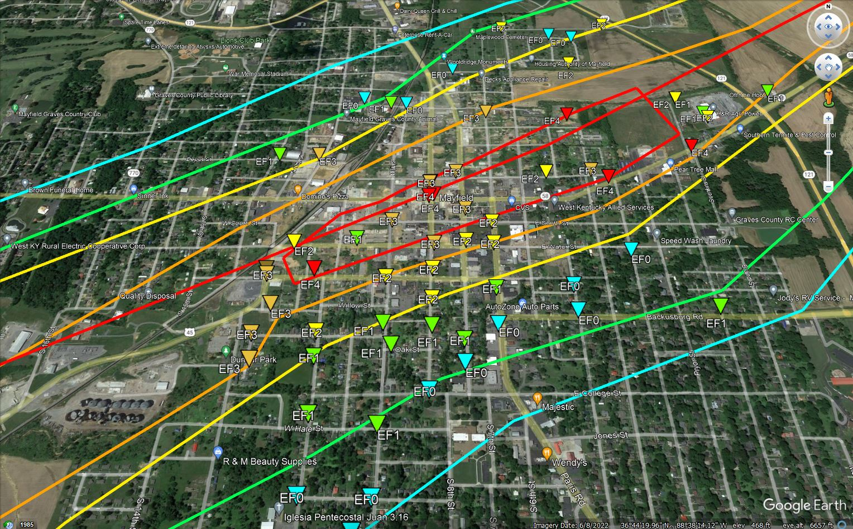
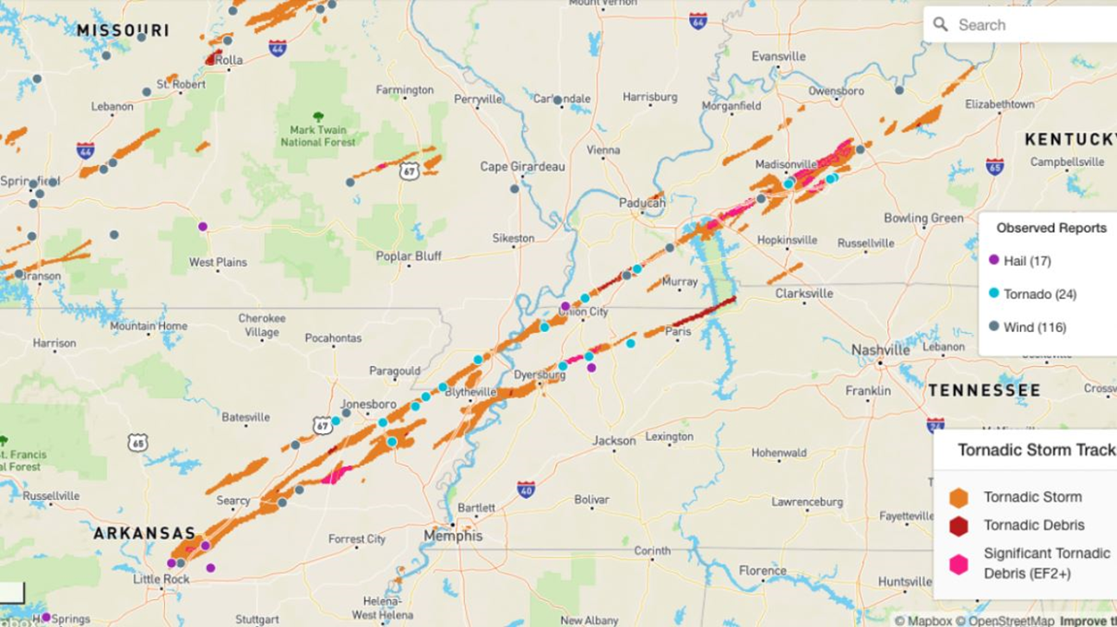
Natural Disasters
Western Kentucky Quad State Tornadoes
Notes:
On Friday, December 10, 2021, a strong low-pressure system tracked from Kansas City towards the Great Lakes region producing a significant severe weather event across the Midwest and Southeast. Several tornadoes were confirmed across the Midwest and Southeast. Preliminary reports indicated 52 tornadoes, 270 wind, and 20 hail reports across several states.

Slide 25
Natural Disasters
Downtown Mayfield

Slide 26
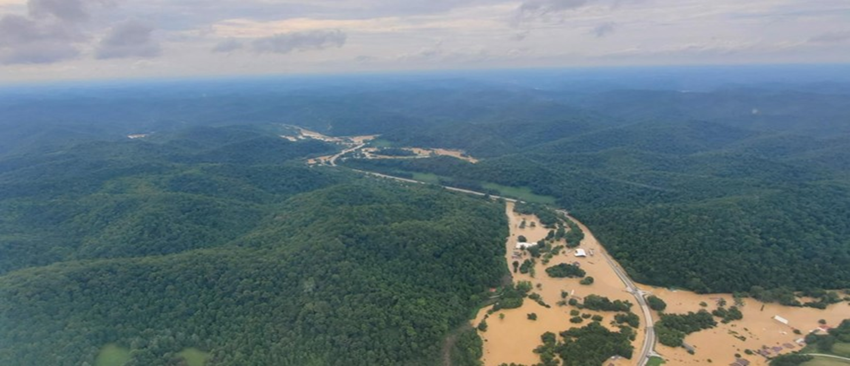
Natural Disasters
Southeast Kentucky Floods
Notes:
On July 27, 2022, multiple rounds of thunderstorms impacted several counties in Eastern Kentucky, resulting in catastrophic flooding, with counties receiving 6”-8” of rain overnight.
On the evening of July 28, 2022 Martin County received an additional three (3) inches of rain, resulting in additional flooding of the area.
Multiple counties were impacted including Breathitt, Clay, Floyd, Johnson, Knott, Leslie, Letcher, Magoffin, Martin, Owsley, Perry, and Pike.
Many roads in these counties were covered with water and impassible, and several affected by mudslides. Numerous regulated underground storage tank facilities and oil and gas production and storage areas were impacted by flood waters or power outages. Multiple areas experienced sporadic communications with some areas having no communications. The Governor has declared a State of Emergency through Executive Order 2022-457, resulting in Presidential Declaration 29 July 2022, 4663-DR.

Slide 27
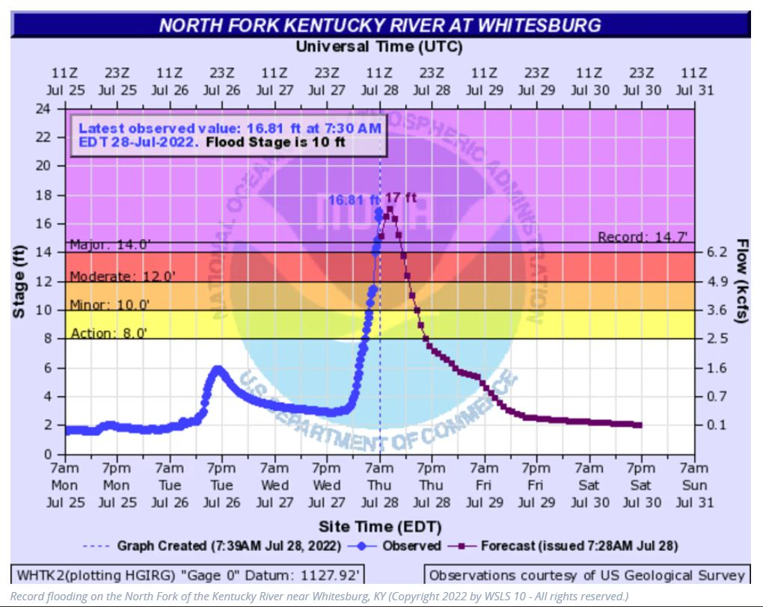
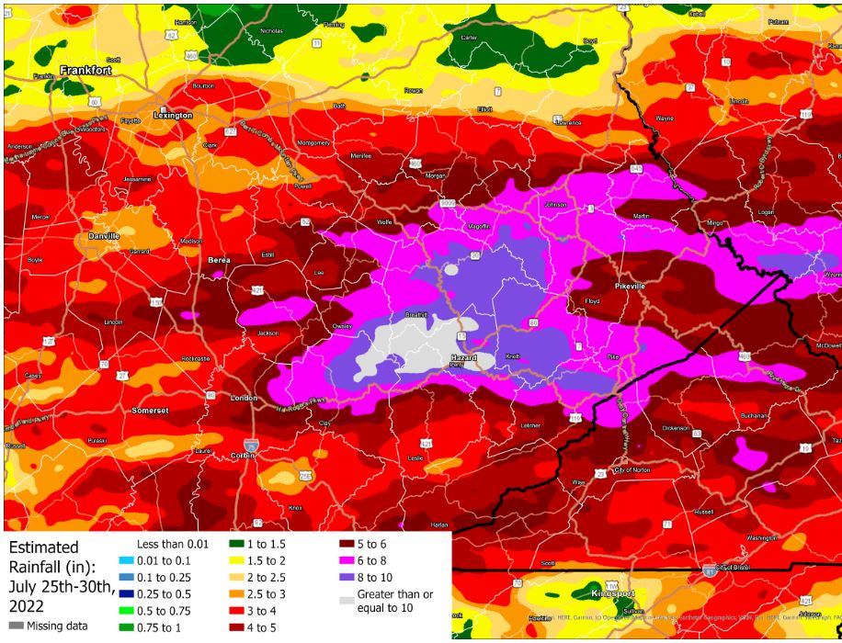
Natural Disasters
Southeast Kentucky Floods
Notes:
Left: North Fork of the Kentucky River- well above flood stage, actually had gauge failure
Right: Rain totals in the counties receiving rain July 25th through the 30th . NOTE: Catastrophic flooding caused by rain amounts in excess of 10 inches

Slide 28
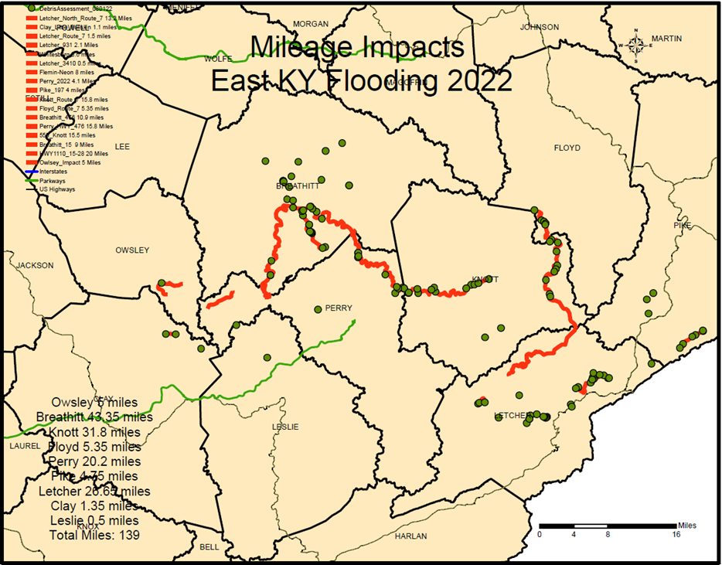
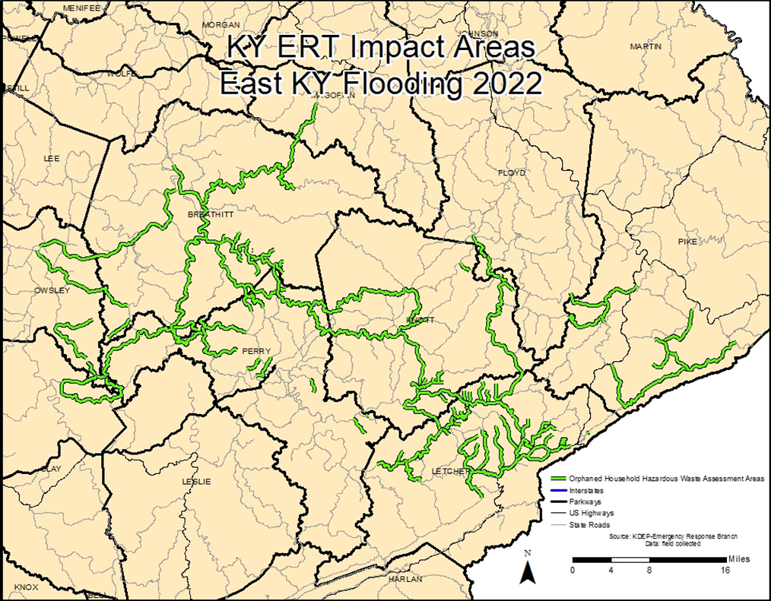
Natural Disasters
Southeast Kentucky Floods
Notes:
Five (5) ERT reconnaissance teams each comprised of 2 responders initiated preliminary damage assessments to determine the extent and magnitude of the flood and areas in which removal actions would be required and to identify high priority / time critical removal and/or spill response actions.
Based on initial assessment surveys, 139 miles of roadway/drainage require removal activities (container collection)
Estimated Miles for requiring removal actions:
Owsley Co: 5 miles
Breathitt Co: 43.35 miles
Knott Co: 31.8 miles
Floyd Co: 5.35 miles
Perry Co: 20.2 miles
Pike Co: 4.75 miles
Letcher Co: 26.65 miles
Clay Co: 1.35 miles
Leslie Co: 0.5 miles
Total Estimated Miles: 139
Emergency contractors provided preliminary rate of progress at 0.25-0.50 miles per day per crew based on worse-case examples visited.
End result: 314 miles of roadway / drainage assessed and recovery actions completed.

Slide 29
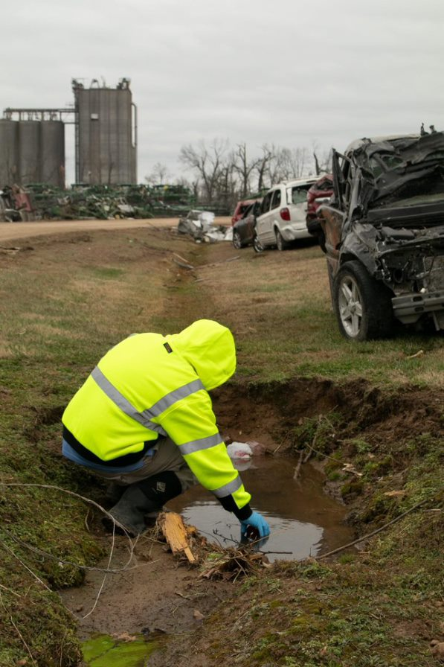
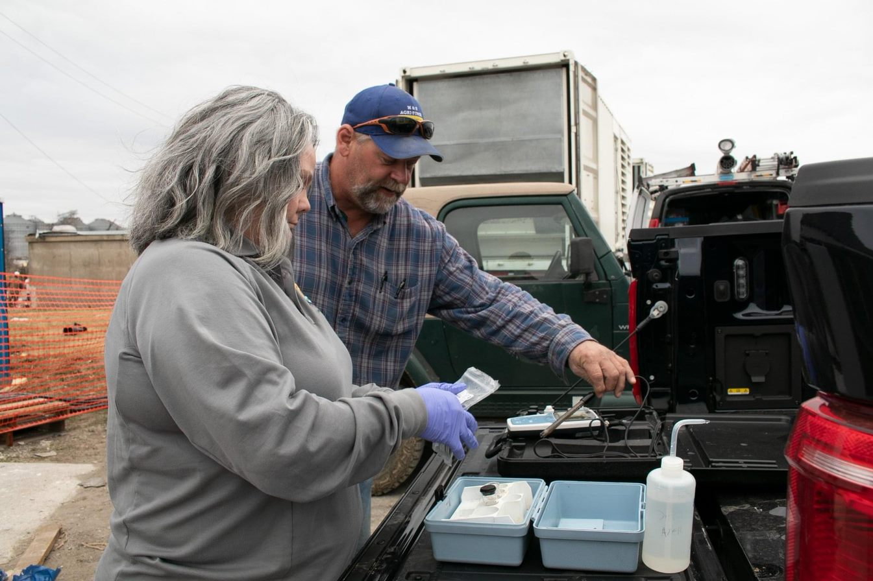
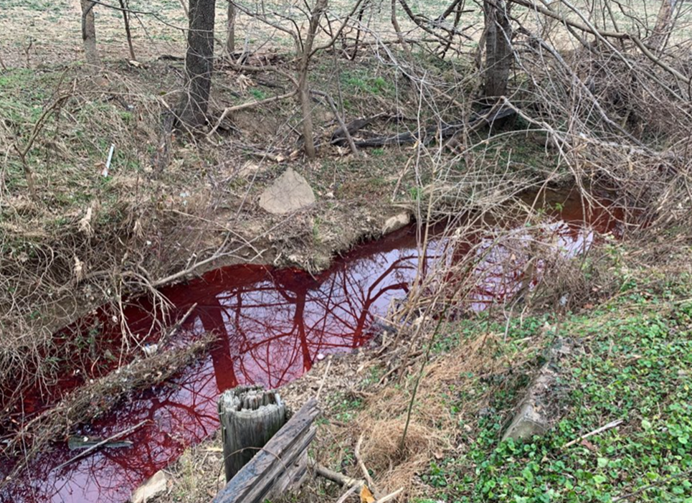
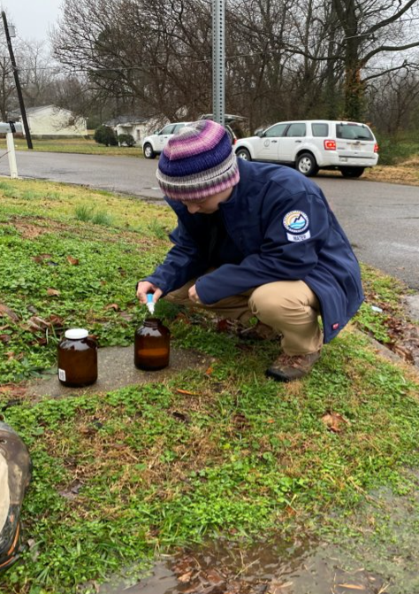
Challenges and Response: Water/Wastewater
Notes:
West KY- 43 water system samples were analyzed in the field using ERTs mobile GC/MS to assist the Mayfield water treatment plant in returning to operation.

Slide 30
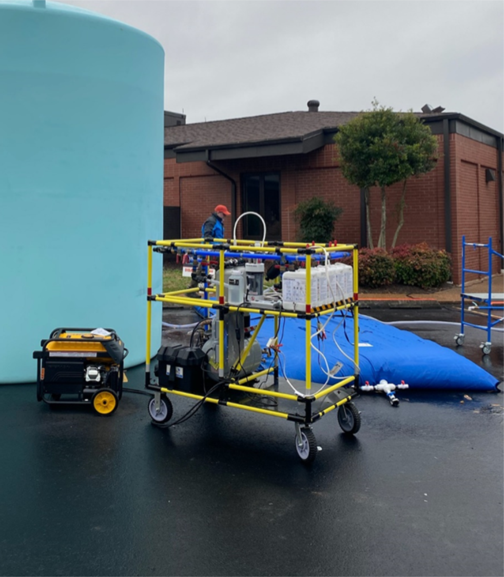
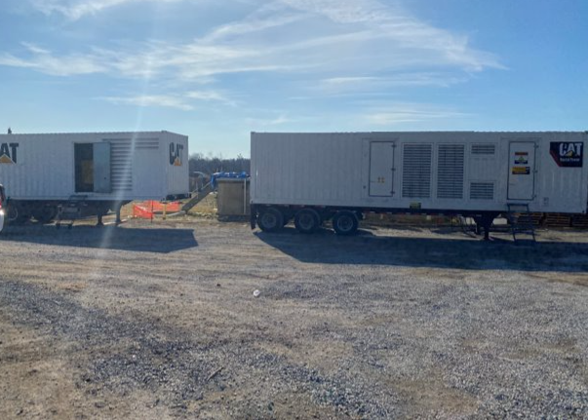
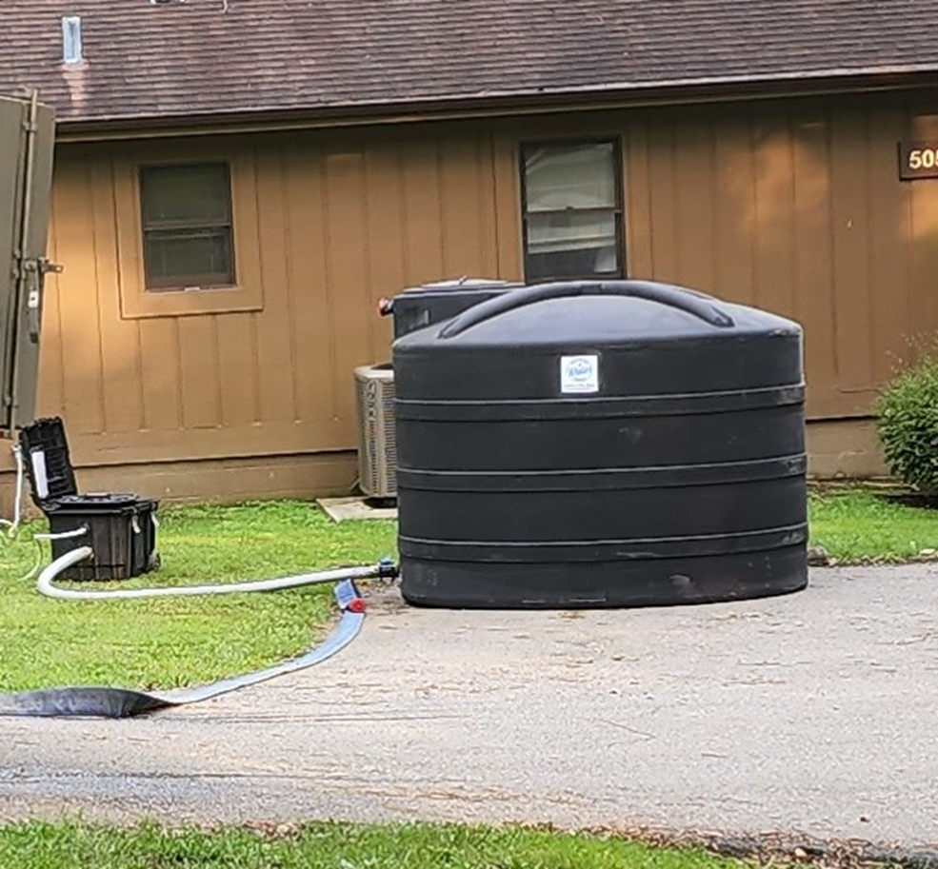
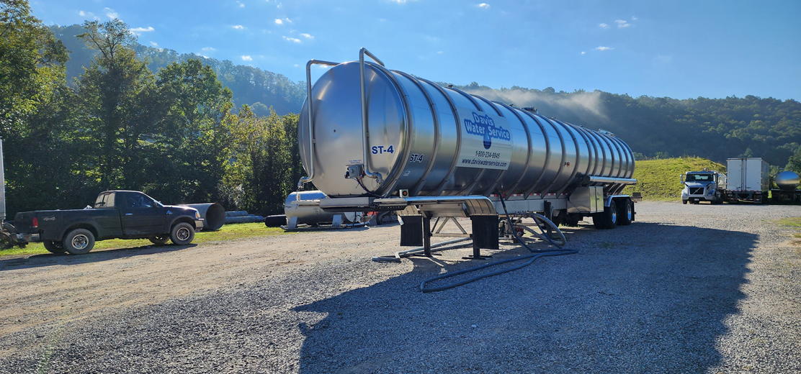
Challenges and Response: Water/Wastewater
Notes:
West KY-
Left: Emergency Potable Water- WOW Water On Wheels Carts, 6500 gallon storage tank with 1250 storage bladder
generates bleach for cleaning and general disinfection
Middle: Generators brought in for restoration of water production- pressure was restored.
Boil water advisories were lifted within 1 week
East KY-
Far Left- Davis Water also set up 2000-gallon poly tanks and pump systems at each of the 5 cottages. Water was back fed through outside garden hose spigots.
Left Bottom: Davis Water set up a 20,000-gallon tanker outside of Buckhorn and hauled water from Knott Co. Water District to supply their operations.
Davis Water supplied water to the Lodge for 43 days. The lodge and cottages used about 8000 gallons per day.

Slide 31
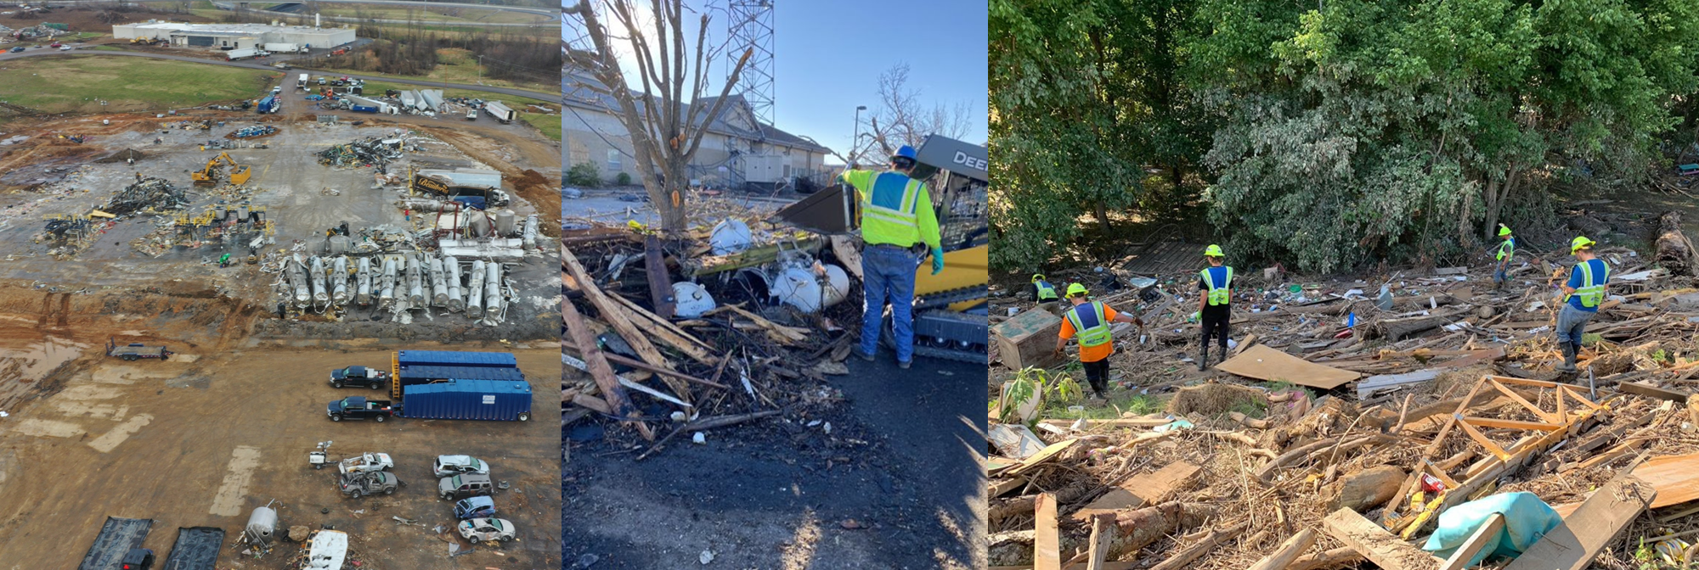
Challenges and Response: Debris Removal/Cleanup
Notes:
Totals for the Paducah Regional Office:
Staging Sites: 9
New CDDs: 5
Fulton County:
Staging Sites: 1 (Staging of vegetation fur mulching)
Hickman County:
Staging Sites: 1 (Burning of vegetation and dumpsters for CDD materials)
Graves County:
Staging Sites: 4 (2 staging of vegetation and CDD materials, 1 burning of vegetation and 1 staging of vegetation)
New CDDs: 3 (2 new sites, 1 existing CDD with new emergency on site)
West KY Landfill also received an Emergency Vertical Expansion
Lyon County:
Staging Sites: 1 (Burning of vegetation and staging for CDD materials)
New CDDs: 1
Marshall County:
Staging Sites: 2 (1 Burning of vegetation and staging for CDD materials, 1 for staging of vegetation temporarily)
New CDDs: 2 (1 used, 1 permitted but not used)
Bowling Green Regional Office
Staging Sites:10
CDD (64,067 cu tons), vegetative/woody debris (156, 841 cu tons). The veg/woody debris was shredded and used as beneficial reuse.
Madisonville Regional Office
17 brush staging/burning sites, 1 CDD staging site and 11 emergency CDD disposal sites in our region.
East KY Waste volumes generated & disposed:
80 cu yds scrap metal (recycled)
275 cu yds waste disposed at contained landfill (impacted soil, crushed empty containers, solidified non-hazardous liquids, etc.)
9,057 gallons of petroleum water mix recycled/treated
306 gallons waste oil
28 drums – HHW / Characteristic Hazardous
1 PCB Transformer
2 cu yd HW (paints/aerosols)
3 Spill Response Actions (Fuel AST battery, Crude Oil AST, UST failure)

Slide 32
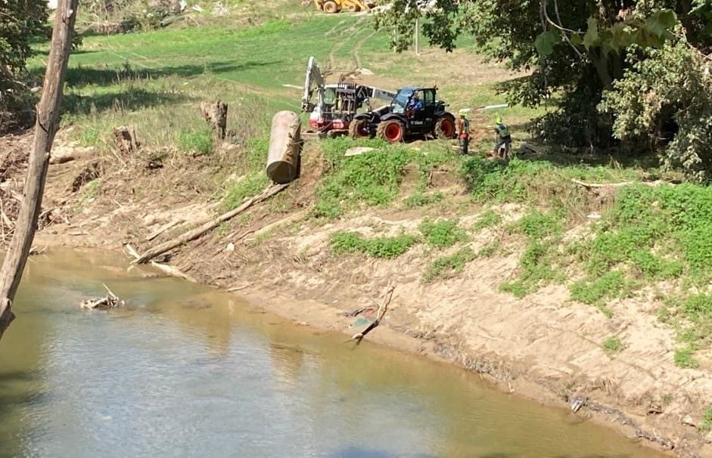
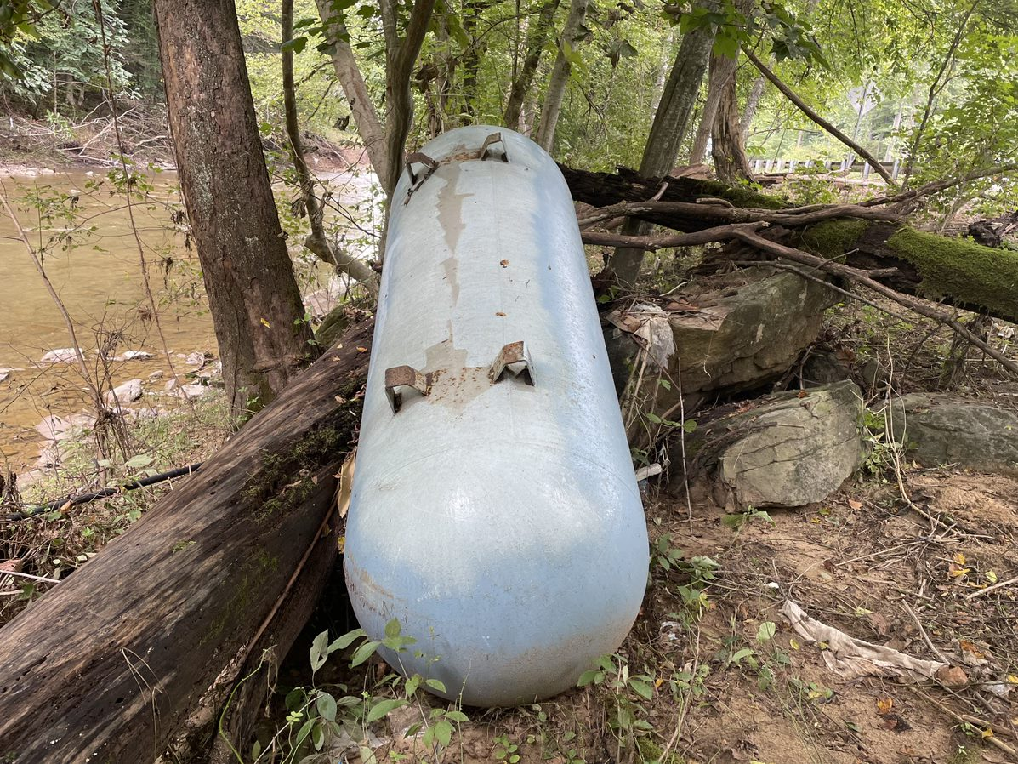
Challenges and Response: Orphaned Hazardous Materials
Notes:
East KY Waste volumes generated & disposed:
80 cu yds scrap metal (recycled)
275 cu yds waste disposed at contained landfill (impacted soil, crushed empty containers, solidified non-hazardous liquids, etc.)
9,057 gallons of petroleum water mix recycled/treated
306 gallons waste oil
28 drums – HHW / Characteristic Hazardous
1 PCB Transformer
2 cu yd HW (paints/aerosols)
190 lbs pool chemicals
3 Spill Response Actions (Fuel AST battery, Crude Oil AST, UST failure)

Slide 33
Challenges and Response: Spill Response
Notes:
Oil and Gas tank battery flooded and tanks floated releasing undermined volume of crude oil upstream of WTP intake. ERT mobilized contractors to boom and contain crude oil and transferred clean-up activities to the operator.
Fuel tank AST battery flooded resulting in release of diesel fuel. ERT personnel initiated emergency actions and transferred activities to the responsible party.

Slide 34
Challenges and Response: USTs
Notes:
West: Approximately 200 transformer spills of varying sizes were encountered throughout the 16 counties. Clean-up guidance and oversight performed by ERT and regional office program staff (DWM).
East: Flooded UST facility resulting in catastrophic failure of one UST and complete loss of product with recoverable free product impacts in underground utility trenches. ERT led emergency actions to recovery free product and establish containment of the subsurface release.

Slide 35
Western KY: Candle Factory & Pilgrims Pride
Notes:
2 facility spills requiring significant emergency containment & clean-up oversight by ERT staff (DWM). Mayfield Candle Factory and Pilgrim Pride chicken hatchery.
43 water system samples were analyzed in the field using ERTs mobile GC/MS to assist the Mayfield water treatment plant in returning to operation.
2 facility spills requiring significant emergency containment & clean-up oversight by ERT staff (DWM)
1 train derailment involving multiple tanker cars was responded to by ERT staff.
CMV incident with chemical spill requiring ERT oversight of emergency containment and clean-up.
Approximately 200 transformer spills of varying sizes were encountered throughout the 16 counties. Clean-up guidance and oversight performed by ERT and regional office program staff (DWM).

Slide 36
Western KY: Mayfield – Debris Removal
Notes:
~106 Oil and gas facilities surveyed by field staff (ERT and regional office DWM and DOW program staff) for impact across the region
Orphaned hazardous material survey and collection performed in collaboration with US EPA in all 16 originally declared counties.
Area survey of storm debris/demolition debris for asbestos-containing material (ACM) conducted by DAQ staff. Monitoring of contractor collection and ultimate disposal performed by ERT and regional office DAQ program staff.
69 emergency vegetative burning/staging, CDD staging and/or emergency CDD landfills were evaluated and 65 emergency permits were approved by regional office program staff (DWM and/or DAQ).

Slide 37
Department for Environmental Protection Emergency Response Branch
James “Buck” McCloud
James.McCloud@ky.gov
C: 606-309-7506
Spill Reporting: 800-928-2380

