Slide 1
ORSANCO Spill Response
Regional Response Team 4 Meeting
October 31 - November 1-2, 2023

Slide 2
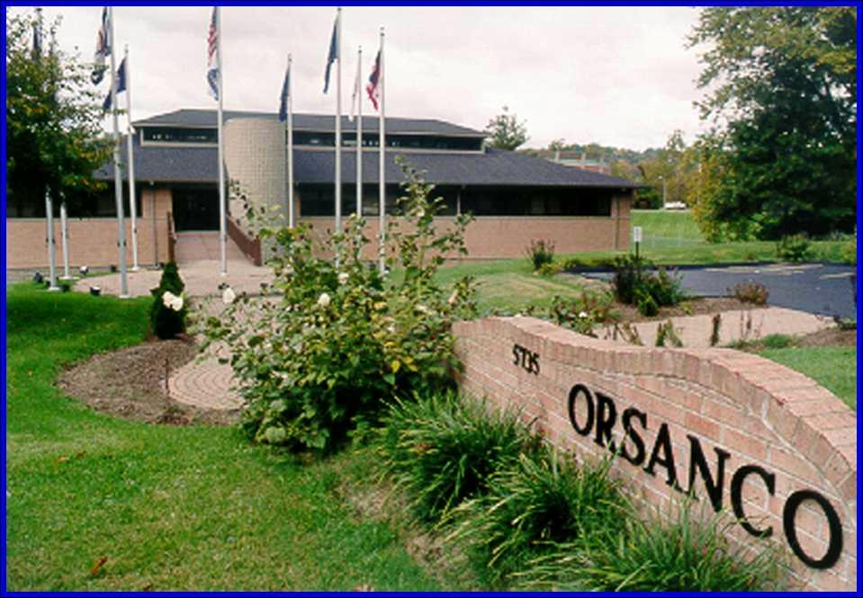
What is ORSANCO?
Ohio River Valley Water Sanitation Commission
In 1920s and 1930s the Ohio River was very polluted
Problem was too big for just one city or state to fix
Created ORSANCO in 1948, bringing 8 states together to protect the river

Slide 3
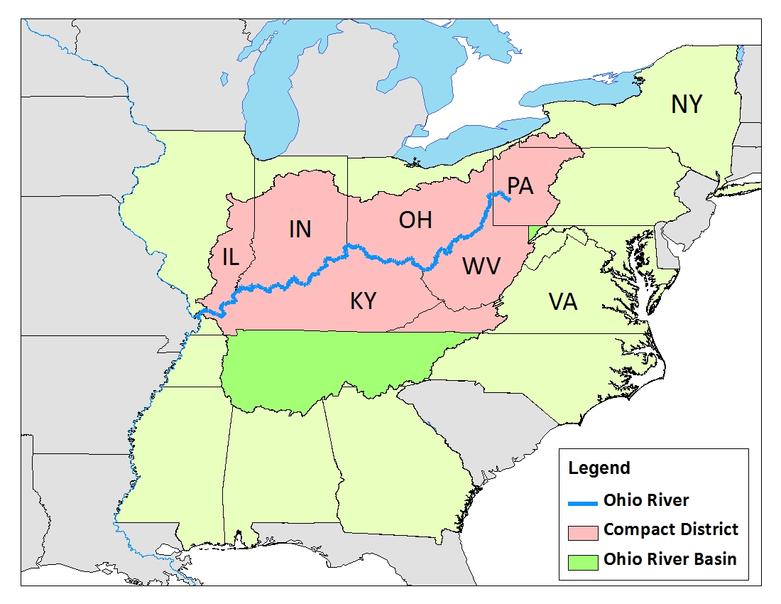
Ohio River Valley Water Sanitation Commission
Established by Compact (1948)
Ratified by Congress
Eight signatory states
IL, IN, NY, KY,
OH, PA, VA, WV

Slide 4
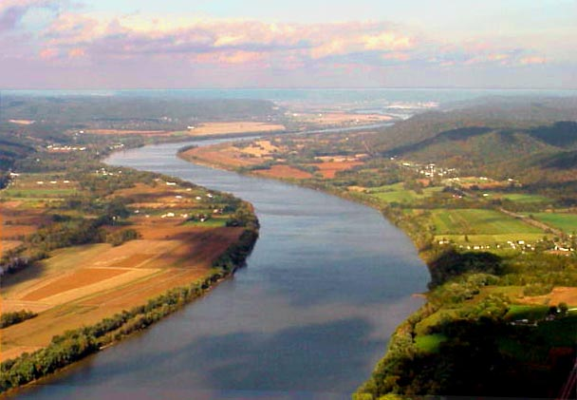
ORSANCO Mission
Abatement of interstate water pollution in Ohio River Valley compact district.
Primary focus on Ohio River
Establish minimum WQ standards
Wastes discharged in one state shall not “injuriously affect” the waters of another state

Slide 5
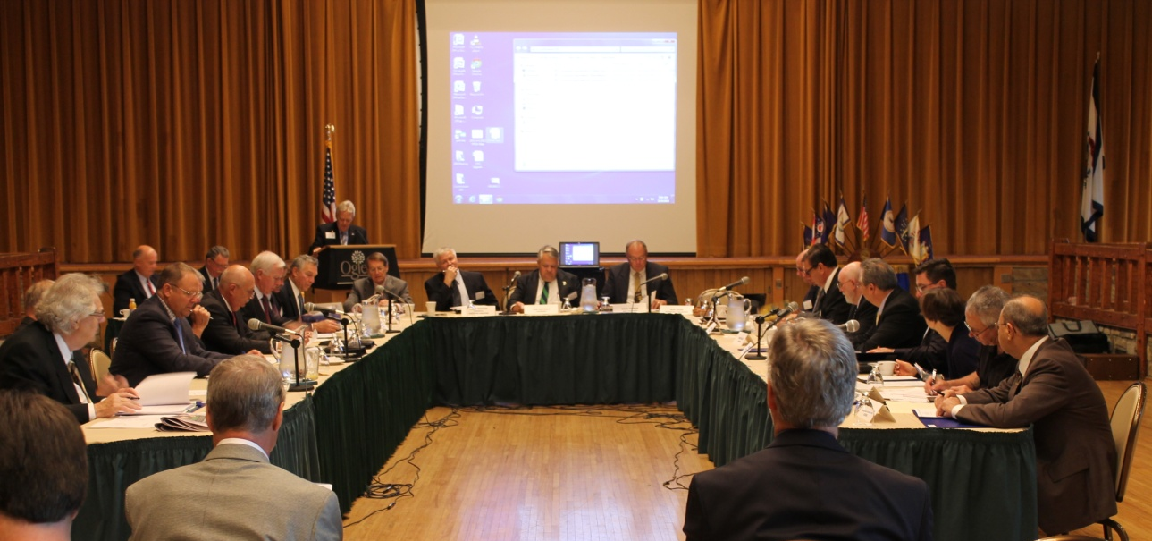
How the Commission Operates
3 Commissioners from each state
3 federal Commissioners
Funding
States
US EPA
22 person staff
Numerous inter-agency and stakeholder advisory committees

Slide 6
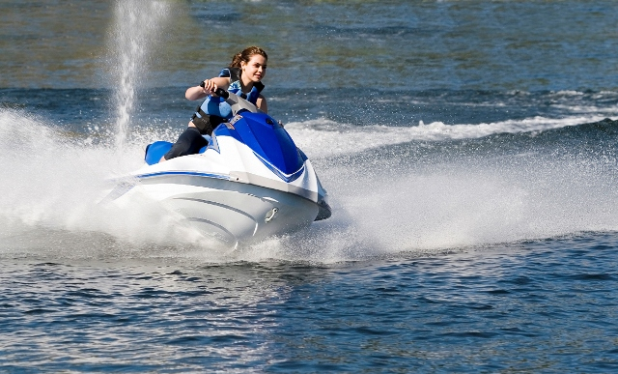
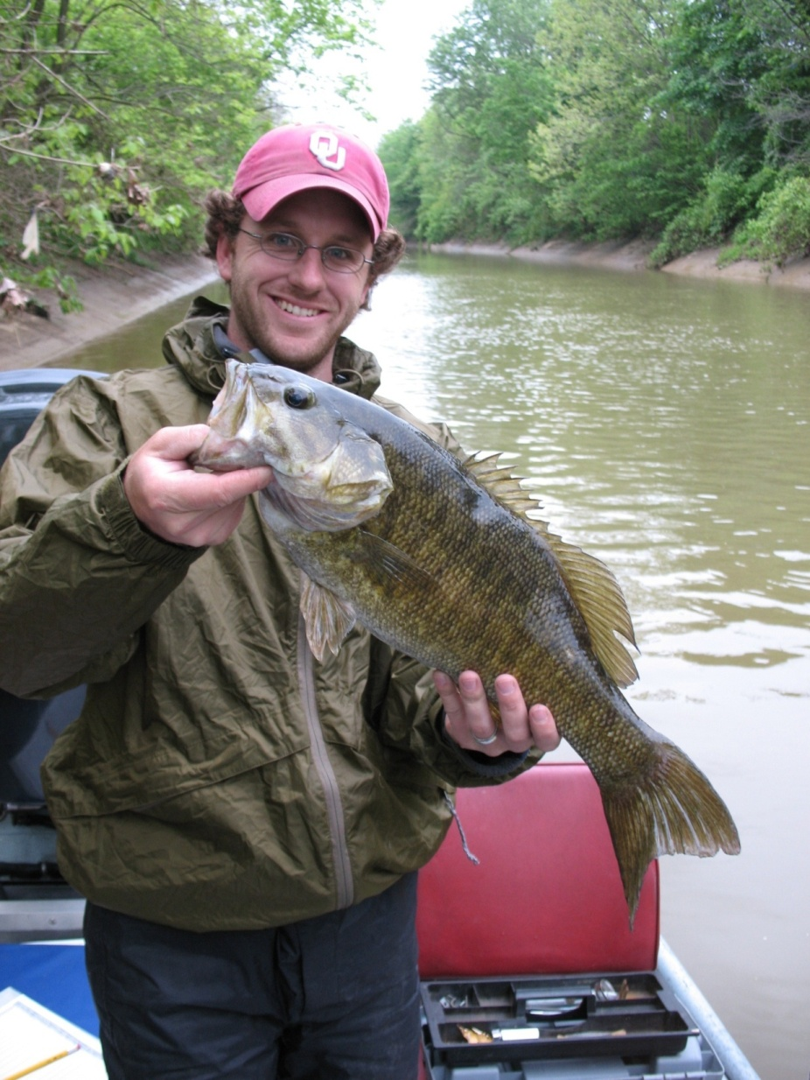
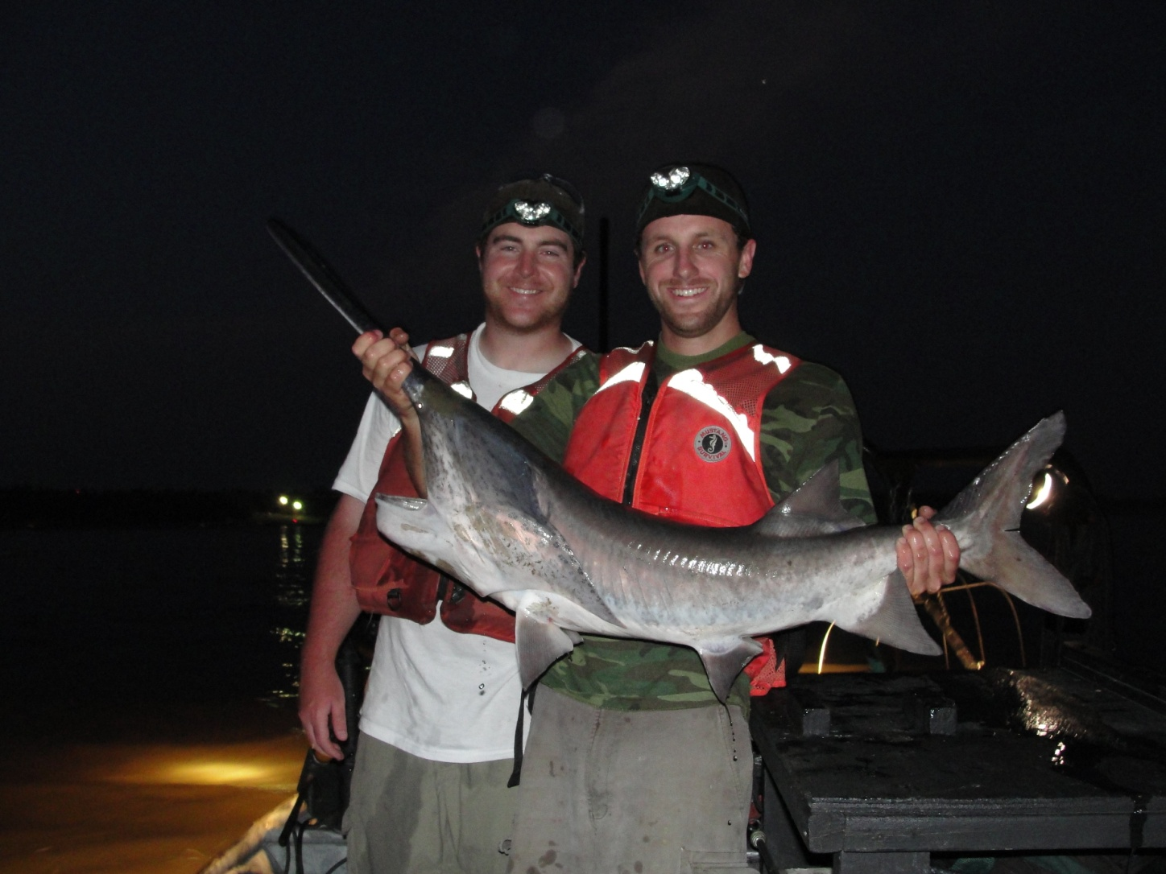
What We Do
Our mission is to protect the uses of the Ohio River.
We monitor the river to assess if it is:
Safe for drinking water
Safe to recreate
Safe to eat the fish
Safe for aquatic life

Slide 7
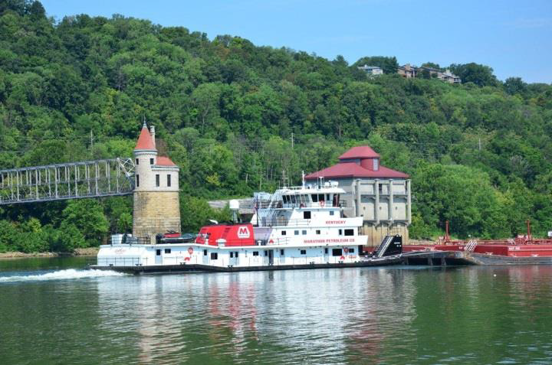
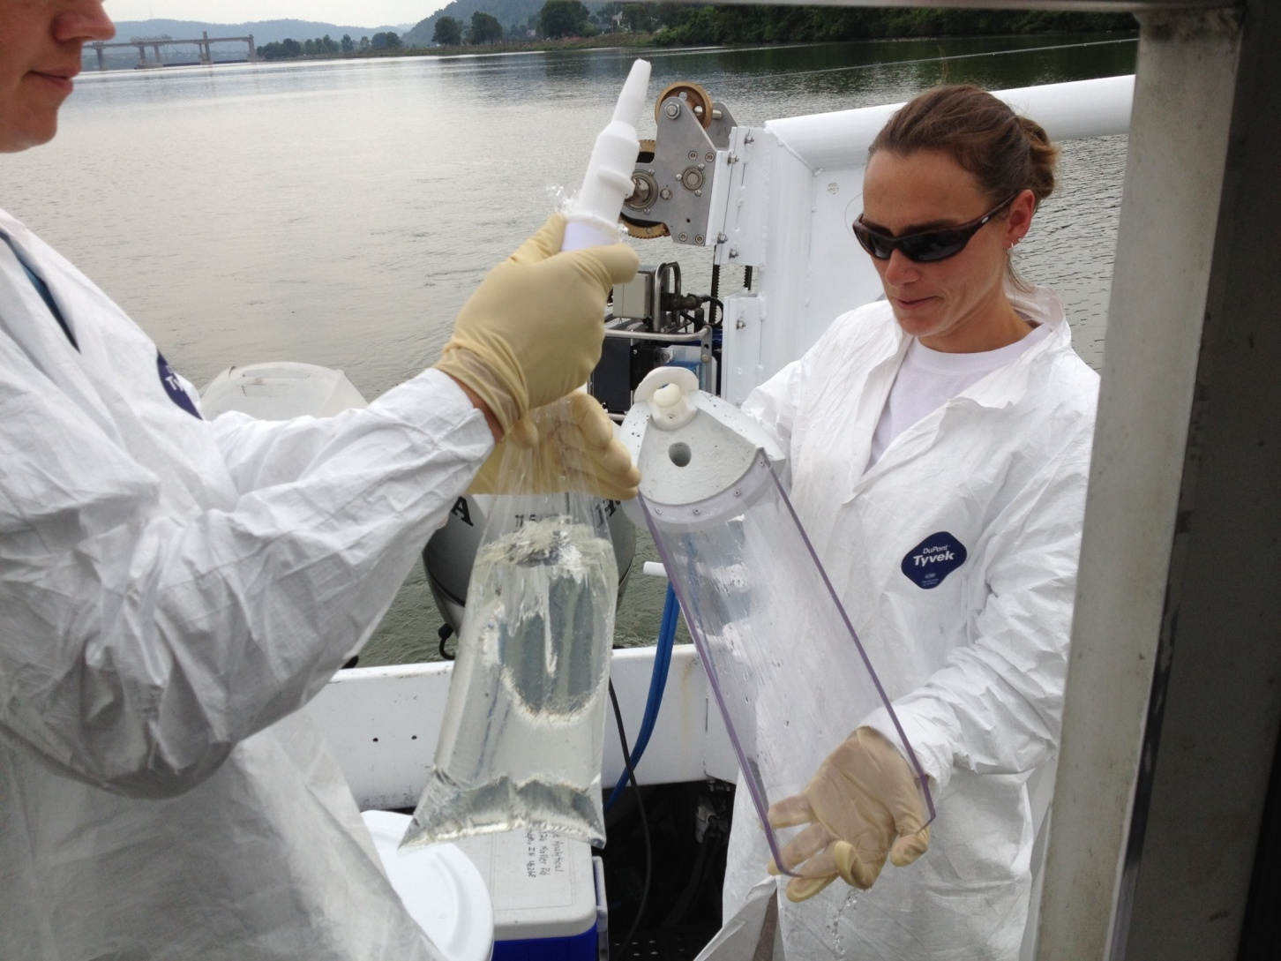
Keeping Our Drinking Water Safe
Drinking water source to 5 million people
Collect and analyze samples daily
Track major spills
Contact water intakes

Slide 8
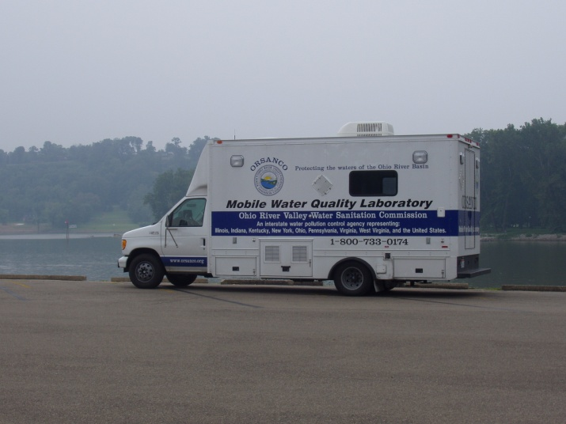
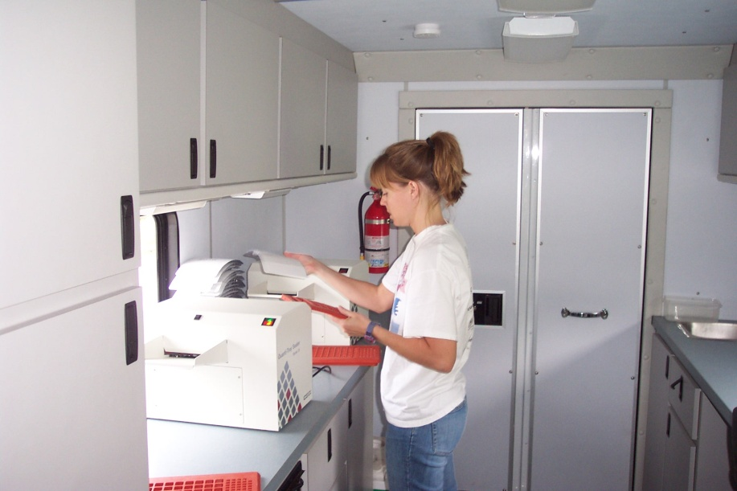
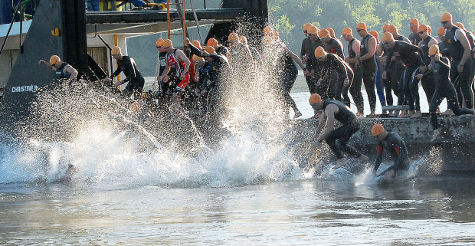
Is It Safe To Swim?
Collect and analyze samples for bacteria weekly during recreation season
Test samples for special events

Slide 9
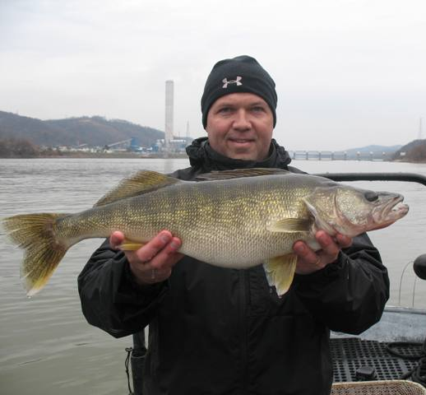
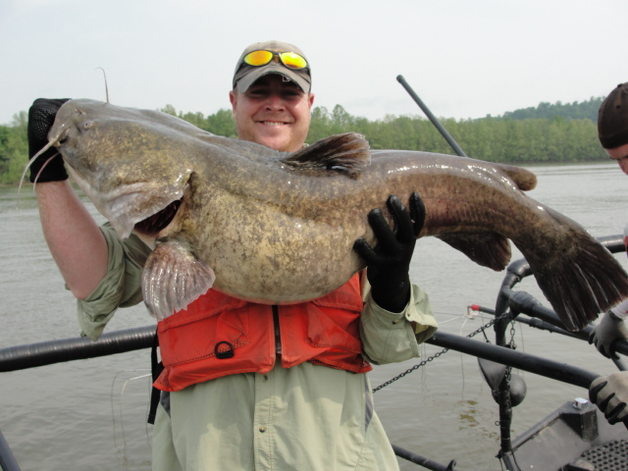
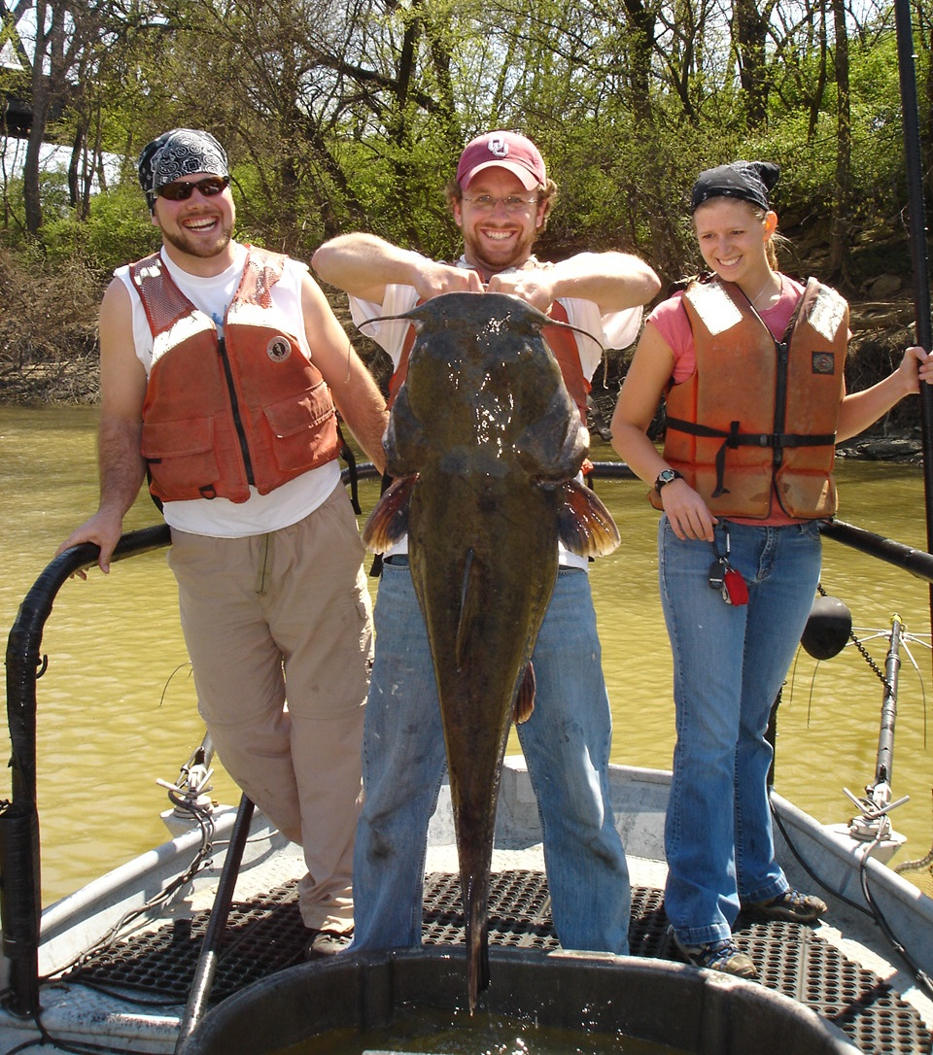
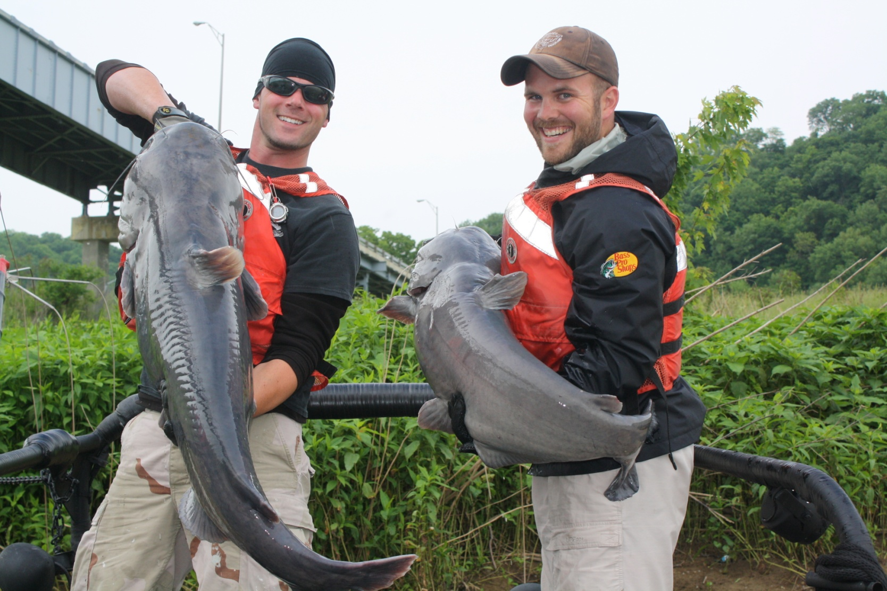
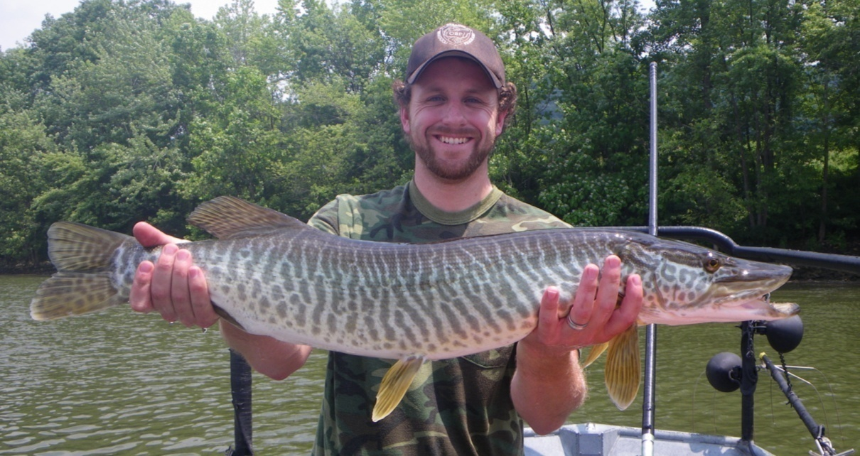
Can I Eat the Fish?
Collect and analyze fish samples every year.
Compare pollutant levels in fish to recommended values for food.

Slide 10
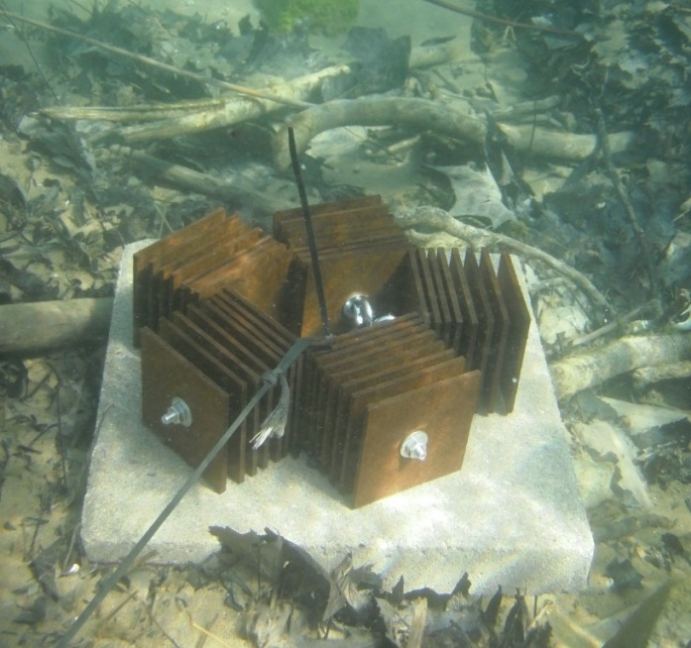
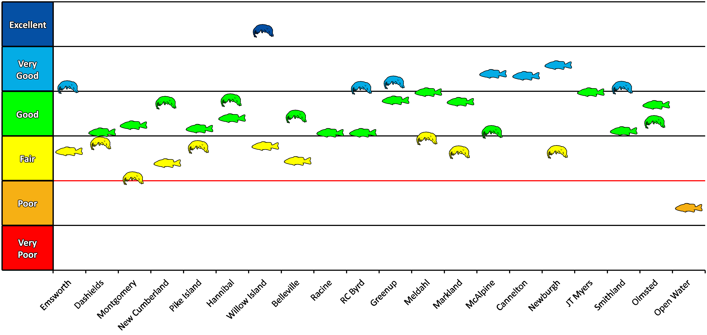
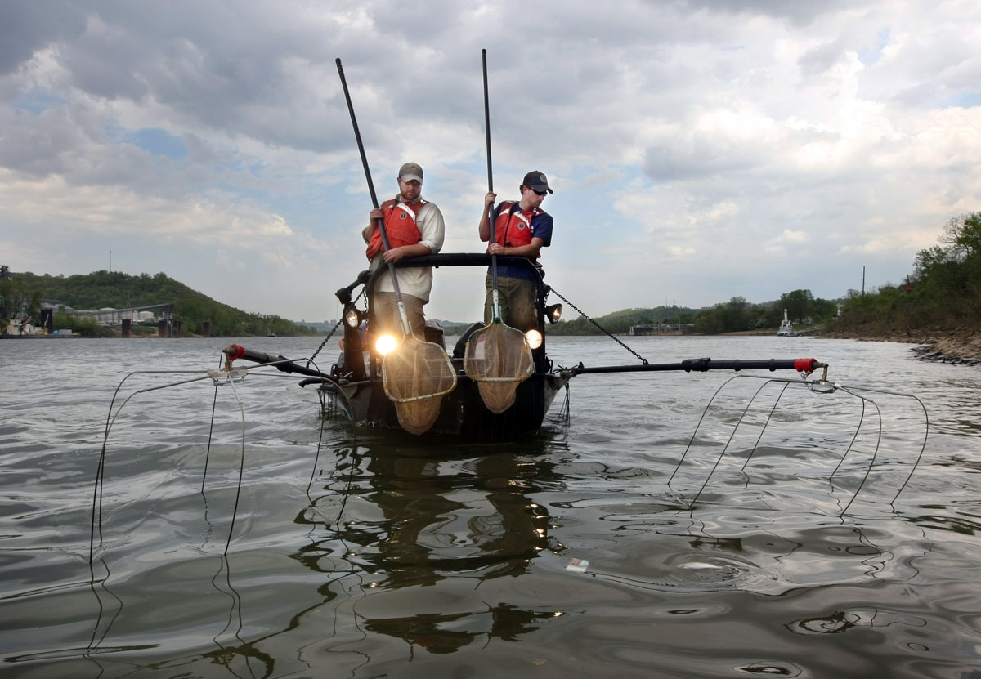
Aquatic Life
Over 130 fish species identified in the Ohio River
Collect fish and bug population data yearly

Slide 11
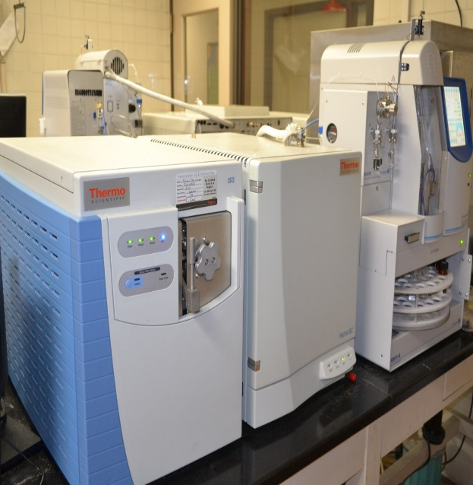
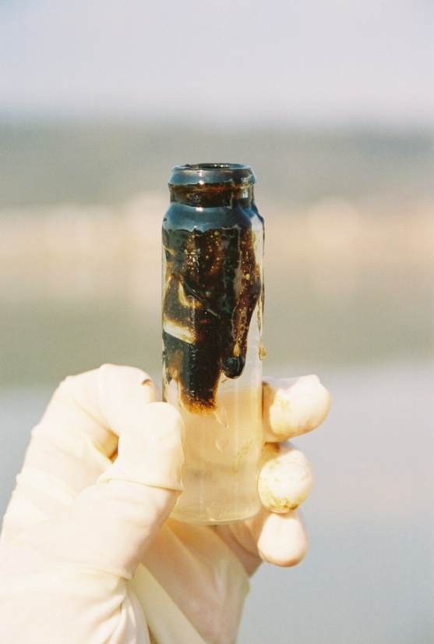
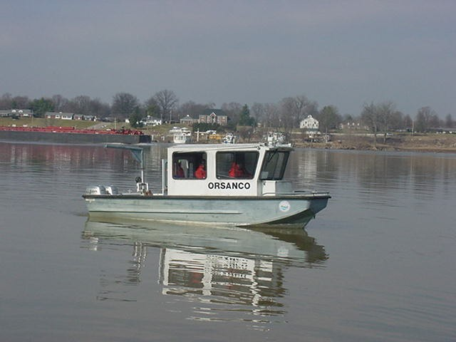
Role in Spill Response
Planning and Preparedness
Communications
Time-of-Travel Modeling
Water Quality Monitoring
Analytical Support

Slide 12
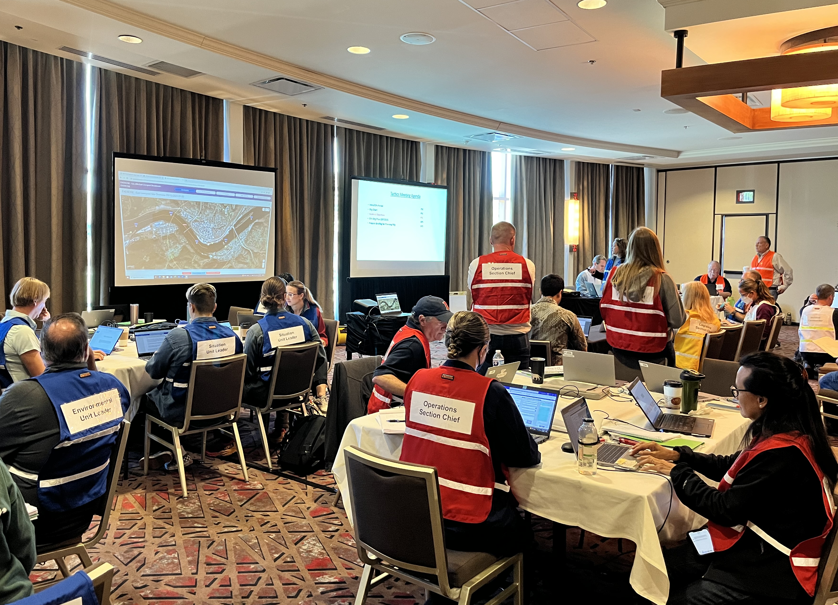
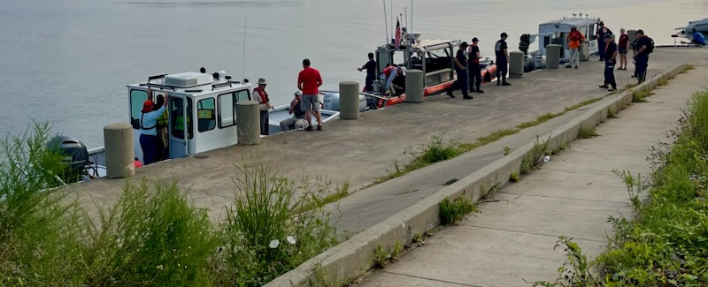
Facilitating Emergency Response Preparedness
Emergency Response Focus Groups
Engage federal/state/local ER personnel
Upper Ohio (Marietta)
Greater Cincinnati (Markland pool)
Kentuckiana (Louisville to Evansville)
Great Rivers Coordination Group (Paducah)
Water Users Advisory Committee
Drinking water utilities

Slide 13
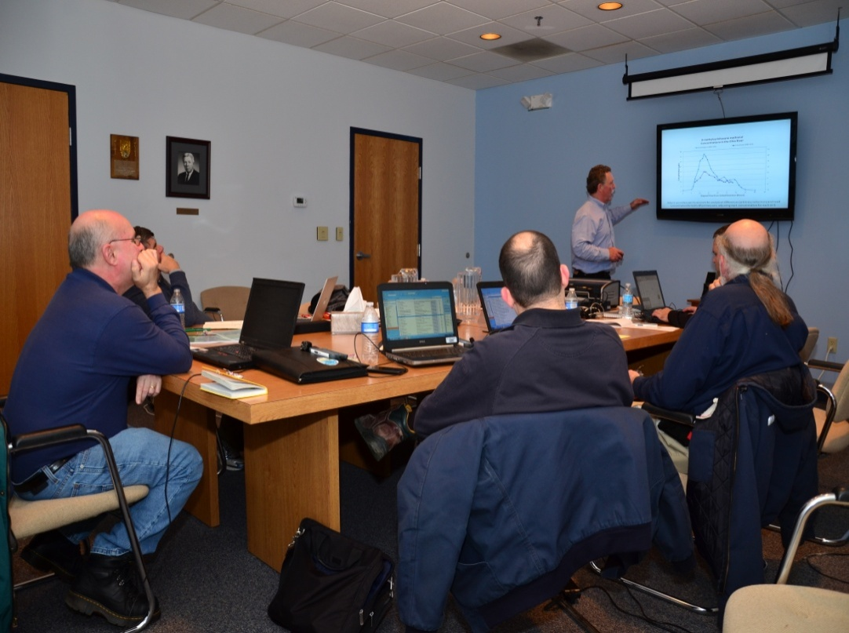
Communications
Rotating 24/7 spill duty
Receive spill reports via National Response Center (NRC) or direct calls
Facilitate interstate communication
State and Federal Agencies
Drinking Water Intakes
Industrial Intakes
Media / Elected Officials / General Public

Slide 14
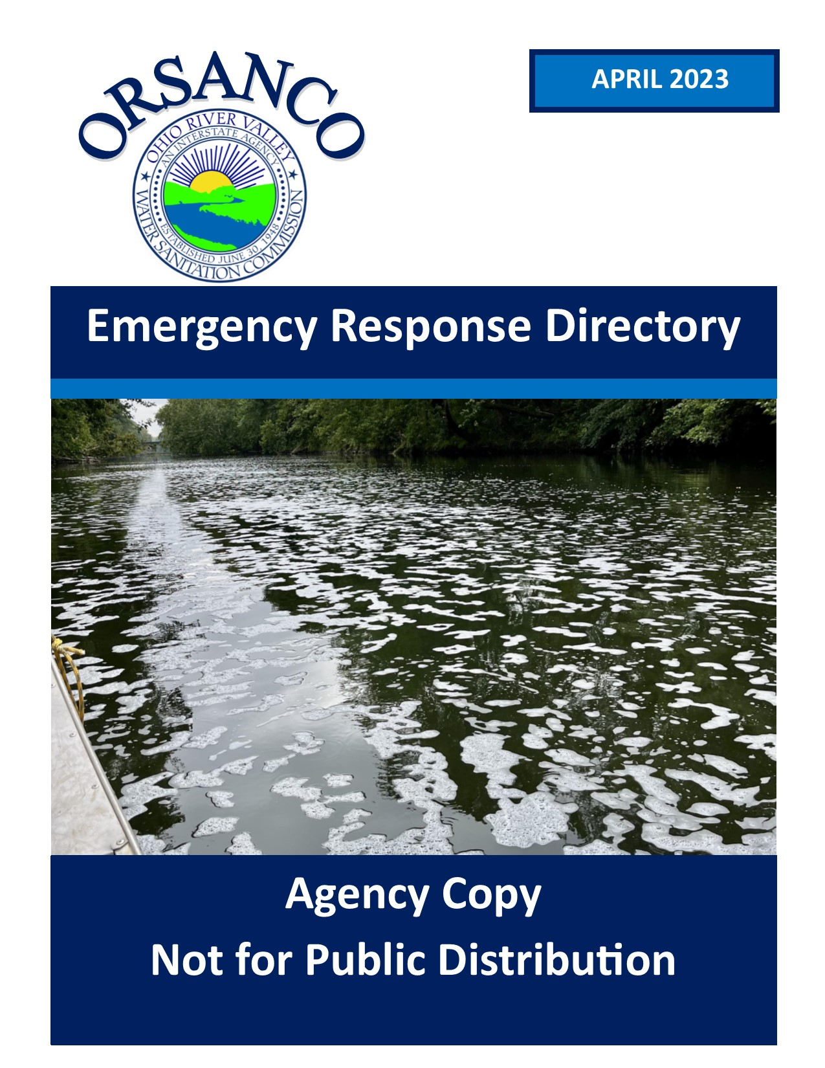
Spill Notification
Emergency Response Directory
State/Federal contacts
Water utilities
Key river features
Spills Email Distribution List
Phone Notifications
Water utilities and ER agencies
Coordinate Calls & Meetings
Available to coordinate calls when necessary

Slide 15
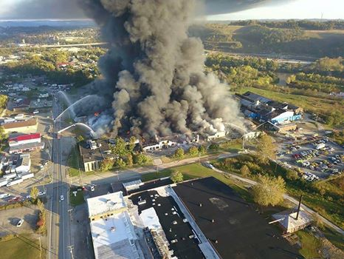
Key Questions?
What?
Where?
How much?
Actions taken?
Concentration?
When will it arrive at downstream intakes?
How long is the plume?

Slide 16
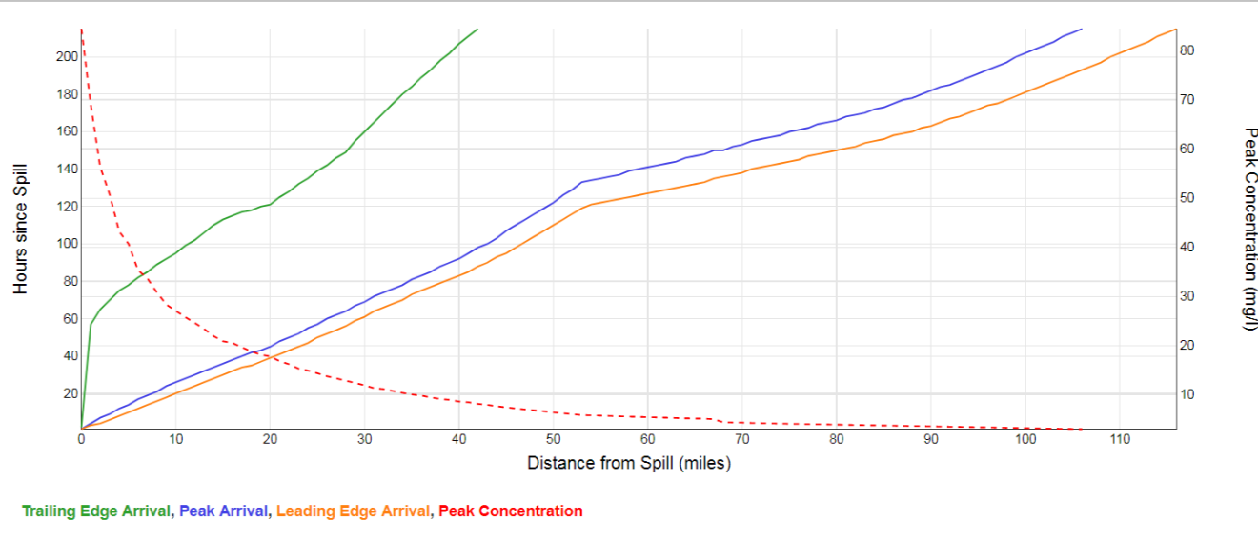
Time-of-Travel Modeling
Ohio River Spill Modeling System
Input date, time, amount, duration, decay
Uses daily HEC-RAS flow file from NWS
Predicts plume time-of-travel
Leading edge; peak; trailing edge
Estimates pollutant concentration
Utilized to:
Inform water utilities and others of spill location
Inform sampling crews where to monitor

Slide 17
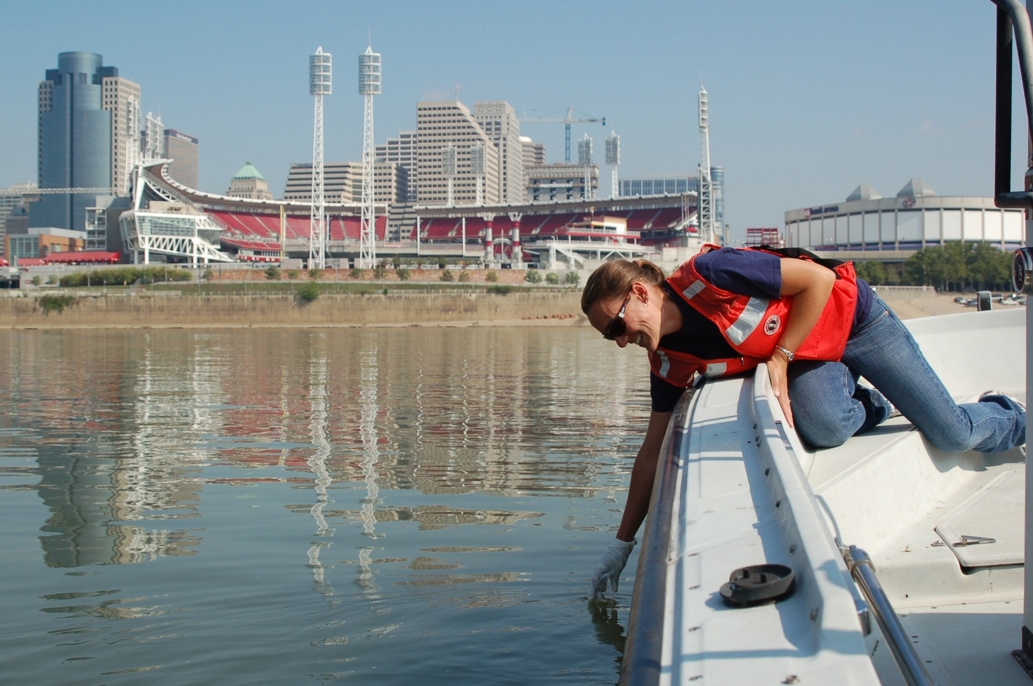
On-River Spill Tracking
Water quality sampling to track plume
Shore-based (access points, locks & dams)
Boat-based (safety limitations)
Provide coordination of multi-agency sampling efforts
Available Resources
Boats – flow-through monitoring
Multi-parameter datasondes
Water and sediment samplers
Flourometers
Biological sampling

Slide 18
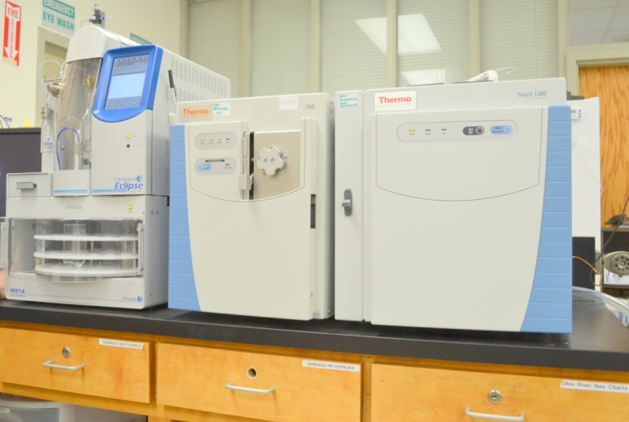
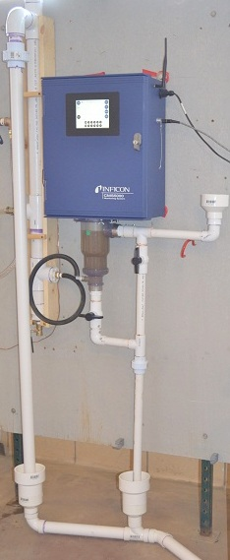
Spill Detection Monitoring Network
Organics Detection System (ODS)
Daily analysis of water samples for volatile organic compounds for spill detection
16 stations (13 mainstem + 4 tribs)
Detect thousands of compounds
Calibrated for 30 VOCs
Provide coordination of laboratory services
Within ODS network
Contract laboratories
Gas Chromatograph Mass Spectrometer

Slide 19
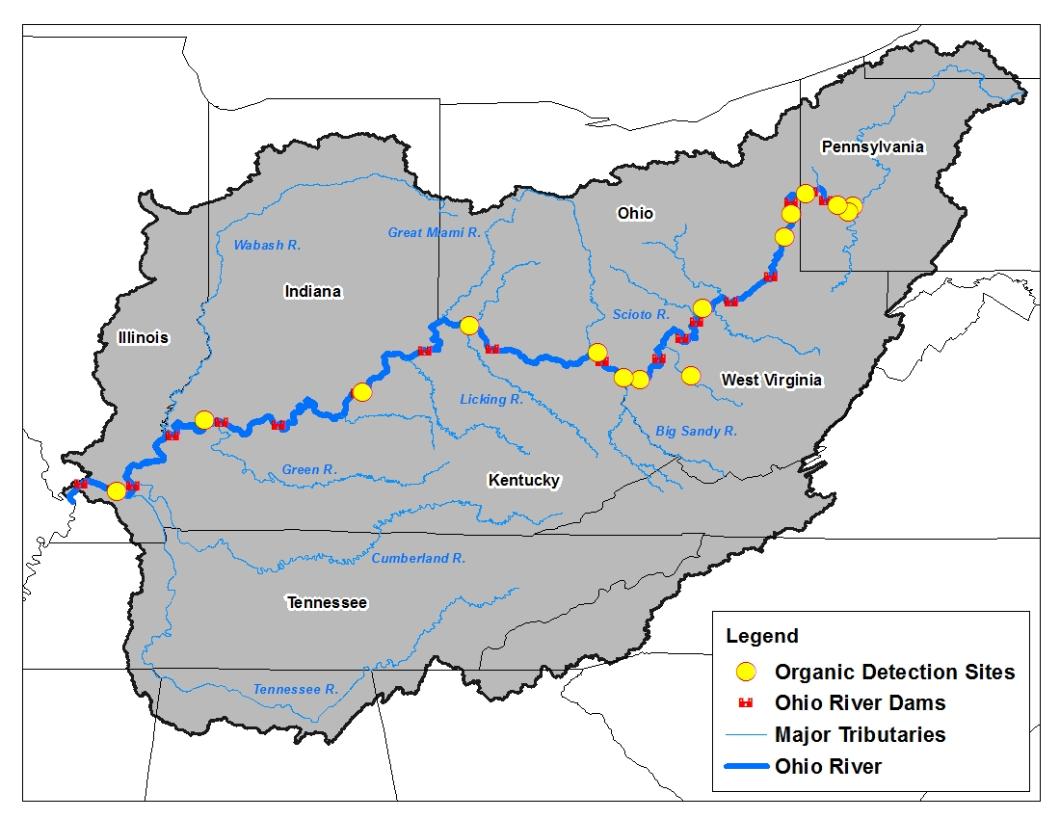
Organics Detection System Sites
Organics Detection System

Slide 20
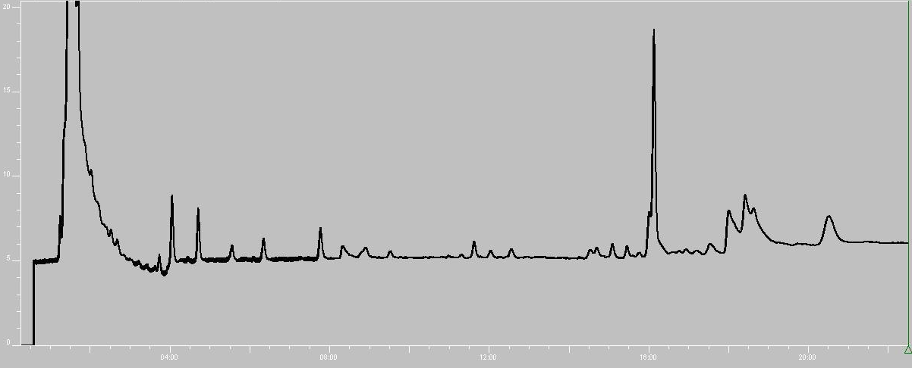
ODS Network Functions
Routine screening and ambient monitoring at intakes
Alert operators of events that may impact treatment
Enhanced monitoring capabilities during spill events
Increase sampling frequency
Perform confirmation analyses
Provide analysis to assist plume tracking
Develop methods for contaminant analysis
Foster improved communications and information sharing among water utilities

Slide 21
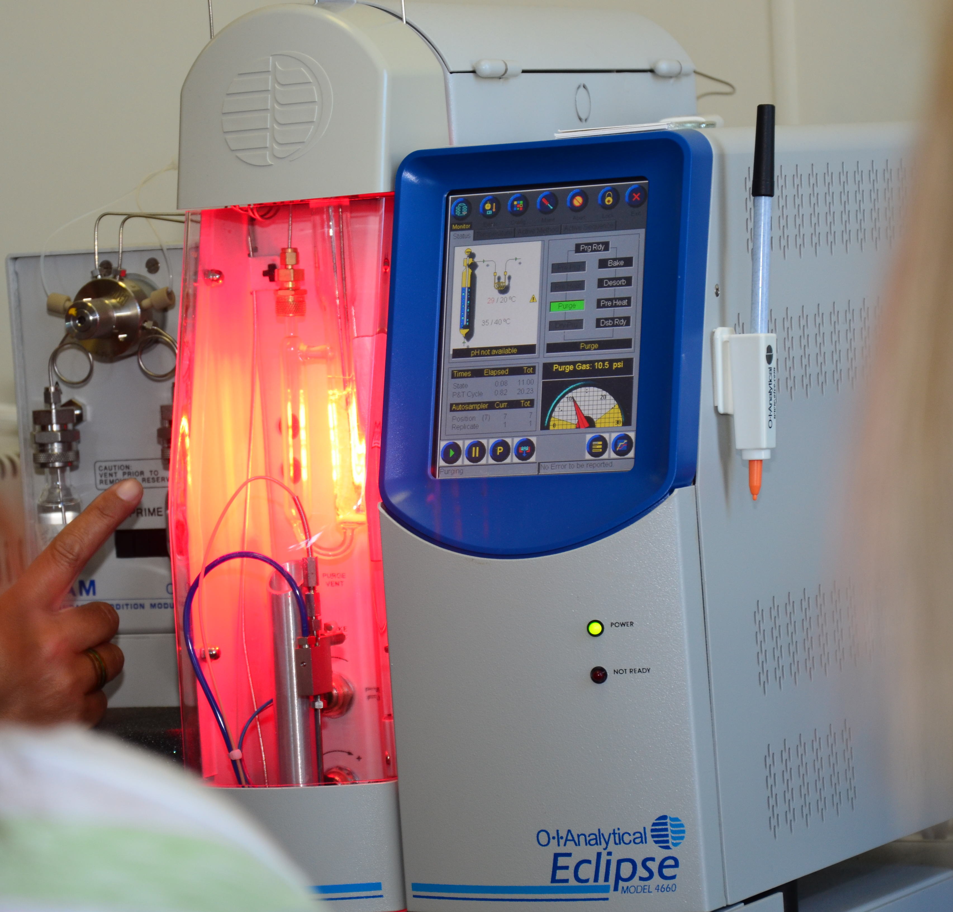
Routine Monitoring
Samples collected and screened daily
Not all plants have ODS operators on weekends
Samples typically from raw water line
Represents water drawn into plant at intake depth
ODS operators notify ORSANCO if detection >2 ppb or distinct observable pattern of low level detections
Approximately 2,000 samples screened monthly from all sites in ODS network

Slide 22
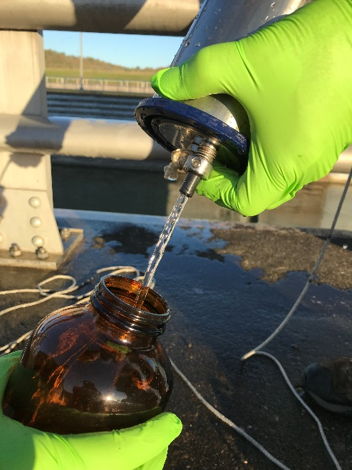
Points of Emphasis
Reinforce need for quick initial WQ assessment
Decisions will be made regardless of data availability
Get screening-level data quickly to decision-makers
Impacts can extend well beyond point of release
Organics Detection System Partners
Can be great resource for quick screening results
Utility network also helpful to share treatment info

Slide 23
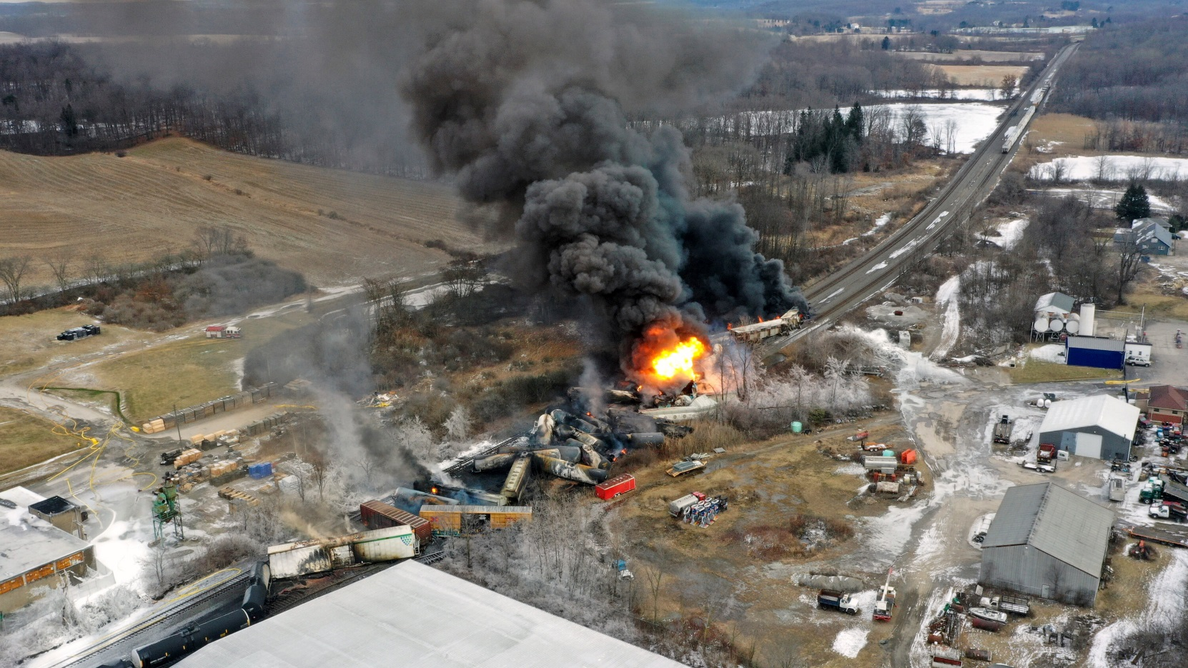
ORSANCO Role in East Palestine, Ohio Train Derailment (February 3, 2023)
Ohio River Valley Water Sanitation Commission (ORSANCO)

Slide 24
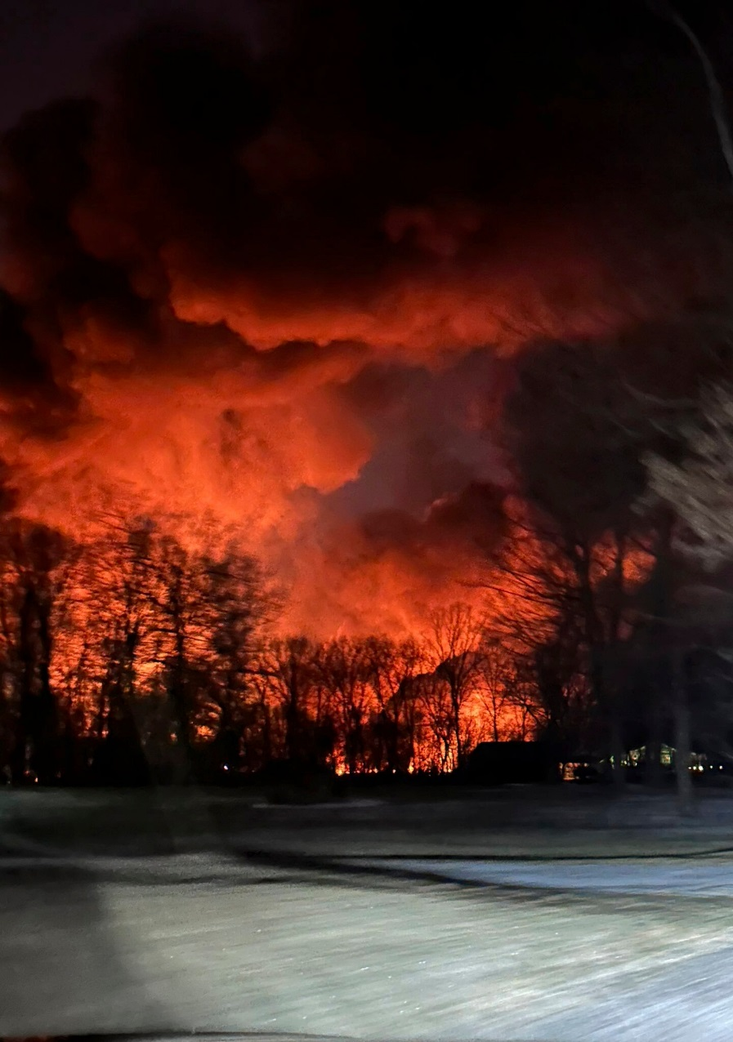
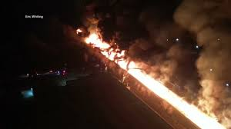
Initial Report
Feb 3, 2023 – Train derails in East Palestine, OH at 20:55
50 cars derailed (10 haz mat tankers)
NRC report received 23:12 indicating derailed cars on fire
POTENTIAL RELEASE of unknown materials
Melissa Smith via AP

Slide 25
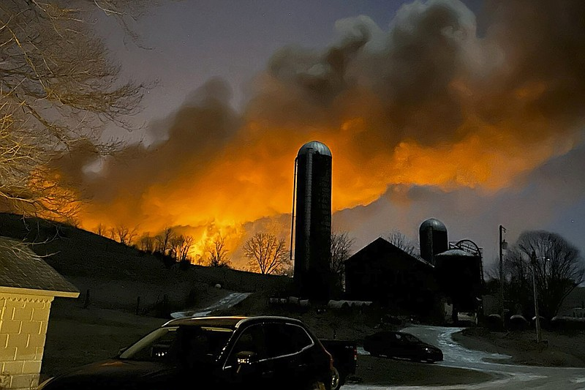
Initial Details
Feb 4, 2023 –
Fire ongoing, but reduced
5 vinyl chloride tankers derailed (at least 2 engulfed)
Other hazmat railcars also burned
Unknown materials/quantities released
Sulphur Run to Leslie Run impacted by runoff
Fish kill observed
Incident location is 19 stream miles to the Ohio River
Enters Ohio River at ORM 39.6
ORSANCO notified water utilities from East Liverpool, OH to Weirton, WV
Spill report emailed to distribution list
Melissa Smith via AP

Slide 26
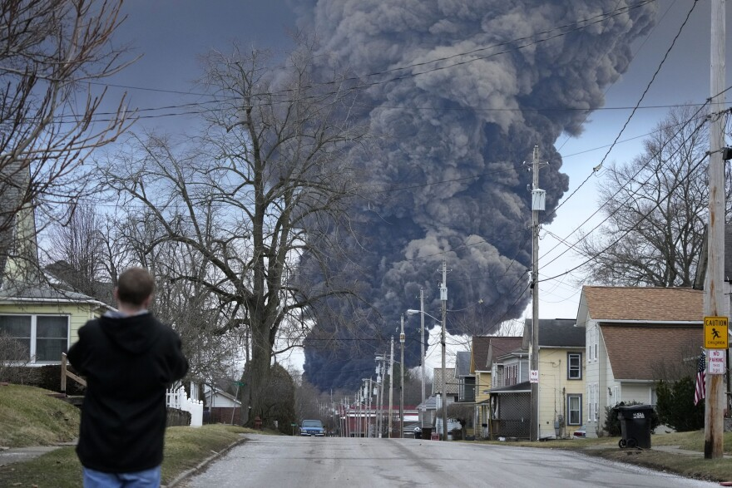
Many Unknowns
Feb 5, 2023 –
Pressure buildup noted in vinyl chloride railcar
Water quality sampling of nearby creeks underway
Feb 6, 2023
Products being transported reported to include:
Vinyl chloride
Butyl acrylate
Benzene residue
Combustible liquids
Volumes released unknown
Unknown if materials will reach the Ohio River
Weirton, WV ODS station running samples every 2 hours
Gene J. Puskar / AP

Slide 27
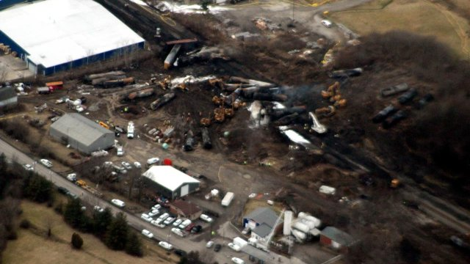
First Detection in Ohio River
Feb 7, 2023 –
ORSANCO briefs Technical Committee
No detections at that time
Shortly thereafter first detection observed
Butyl acrylate detected at Weirton in sample collected at 1600 on Feb 6
All surface water utilities from East Liverpool, OH to Wheeling, WV notified by phone of detections
ORSANCO water quality field crew mobilized
EPA Feb 7, 2023

Slide 28
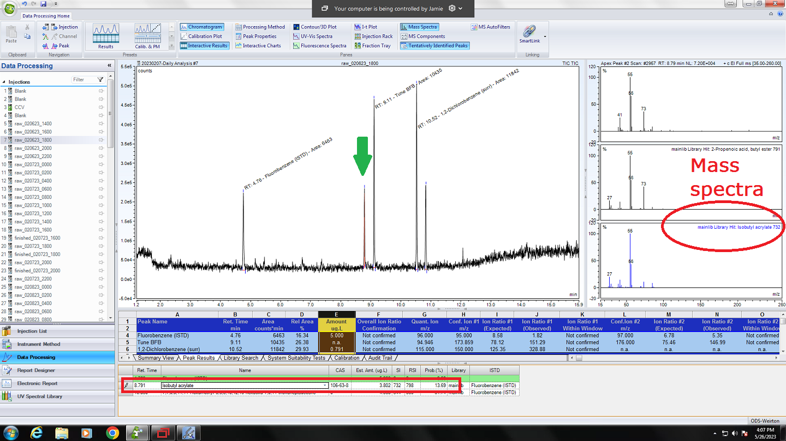
Initial Detection in Ohio River Weirton, WV Feb 6, 2023 at 1600

Slide 29
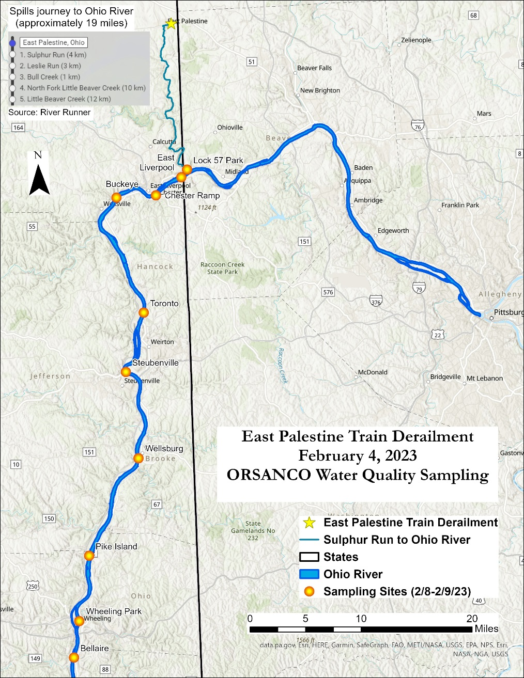
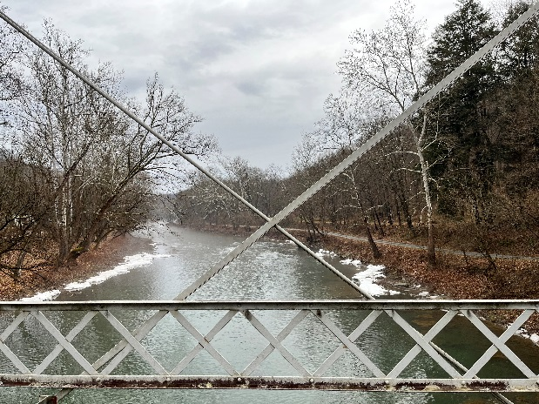
First ORSANCO Crews Deployed
Feb 8, 2023 –
ORSANCO crew sampled Little Beaver Creek to Bellaire, OH
Samples collected in triplicate
1 for local ODS
1 for Greater Cincinnati Water Works
1 for ORSANCO
Second crew deployed to Incident Command
Received train manifest
Ordered butyl acrylate standard

Slide 30
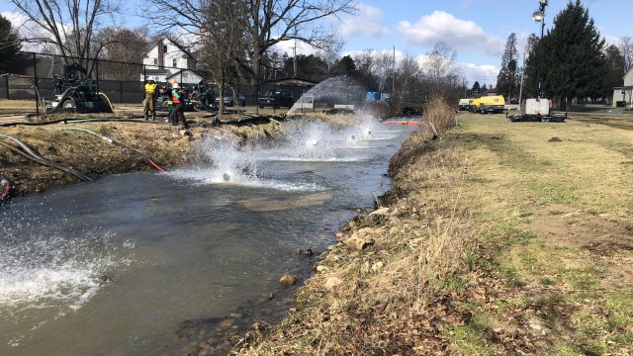
Continued Monitoring
Feb 9-10, 2023 –
ORSANCO met with response agencies & RP at Command Center
Repeated similar sampling approach as done on Feb 8
Little Beaver Creek to Wheeling+
Samples run at Wheeling Water
WV water intakes shut down
Needed 2 non-detects in finished to reopen
Feb 11 - ATSDR releases Health Guidance Values
n-Butyl acrylate: 560 ug/L
2-ethylhexyl acrylate: 500 ug/L

Slide 31
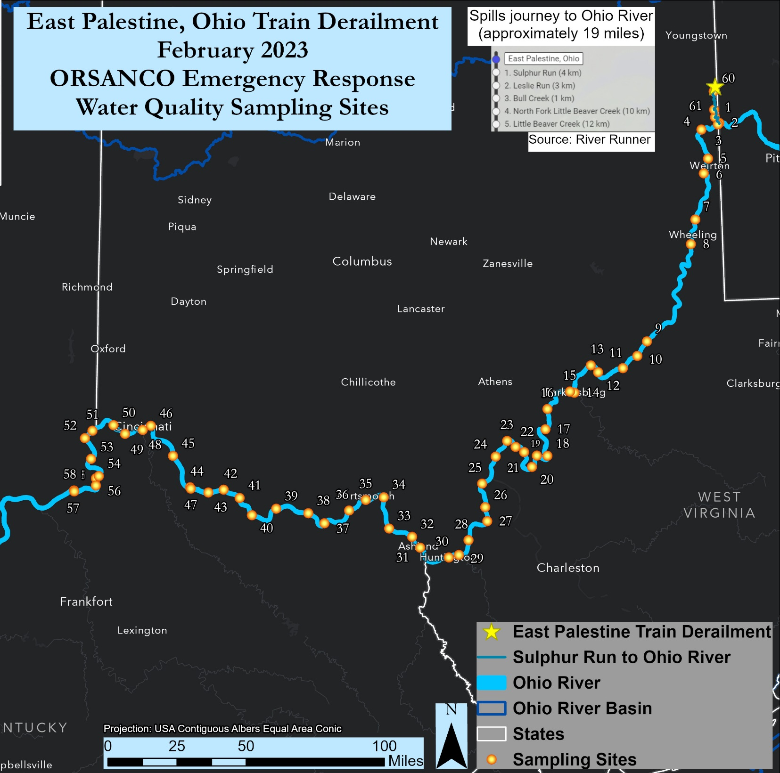
February 10, 2023
Detection
Non-Detect
Surface Grab Samples analyzed at Wheeling ODS; presence/absence
Ref | City | Mile Point | State | Date | Time | n-Butyl Acrylate (p/a)
1 | Grimms Bridge | Beaver 3.0 | OH | 2/10/2023 | 1350 | present
2 | Lock 57 Park | Beaver 0.2 | PA | 2/10/2023 | 1300 | present
3 | East Liverpool | 40.2 | OH | 2/10/2023 | 1420 | absent
 | Chester | 43.0 | OH | 2/10/2023 | 1125 | absent
6 | Steubenville | 65.3 | PA | 2/10/2023 | 1605 | present
 | Follansbee | 70.8 | OH | 2/10/2023 | 1300 | absent
 | Wheeling River Grab | 86.0 | WV | 2/10/2023 | 1600 | present
8 | Bellaire | 93.9 | WV | 2/10/2023 | 1715 | absent
 | Moundsville | 101.7 | WV | 2/10/2023 | 1750 | present
 | New Martinsville | 126.0 | WV | 2/10/2023 | 1900 | present
 | Sisterville | 137.2 | OH | 2/10/2023 | 1945 | present

Slide 32
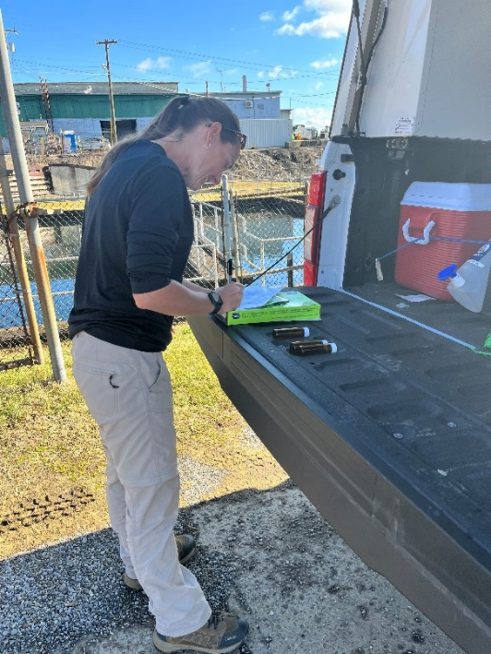
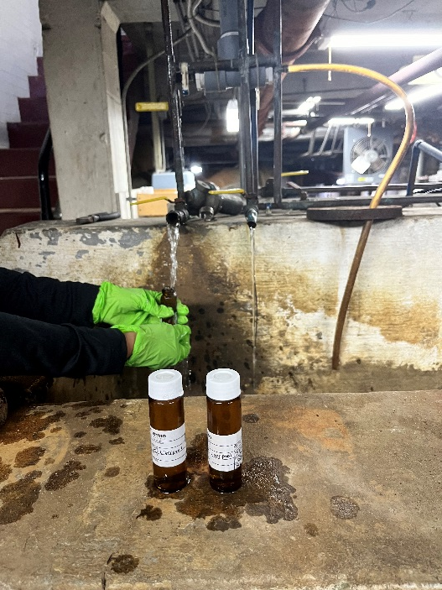
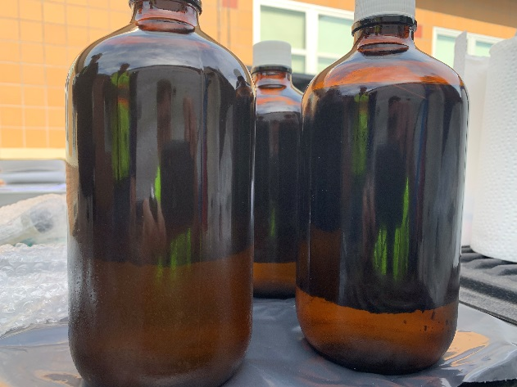
Tracking Leading Edge
Feb 11-19, 2023 –
Transitioned sampling to tracking leading edge
Sampled 50 to 120 miles per day
Early on plume traveled ~25 miles/day
Later, velocities increased to ~100 miles/day
Sample
Analyze
Model
Report
Plan

Slide 33
Downstream Tracking Concludes
Feb 19-20, 2023 –
Fixed station sampling at Markland Locks & Dam
Sampled every two hours from lockwall
Samples analyzed by Louisville Water
Feb 21-22, 2023:
Fixed station sampling at Cannelton Locks & Dam
Sampled every two hours from lockwall
Samples analyzed by Evansville Water
All samples from Markland & Cannelton non-detect

Slide 34
Extended WQ Monitoring
Feb 22-23, 2023 –
Partial loss of containment reported near derailment site
ORSANCO crew sampled morning of Feb 23
Low-level hits on Little Beaver Cr. and Leslie Run
Butyl acrylate
2-ethyl hexanol
2 ethylhexyl acrylate
March-April
Coordinated water quality sampling and analysis with several water utilities along length of river
All results non-detect

Slide 35
Incident Review Perspectives
View incident from different perspectives to improve future responses
20/20 Hindsight
What If Scenarios
What You Know, When You Know It

Slide 36
Challenges and Lessons Learned
East Palestine Train Derailment

Slide 37
Communication Challenges
Limited/inaccurate incident details during early stages
ORSANCO not privy to response agency reports
Flow of info slow in the beginning
Struggled to get a coordinated sampling plan
Misleading social media led to undue public alarm
Many do not understand nature of their drinking water source
Inundated with information requests
Intense interest from media, elected officials and general public
Consistent messaging on dioxin slow to develop

Slide 38
Analytical Challenges
Initially unknown materials released
What to test for?
Labs not calibrated for butyl acrylate and other compounds released
Needed standards to calibrate
Unusual detections at Wheeling ODS
Detections interspersed with non-detects
ODS capabilities and utility not understood by some agencies

Slide 39
Data Challenges
Which data to distribute and publish?
ODS screening vs GCWW
How to best report peaks less than PQL?
Consistent messaging with partners
Keeping up with sample info, mapping and analytical results
Connectivity issues with electronic devices

Slide 40
Lessons Learned
Be proactive to post contact info and incident details online
Response agencies unfamiliar with key attributes of ODS network
Prepare materials detailing ODS capabilities, applications, and limitations to share with response agencies
Develop spill response toolbox to standardized data collection/reporting and improve spill response readiness
Need common understanding among partners regarding data reporting
Screening level vs certified results
Reporting data for peaks <PQL ???

Slide 41
Lessons Learned
Proactively determine need for Command Center engagement and water quality sampling
Staff resources stretched to limits
Need more staff cross-training for necessary redundancy
Sampling, GIS, data management, ODS, Incident Command, public info
SWIGs want to be on spill updates
Engage ATSDR early if unregulated materials involved
Keep task management groups small (e.g. sampling plan development)

Slide 42
ORSANCO Spill Response Recap
ORSANCO is a unique entity with focus on water quality
Role sometimes not widely understood
Not typically a first responder
Notifications are automatic; Field response upon consultation
Provides coordination among response agencies and water utilities
Extensive WQ monitoring, modeling & analytical capabilities
Can provide rapid turnaround of WQ results
Constantly working to improve response capabilities
Integrated data sharing
Opportunities to maintain & upgrade equipment

Slide 43
Questions or Comments?
Contact Information
Sam Dinkins
sdinkins@orsanco.org
513/231-7719

