Slide 1
poison centerS AND PEHSU as EMERGENCY COLLABORATORS
Robert J. Geller, MD, FAAP, FAACT, FACMT
Medical Director, GA Poison Center
Professor of Pediatrics, Emory University
Formerly, Director, Emory Southeast PEHSU

Slide 2
Disclaimers
Robert Geller is a salaried employee of Emory University. As part of his duties, he serves as Medical Director and Project Director for the Georgia Poison Center.
The Georgia Poison Center is operated by Grady Memorial Hospital Corporation under grants from the State of Georgia, US HRSA, and philanthropic contributions.

Slide 3
Responsibility
The contents of this presentation have been discussed in general with leaders of each Region 4 poison center and with the leaders of the Southeast PEHSU.
However, the exact contents and the presentation itself are solely the responsibility of Dr Geller and have not been endorsed or approved by any organization.

Slide 4
Overview
History
strategy
NEXT STEPS

Slide 5
Why we’re here today
Poison centers often are called early in an event from affected individuals and concerned individuals
Poison centers interact with concerned individuals and on-scene responders but are not officially members of the RRT
We would like to be involved early by professionals on-scene
Get reliable information from those most knowledgeable about the details – Timely, Accurate, Up-to-date – rather than from the media
Allows us to provide most accurate clinical information and medical management advice

Slide 6
HISTORY

Slide 7
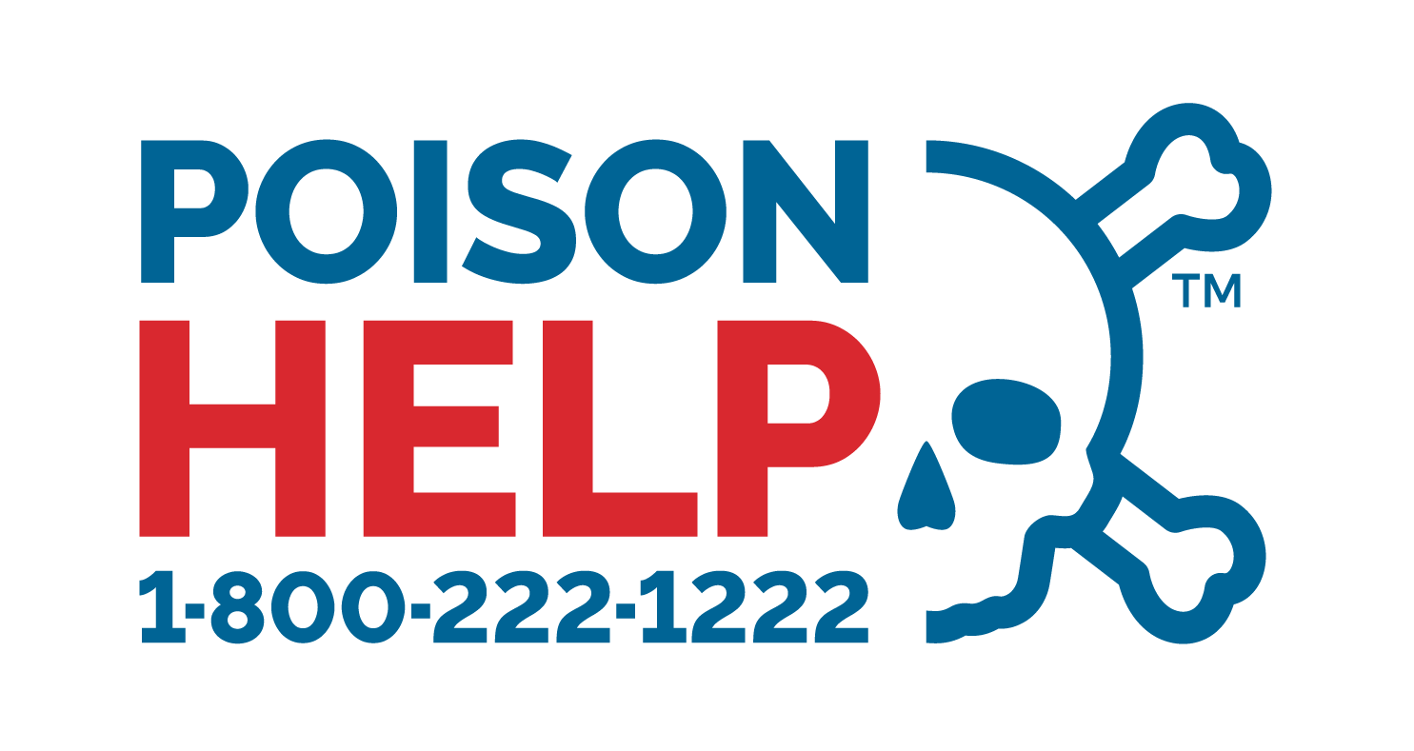
Poison Centers
First poison center founded 1953
Currently 55 US poison centers serve the entire US (including territories)
Collaborative relationship with Health Departments in their service areas
Calls to national toll-free number answered by medical professionals, 24 x7, 365
RNs, PharmD, MD
Specially trained to obtain situational information and then provide triage and management advice
Backup by toxicology fellowship trained MDs and PharmDs in near-real-time

Slide 8
US Poison Centers
About 3,500,000 calls answered annually from across the US
National toll-free number routed by geography and/or caller phone number
Routing should be driven by caller location, but sometimes routed by caller phone NPA and NXX
Median time to answer call <1 minute

Slide 9
US Poison Centers
All calls entered into a local medical record
Standardized abstract of all cases uploaded to national surveillance system
Continuous automated plus human review of unexpected data
Many poison centers also upload data to State PH systems

Slide 10
Poison Center Data
Standardized data format used by all US poison centers
Each poison center owns and retains its own data
Each center can provide customized reports about data it collects as appropriate

Slide 11
Poison center funding
Complex and somewhat different per center
Generally state and local funding
Some funding available through US HRSA under the Poison Control Stabilization and Enhancement Act
Provides approximately 13% of GA Poison Center funding
Poison centers reduce expense by $13 for every $1 spent on them (in last available estimate from health care economists)

Slide 12
Pediatric Environmental Health Specialty Units
Created 1998-2002 nationally by EPA Region
Funded jointly by EPA and ATSDR, 1 per region
Intended to address issues about the impact of the environment on children’s health and serve as advocates for improving the environment
Not available 24x7, 365
Not intended to address acute emergencies

Slide 13
Pediatric Environmental Health Specialty Units - staff
Medical Toxicology
Environmental Health
Nursing
Developmental Pediatrics
Ob-Gyn

Slide 14
Poison Centers in the Southeast US
All accredited as meeting national standards
All mature institutions – each more than 20 years in operation
All have internal staff plus internal medical direction
All operate 24x7, 365

Slide 15
Georgia Poison Center
GPC founded at Grady in 1971
Proclaimed the official poison center of the State of Georgia in 1981 by Georgia Board of Public Health
State and Federally funded
Operates 24x7, 365
Staffed by nurses/ pharmacists/ physicians, backed up by medical toxicologists (MD) and clinical toxicologists (PharmD)
Accredited as a Regional Poison Center for more than 30 years
Assigned seat at the table at State PH EOC

Slide 16
GPC Features
Handles more than 100,000 calls annually
Incoming calls handled by Specialists in Poison Information, with backup as needed
Nurses/ pharmacists/ physicians specifically trained to collect information, triage cases, present initial recommendations
Continuous available of medical toxicology backup
9 attending physicians fellowship trained in medical toxicology
Bring direct patient care experience to the situation at hand

Slide 17
Why People call Poison Centers
Timely advice, free to caller
Most cases managed at caller site
Independent expertise

Slide 18
Why People call PEHSU
Detailed advice, free to caller, not 24/7
Case-specific, shared with other agencies
Independent expertise

Slide 19
Where poison centers get their substance information
Micromedex
Online or in-house MSDS
In-house expertise
Corporate supplied data
More than 1,000 toxin monographs written by toxicologists and periodically updated
Subscription database containing more than 7,000,000 products and ingredients

Slide 20
Where poison centers get their management recommendations
Micromedex
Clinical references
In-house guidelines and expertise
Subspecialty consultants
Botany
Zoology
Emergency response (local/state/Federal, as most appropriate)

Slide 21
Poison Centers across the US – Recent Emergency Response Collaborations of Note
Hurricane preparedness through public media
Carbon monoxide from generators
Drinking water safety
Electrical hazards from downed power lines
Others
WV chemical release into water supply 2014
Train derailment Ohio 2023

Slide 22
Ongoing GPC Collaborations
US OSHA Region 4
Expedited reporting of workplace toxic hazards
Leads to expedited hazard analysis and possible preventive intervention
Disease reporting and triage
24 x 7 disease reports accepted on behalf of GA Public Health
Triaged, high risk events reported to on-call PH regional or state leadership
Chempack
State/ Federal collaborative program for emergency recognition and prompt deployment of needed antidotes statewide

Slide 23
Previous GPC collaborations
Lead agency for toxicology preparedness – Atlanta Olympic Games, 1996
Collaborated with Grady Hospital, USPHS Region 4, other Federal and State partners
Increased staffing
Remote workers
Antidote stocking enhanced at Grady
Geller RJ, Lopez GP. “Poison Center Planning for Mass Gatherings.” J Toxicol Clin Toxicol 1999; 37: 315-319.
Geller RJ, Lopez GP, et al. “Atropine Availability as an Antidote for Nerve Agent Casualties: Validated Rapid Reformulation
of High-Concentration Atropine from Bulk Powder.” Ann Emerg Med 2003; 41: 453-456

Slide 24
Previous GPC Collaborations
Biolab warehouse fire 2004
Chlorine and organic bromine compounds for pool and spa use
Warehouse fully engaged, massive smoke plume
More than 3000 evacuated
Poison center was point of public contact for concerned individuals
Poison center participated in EOC calls

Slide 25
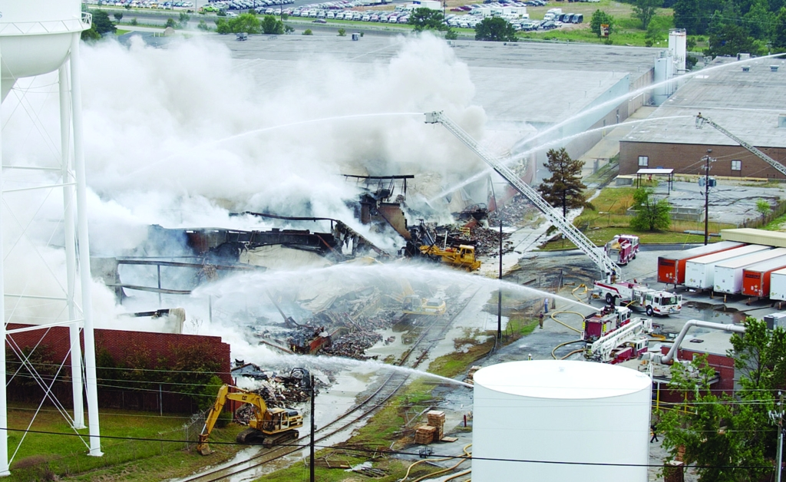
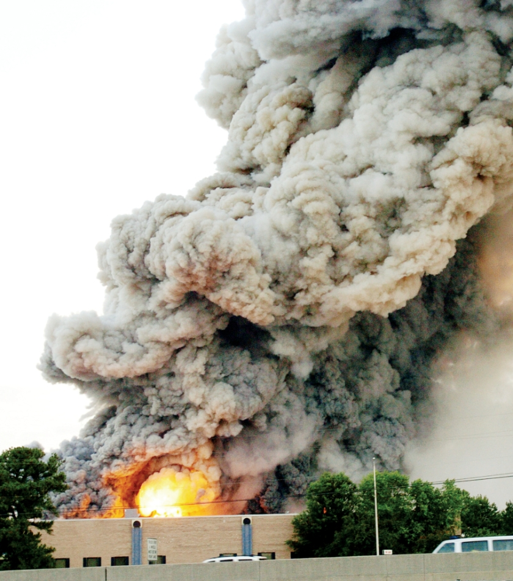
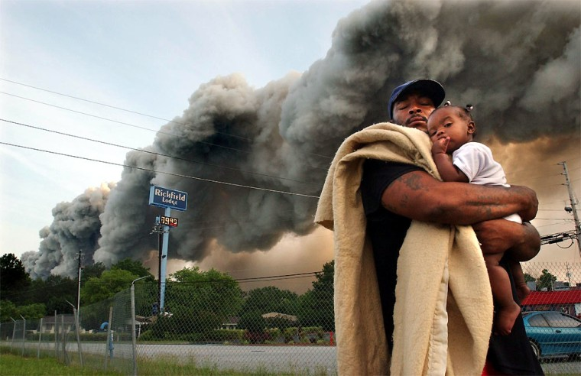
https://colinmstewart.com/portfolio/fire-leaves-residents-scrambling/
https://www.nbcnews.com/id/wbna5059026
https://colinmstewart.com/biolab-fire/

Slide 26
Previous GPC Collaborations
GA PHEP planning for ESF 8
Medical countermeasures
Public information provision
Atlanta SuperBowl planning and preparedness 2019
Elemental mercury exposures
Collaboration with US EPA Region 4 response team when site assessment and/or cleanup needed
Pooler GA High School June 2008
Many smaller scale cases

Slide 27
Previous GPC Collaborations
Hurricane Katrina/Rita
Assisted displaced refugees to Georgia to find healthcare, medications, and address illness concerns
Deep Water Horizon Gulf Oil Spill
Information provider to the concerned public
Graniteville, SC Train Derailment 2005
Chlorine release 7 miles past the SC-GA border
Many patients sought care in GA

Slide 28
STRATEGY

Slide 29
Background for implementation
Called frequently by the community about situations of concern
Suspected or known to be toxic in etiology
Generally considered by the public to be a credible and independent information source
Poison center management collaborates with State Public Health and EMA
Public Health Emergency Management
Emergency Management Agency
Poison center management collaborates with State Environmental agencies
Environmental Protection Department
Natural Resources

Slide 30
Message Communication
Standardized content
Content coordinated with topic experts from appropriate agencies
“I don’t have the answer, let me find someone who does”
Questions posed form basis for development of further FAQ answers

Slide 31
Educating the Public and Providers, Managing the Media, Timely
Collaboration is essential to presenting one common message
Disagreement between entities recognized as experts may occur but is ideally minimized
Poison centers can speak authoritatively when opportune– independently or as part of a joint information center

Slide 32
Call Capabilities
Ability to scale staffing up to meet demand on short notice
Ability to utilize automated messaging on-the-fly
Ability to dedicate event-specific phone number on-the-fly
Route to separate call queue or to automated messaging

Slide 33
Large Scale Communications Strategy
Messaging developed in coordination and collaboration with local/ State/ Federal partners
- But formal clearance not required
Limited number of authorized spokespeople
Media communications trained

Slide 34
GPC Large Scale Communications Strategy
Role limited in large scale events to that authorized by lead agency
Does not require multiple layers of clearance
Limited number of authorized spokespeople
Dr Robert Geller
Dr Gaylord Lopez
Media communications trained
Dr Geller has had more than 100 media appearances during his career

Slide 35
GPC Large Scale Communications Strategy 2
Control the topic
Limit the number of points to discuss
Bring the question back to one of your planned answers
Limit your answers to what you know to be true
No speculation or guesses
Describe how you will find the answers where you don’t know
Maintain your credibility

Slide 36
GPC Caller Satisfaction ratings
>99% 4 or 5 on 5-point Likert scale

Slide 37
NEXT STEPS

Slide 38
Why we’re here today
Poison centers often are called early in an event from affected individuals and concerned individuals
Even though we are not officially part of the RRT, we would like to be involved early by professionals on-scene
Get reliable information from those most knowledgeable about the details – Timely, Accurate, Up-to-date – rather than from the media
Allows us to provide most accurate clinical information and medical management advice

Slide 39
Proposed Poison Center role in emergency responses
Being involved from the beginning
Informed initially
Kept up to date
“Seat at the table” when appropriate
Answering individual health questions from the public and health professionals
Medical toxicologists have the medical experience and expertise to do this
PhD toxicologists are experts in chemical behavior and interactions
Early notice and detailed situational awareness provides us the ability to inform front-line staff and medical toxicologists on backup
Scale up call handling capability where appropriate
Create standard responses to anticipated common questions where appropriate

Slide 40
Poison center capabilities
Rapidly implemented dedicated line
Medical and non-medical assistance
IVR and automated messaging
Medical toxicology expertise about current effects and likely future concerns
Multidisciplinary staffing offers opportunities to relate to many different constituencies
Website access
Chat, email, text messaging
Assistance in disseminating FAQs/ fact sheets- many already exist
Customizable data collection/ aggregation/ reporting
Caller location
Caller concerns / health effects
Availability for public meetings and media outreach
Access for health care professionals 24x7 and for on-scene staff 24x7
Coordination with regional/ state health officials

Slide 41
Proposed PEHSU role in emergency responses
Being involved from the beginning
Informed initially
Kept up to date
“Seat at the table” when appropriate
Answering individual health questions from the public and health professionals and addressing community concerns about long-term health effects to children
Poison centers typically focused on acute effects
PEHSU typically focused on effects on children and pregnant women

Slide 42
Implementation ideas to consider
Establish MOU between each poison center and regional RRT
Establish MOU between SE PEHSU and regional RRT
Exchange “back-door” direct emergency numbers
Establish/designate “dark” direct line to each poison center for use solely for this purpose when urgently needed
Messaging developed in coordination and collaboration with local/ State/ Federal partners
- But formal clearance not required
Share, adapt and endorse document similar to R6 RRT Annex 20 "Activation Guidance for Poison Centers"

Slide 43
QUESTIONS?
National poison center public hotline 800 222 1222
Georgia Poison Center public hotline
800 222 1222
404 230 8989
Website chat inquiries: www.georgiapoisoncenter.org
Direct numbers exist for every poison center
Dr Robert Geller
rgeller@georgiapoisoncenter.org
cell 404 405 4425

