Slide 1
Agency for Toxic Substances and Disease Registry (ATSDR)
Leann Bing
ATSDR Region IV
Region 4 Regional Response Team (RRT4) November 1, 2023
Notes:
Stock photo: Family walking together

Slide 2
Overview of ATSDR
Public Health Resources Poison Centers
Notes:
I will give a brief overview of ATSDR, public health resources, and poison centers.

Slide 3
Agency for Toxic Substances and Disease Registry
Federal public health agency (non-regulatory)
Created by the Superfund Law in 1980 (CERCLA), as amended by Superfund Amendments and Reauthorization Act (SARA) in 1986
Congressionally mandated ATSDR to:
Perform public health assessments at hazardous waste sites
Develop toxicological profiles on harmful substances
Conduct epidemiological health studies
Maintain health registries and conduct medical surveillance

Slide 4
ATSDR Regional Offices
Located in each of EPA’s 10 regional offices
Provide unique technical expertise and field experience
Serve as liaisons with ATSDR HQs, EPA, and other federal agencies and help implement regional programs
Develop working relationships with EPA, other federal and state agencies, community groups, and citizens
Provide a national presence

Slide 5
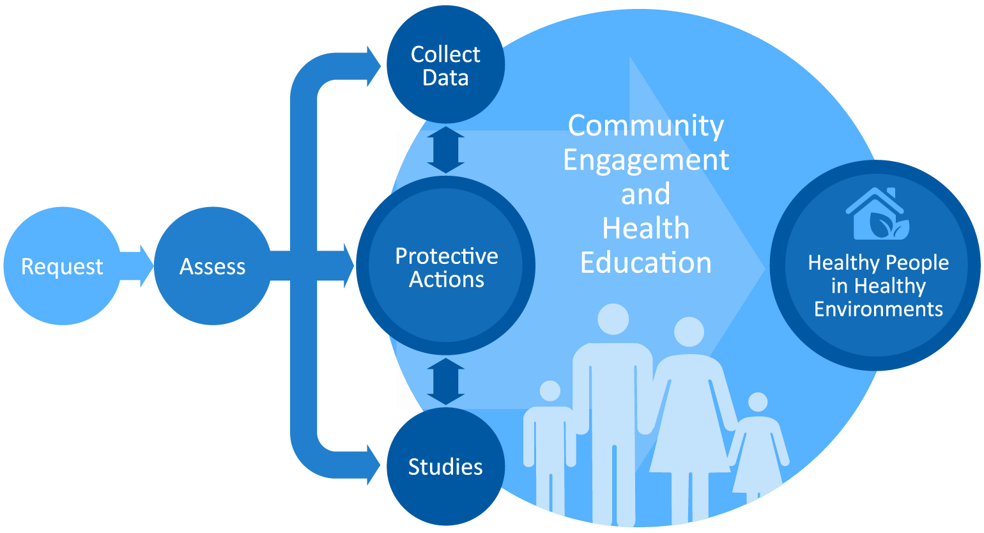
Protecting Communities
We receive requests for support from federal, state, and local agencies; community groups; and residents.

Slide 6
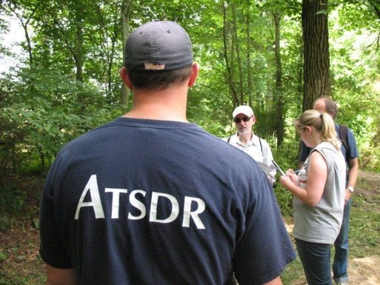
Protecting Communities: What It Takes
Technical Expertise of ATSDR Staff
Toxicology
Environmental Science
Environmental Medicine
Health Education
Epidemiology
Community Engagement
Physical Science and Engineering
Public Health
Source: ATSDR 2010
Notes:
Photo: ATSDR employee talking to EPA person (Source: ATSDR 2010)

Slide 7
Public Health Resources in Emergency Response
Agency for Toxic Substances and Disease Registry (ATSDR)
Poison Centers
Southeast Pediatric Environmental Health Specialty Unit (SE PEHSU)
State Health Departments
Local Health Departments
Tribal Health Departments

Slide 8
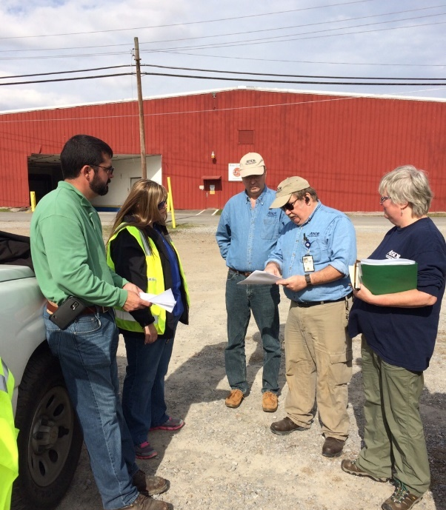
Public Health in Emergency Response
Investigate possible environmental health threats
Make public health recommendations to reduce exposures to hazardous substances
Provide health messaging and communication
Provide clinical and medical toxicology advice
Source: ATSDR 2012
Notes:
Photo: EPA and ATSDR talking at a site meeting (Source: ATSDR 2012)

Slide 9
Poison Center Support in Emergency Response
Respond to calls asking for health advice
Advise to health care facilities and providers on medical management
Collaborate with agencies on health messaging
Provide SitReps on Poison Center call volume, types of calls, symptoms, and geographic distribution
Some PCs may be able to establish a dedicated call line for the ER

Slide 10
Incorporating Poison Centers into the Unified Command System
ATSDR can assist Region 4 Regional Response Team (RRT) with establishing a Region 4 Annex similar to the successful Region 6 RRT Annex 20 - protocols for activating and incorporating PCs into emergency events.
ATSDR can assist the Region 4 RRT with coordinating and collaborating with the 10 regional PCs and 8 state health departments in Region 4.

Slide 11
Leann Bing,
ATSDR Region 4 Representative/
Environmental Health Scientist
Office: 770.488.3002
Email: KBing@cdc.gov
Questions?

