Slide 1
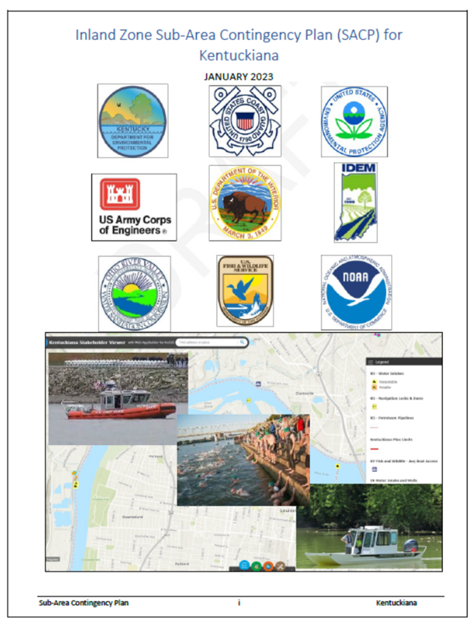
Kentuckiana Sub-Area Contingency Plan (KSACP)
Planning began just before COVID.
COVID paused.
Currently: full speed ahead
The written plan is:
Virtually complete
“River truth” of the plan is underway
Standing by for signature
Kentuckiana Sub Area is
317 Ohio River miles long
Notes:
Add a better photo in place of evolution

Slide 2
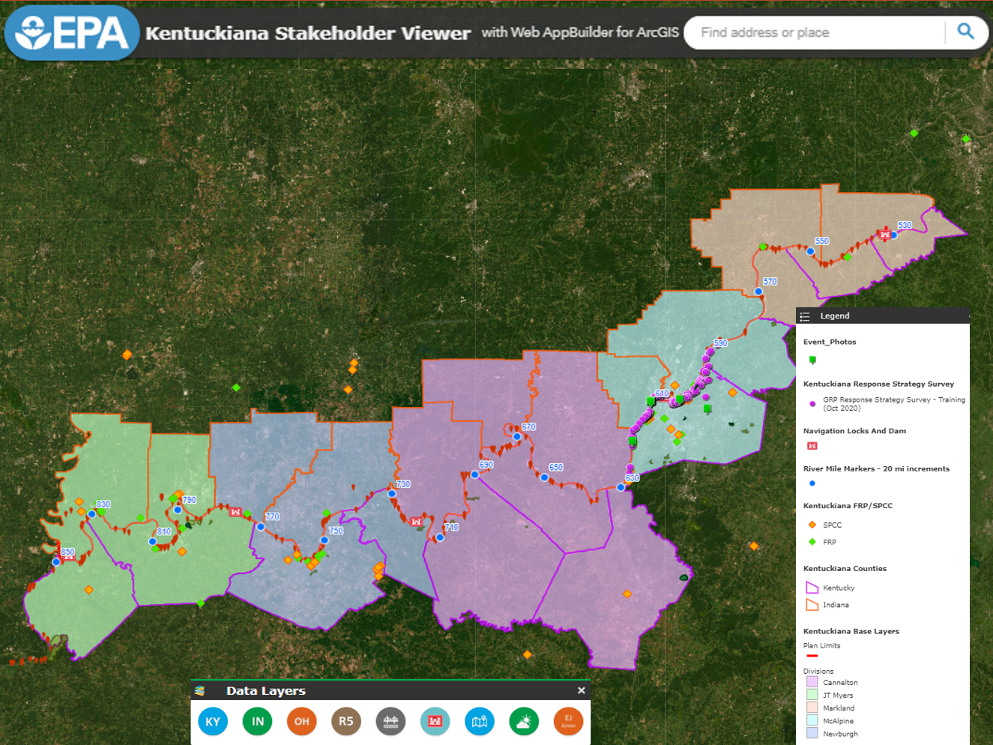
Kentuckiana Sub-Area Contingency Plan (KSACP)
Why this section of the Ohio River ?
Planning components
SAC meetings/training
Written/e-Plan
Viewer created
River verifications with stakeholders

Slide 3
KSACP AOR Visualization
Kentuckiana SACP jurisdiction borders both EPA Regions 4 and 5
Flows along the Kentucky and Indiana state border
The jurisdiction runs the length of the USACE established Ohio River mile markers of 531.5 through 848.1

Slide 4
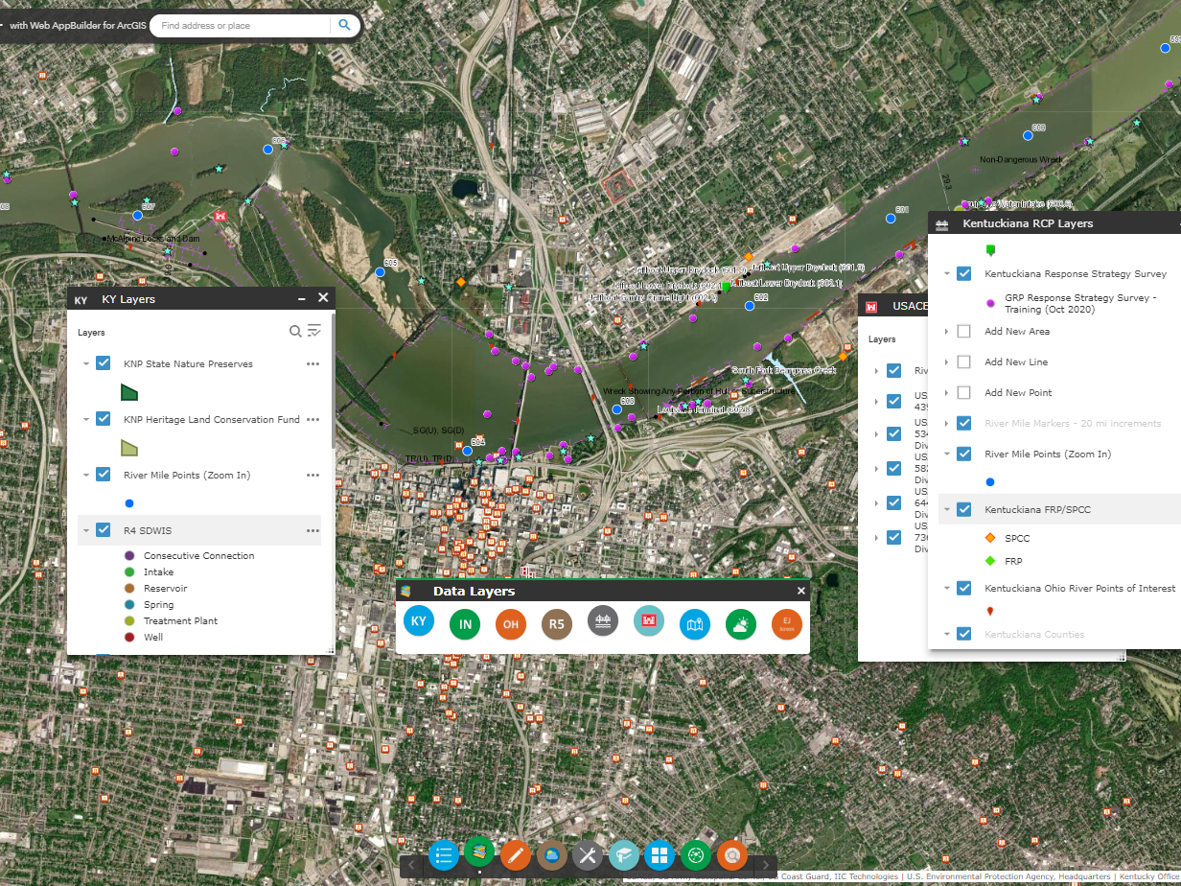
KSACP AOR Visualization
The Kentuckiana SACP
Viewer
Kentuckiana Stakeholder Viewer (epa.gov)

Slide 5
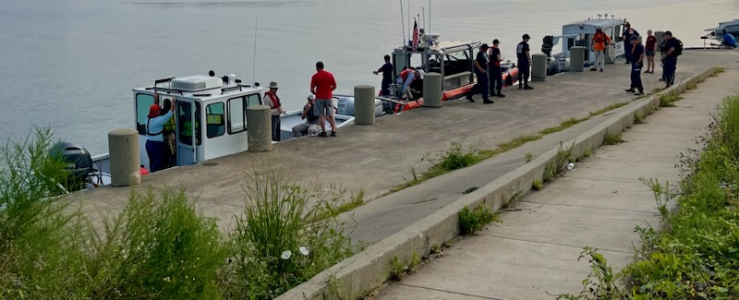
KSACP Stakeholders
Louisville, KY Metro Emergency Services
23 - bordering county EMA’s of Indiana and Kentucky
KDEP
IDEM
KYEM
IDHS
KY and IN - Fish and Wildlife Services
ORSANCO
LAIMA
CORMIG
OREC
5 - USACE Lock and Dams
17 - trafficked bridges which span the Ohio River
EPA Region 4 & EPA Region 5
USCG Sector Ohio Valley
NOAA
DOI
USFWS
Multiple industrial waterfront facilities
Multiple water and power intakes and facilities
51 - Barge Fleeting Area’s
Falls of the Ohio River State Park
Numerous State and Local park and recreation organizations

Slide 6
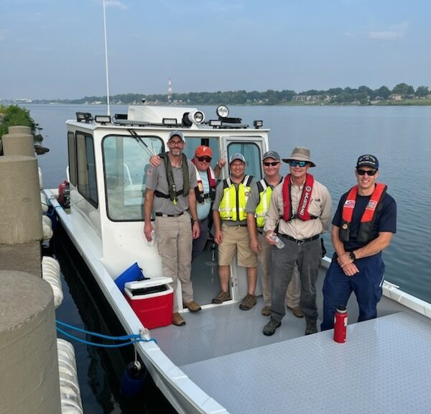
KSACP River Float
August
21-25 2023
Floated the McAlpine Division
Identified mitigation strategies
One of TBD KSACP floats completed
2nd proposed float, Cannelton Division - JT Myers Division (Owensboro - Henderson)
5 teams covered the RDB and LDB
4 days, 41 river miles: 586-627
3 vessels, 4 land vehicles, 22 field team members
Over 118 waypoints collected
ORSANCO, USCG, KDEP, and EPA

Slide 7
KSACP River Float
Data Collection
Reconnaissance of 118 Waypoints completed
10 Location Types identified
Location Type used to classify the mitigation capability of each waypoint in the KSACP Viewer
Photos, coordinates, access, hazards collected
1. Access Point | 6. Deflection Area
2. Amenities | 7. Dock/s
3. Barge Fleeting Area | 8. Marina
4. Boat Ramp | 9. Mooring Area
5. Collection Area | 10. Staging Area

Slide 8
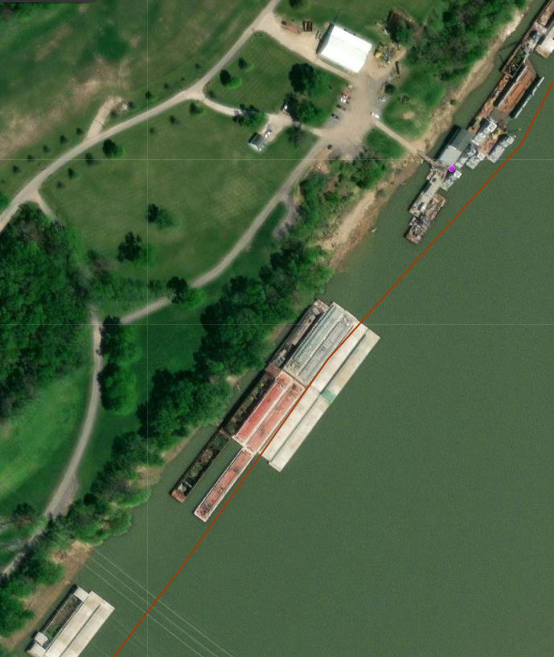
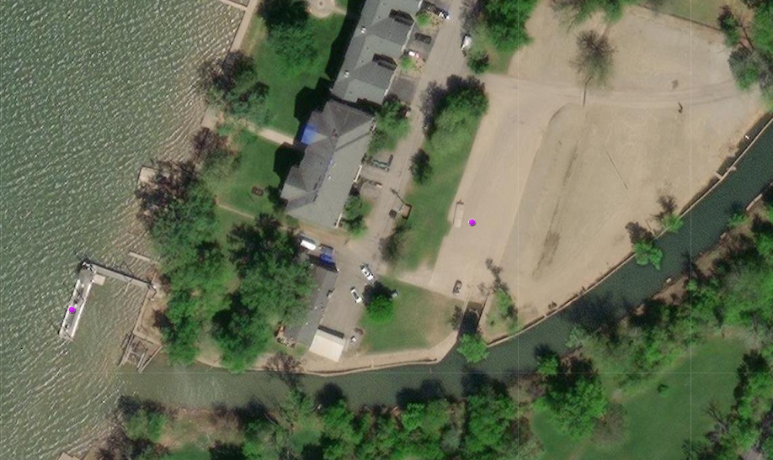
KSACP River Float
Data Collection
Type: Barge Fleeting Area.
Information: Possible containment or floating staging area. Deflection area, collection area.
Type: Amenities
Information: Dock, Fuel, Ice, Parking, restrooms. Deflection area, creek.
Notes:
Each Purple dot seen here is
1 of the 118 waypoints
where mitigation strategy data collection occurred during the River Float

Slide 9
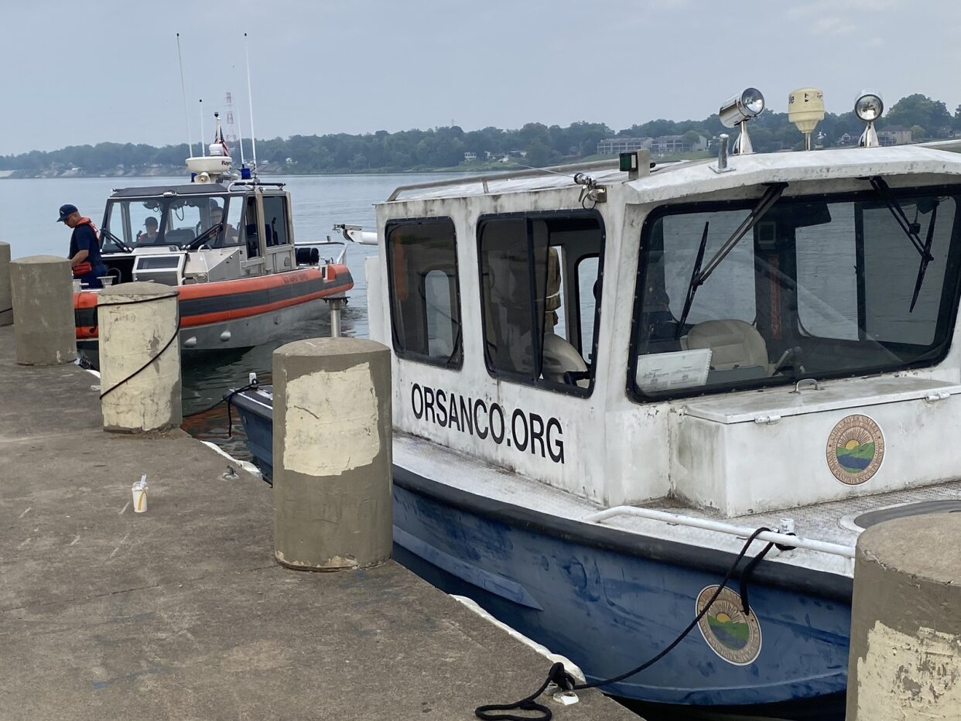
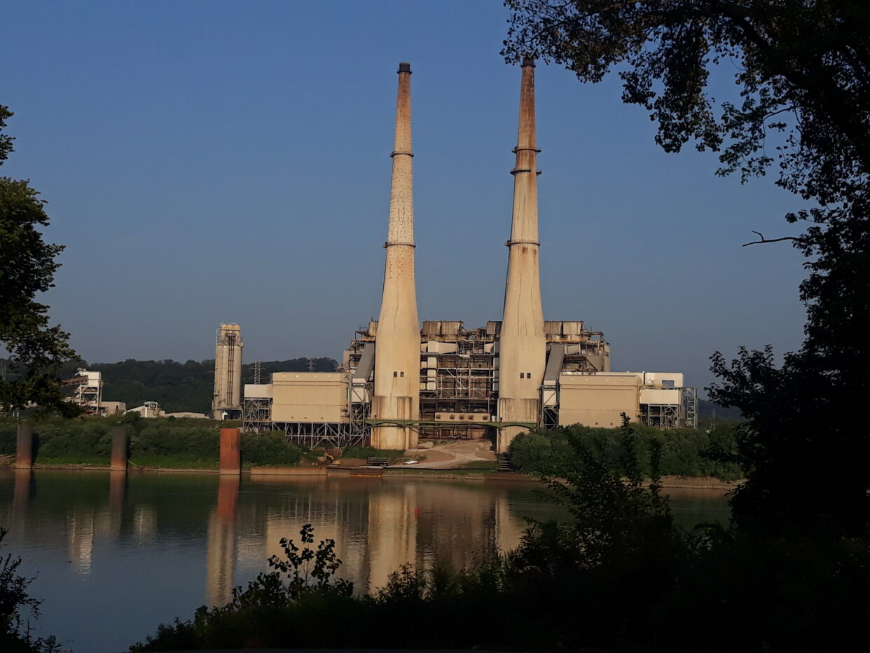
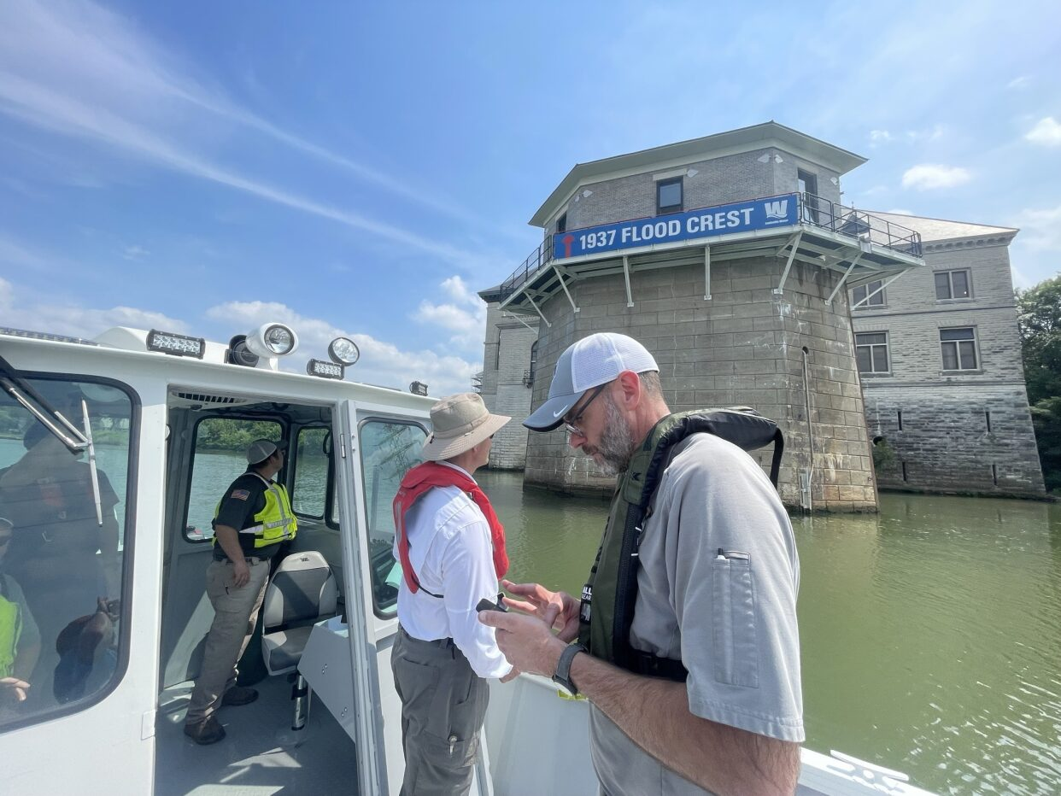
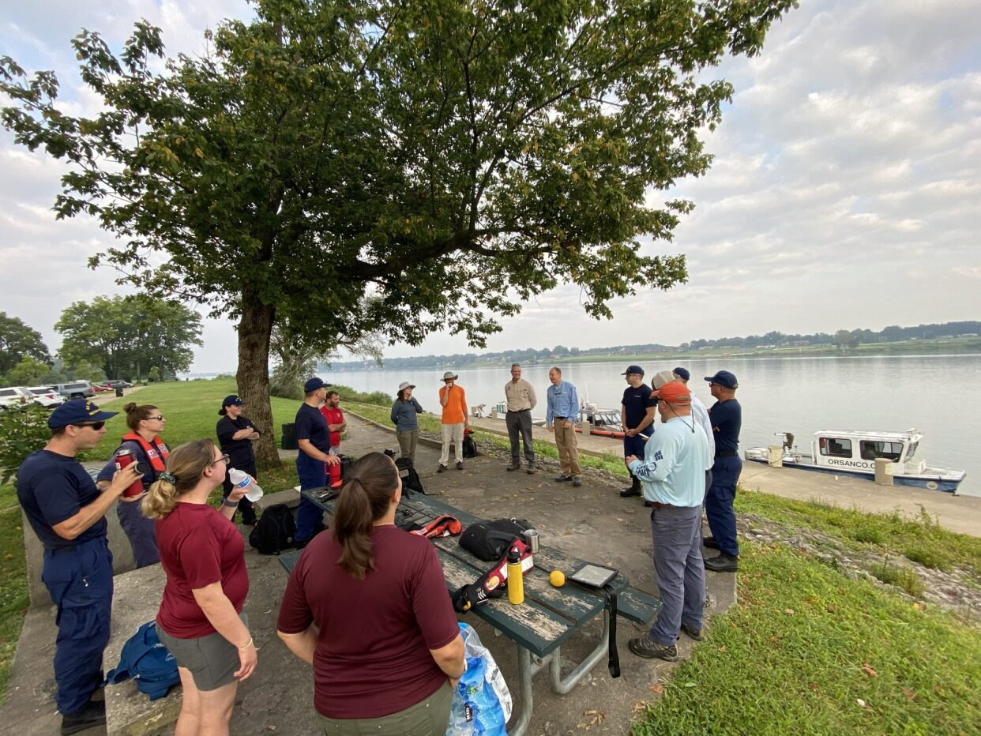
KSACP River Float
Notes:
The River Float team members utilized the GIS supporting applications, Survey 123 and Field Maps, to “collect” data points and mitigation strategies.
Survey 123 and Field Maps allowed field team users, via a iPhone or iPad to collect field information feeding the Kentuckiana Viewer application.
Users on land could use the real time data being collected and correspond back to the field team members to quality control input or converse and plan accordingly.
In review, both GIS supporting applications, Survey 123 and Field Maps, collected information from the field team members to feed the Kentuckiana Viewer

Slide 10
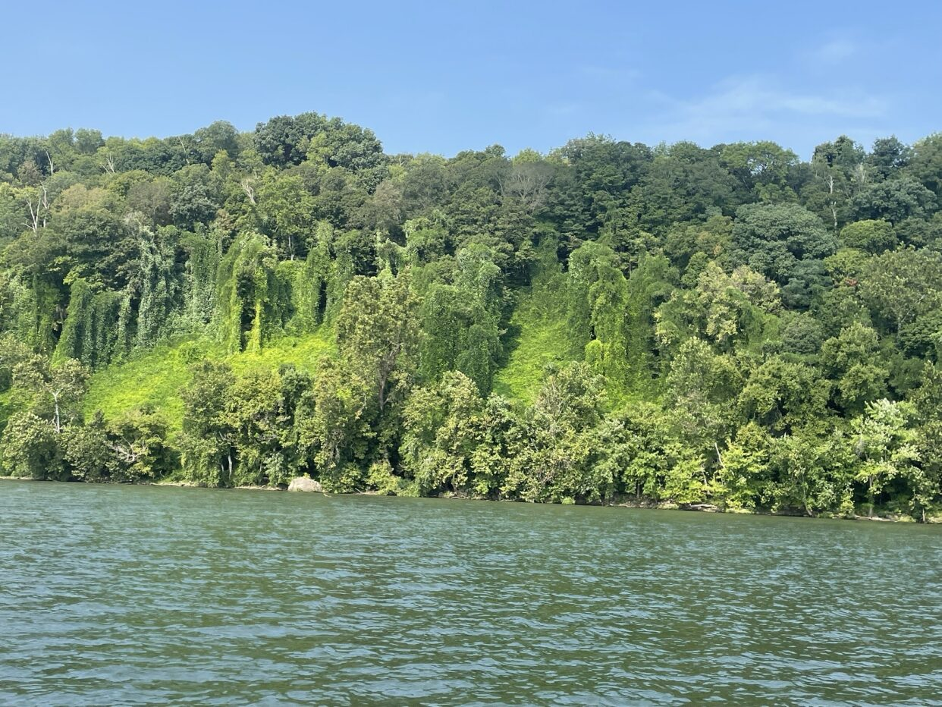
KSACP River Float
Highlights
Over 50 documented lessons learned
Maintain interagency/stakeholder teams for river floats
Planning supported operations. Maintain indoor formal OPS/SAFETY all hands meeting/training
Marine Band handheld radios were critical resources to coordinate and conduct safe operations
Generate a canned message for delivery to public or industry personnel when team is questioned
Request committee chair to send out local notice to mariners/industry a week prior to river float
More PHOTOS!

Slide 11
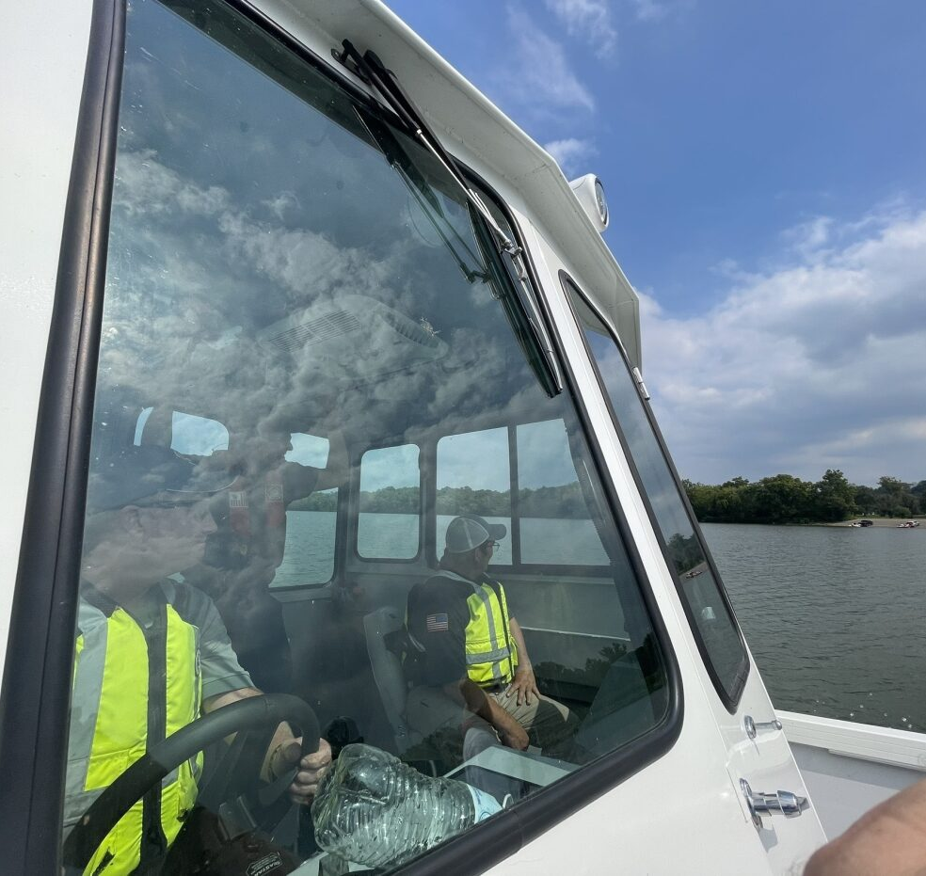
Coming up…
Validate mitigation strategies
River truthing
Virtual
Physical
Joint exercise
Sign the KSACP
Next area for planning?

Slide 12
EPA Region 4 Planner (Atlanta)
Jed Hewitt
Hewitt.Jed@epa.gov
470-813-6925

