Slide 1
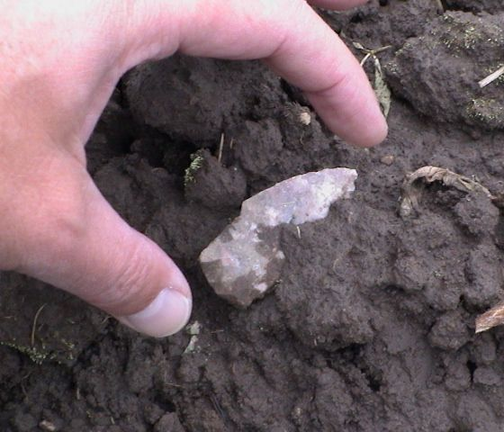
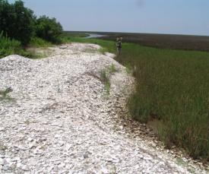
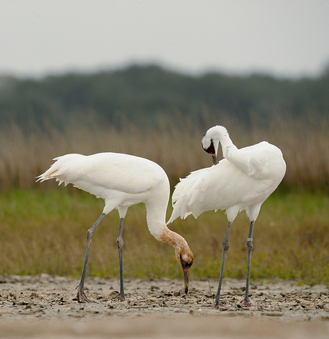
Federally Mandated Consultations for Response
National Oceanic and Atmospheric Administration
NOAA Ocean Service
Office of Response and Restoration

Slide 2
Federally Mandated Consultations
for Federal Actions
Sector Charleston FOSCr Course
8 August 2019
Brad Benggio - NOAA Scientific Support Coordinator & RRT Trustee Representative
Brad.Benggio@noaa.gov
954-684-8486

Slide 3
Purpose:
To minimize RESPONSE related impacts to high priority protected & managed resources
To ensure coordination and input from trustees and resource management agencies
To obtain authorization for “takes” if needed
To document RESPONSE related effects to determine if a formal or informal consultation will be needed at the response conclusion
To provide lessons learned that will improve response actions for the future and update the Area Contingency Plan with Best Management Practices

Slide 4
WHAT
Endangered Species Act (ESA Section 7)
Magnusen Stevens Fisheries Conservation Act (Essential Fish Habitat EFH)
National Historic Preservation Act (section 106) – administered by the State Historic Preservation Office (SHPO)
Tribal Interest administered by the Tribal Historic Preservation Office with each federally recognized tribe-Coordination thru Bureau of Indian Affairs (BIA) or the Dept of the Interior (DOI) representative to the Regional Response Team (RRT)
Native American Graves Protection & Repatriation Act – Coordinate like number 4 above.

Slide 5
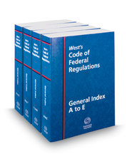
WHY?
1. ITS MANDATED by FEDERAL REGULATION

Slide 6
What are Consultations?
A discussion with a resource agency about how to carry out various activities with minimal adverse effects on the trust resources of that agency
Legally mandated under certain statutes, such as the Endangered Species Act (ESA) and the National Historical Preservation Act (NHPA)
Do no more harm than good

Slide 7
How do the Consultations Affect SCAT Activities?
Usually result in one or more guidelines, known as Best Management Practices (BMPs), which affect how SCAT activities are conducted
May drive selection of cleanup endpoints, or methods of achieving them
Potential addition of a resource specialist to the SCAT team

Slide 8
Endangered Species Act (ESA)
Administered by U.S. Fish and Wildlife Service (USFWS) and National Marine Fisheries Service (NMFS)
Consultation is required by Section 7
“Take” is prohibited by Section 9
During response, FOSC conducts an emergency consultation, in accordance with the Memorandum of Agreement (MOA)

Slide 9
What is Take?
To harass, harm, pursue, hunt, shoot, wound, kill, trap, capture, or collect, or to attempt to engage in any such conduct
By regulation, harm includes activities which significantly impair essential behavioral patterns, including breeding, feeding, or sheltering.
Also cannot destroy or adversely modify designated critical habitat

Slide 10
Best Management Practices and Conservation Measures
Developed in consultation with the individual resource management agency to guide and sometimes limit operations to minimize, reduce, or eliminate any response associated resource impacts

Slide 11
Typical BMPs to Address Listed Species Concerns for SCAT Activities
Limitations on speed of vehicles or vessels
Specific “no-entry” locations
Restrictions on hours of operation

Slide 12
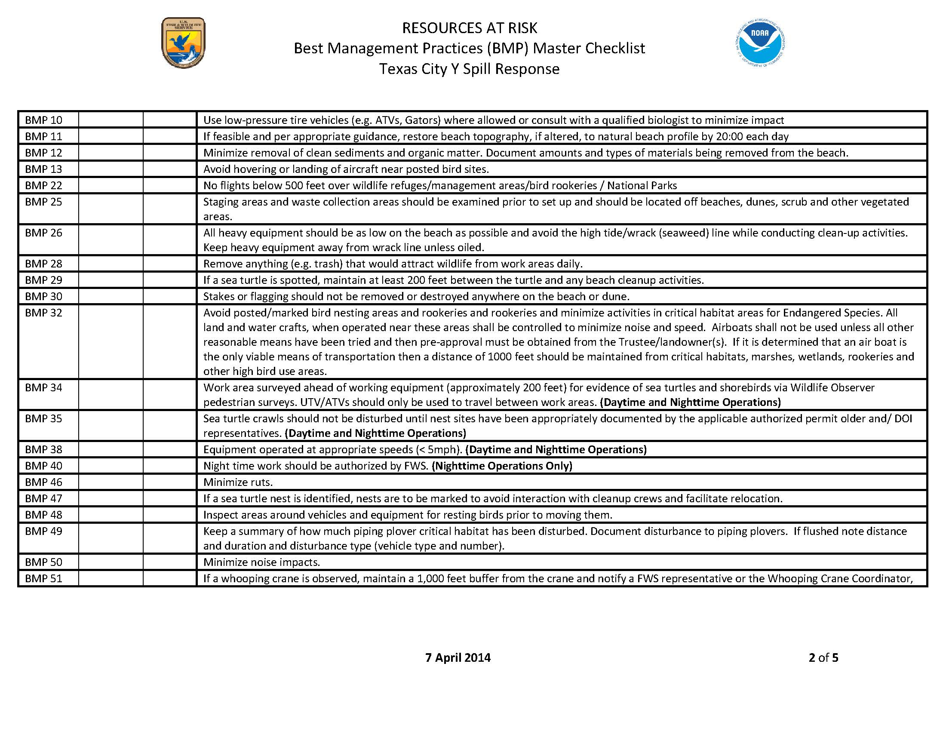
Partial Best Management Practices

Slide 13
Manatee Guidelines
To reduce potential impacts to the manatee to discountable and insignificant levels, the
Service recommends implementing the Standard Manatee Project Conditions, which are
as follows:
The permittee will comply with the following manatee protection conditions:
a. The permittee shall instruct all personnel associated with the project of the
potential presence of manatees and the need to avoid collisions with manatees.
All construction personnel must monitor water-related activities for the presence
of manatee(s).
b. The permittee shall advise all personnel that there are civil and criminal penalties
for harming, harassing, or killing manatees which are protected under the Marine
Mammal Protection Act of 1972 and the Endangered Species Act of 1973.
c. Any siltation barriers used during the project shall be made of material in which
manatees cannot become entangled and must be properly secured, and regularly
monitored to avoid manatee entrapment.
d. All vessels associated with the project shall operate at “no wake/idle” speeds at all
times while in the work area and while in water where the draft of the vessel
provides less than a four-foot clearance from the bottom. All vessels will follow
routes of deep water whenever possible.
e. If manatee(s) are seen within 100 yards of the active construction area all
appropriate precautions shall be implemented to ensure protection of the manatee.
These precautions shall include the operation of all moving equipment no closer
than 50 feet to a manatee. Operation of any equipment closer than 50 feet to a
manatee shall necessitate immediate shutdown of that equipment. Activities will
not resume until the manatee(s) has departed the project area of its own volition.
f. Any collision with and/or injury to a manatee shall be reported immediately to
Anthony Sowers of the U.S. Fish and Wildlife Service, Georgia Ecological
Services Office, Coastal Sub-office, at (912) 832-8739 ext 3.

Slide 14
Importance
THE EXTINCTION CRISIS
It’s frightening but true: Our planet is now in the midst of its sixth mass extinction
of plants and animals — the sixth wave of extinctions in the past half-billion
years. We are currently experiencing the worst state of species die-offs since the
loss of the dinosaurs 65 million years ago. Although extinction is a natural
phenomenon, it occurs at a natural “background” rate of about one to five
species per year. Scientists estimate we are now losing species at 1,000 to 10,000
times the background rate, with literally dozens going extinct every day [1]. It
could be a scary future indeed, with as many as 30 to 50 percent of all species
possibly heading toward extinction by mid-century [2].

Slide 15
1. THE ENDANGERED SPECIES ACT: A WILD SUCCESS
The Endangered Species Act is the strongest law for protecting biodiversity
passed by any nation. Its purpose is to prevent the extinction of our most at-risk
plants and animals, increase their numbers and effect their full recovery — and
eventually their removal from the endangered list.
Currently the Act protects more than 1,600 plant and animal species in the
United States and its territories, many of which are successfully recovering.
Over the past four-plus decades, the Endangered Species Act has repeatedly
demonstrated that — when used to the full extent of the law — it works. The Act
has been more than 99 percent successful at preventing extinction. Were it not
for the Act, scientists have estimated, at least 227 species would have likely
gone extinct since the law’s passage in 1973.

Slide 16
(cont)
But the Act isn’t just keeping species from extinction — it’s also helping hundreds
of species recover. A 2012 Center study documented 110 species that have
seen tremendous recovery while protected under the Act, with the great majority
meeting or exceeding recovery timelines set by federal scientists. This study built
on Center work showing that of all species listed in the northeastern United
States, 93 percent are stable or improving and more than 80 percent are meeting
the recovery targets established in federal recovery plans.
In sum, here&#39;s a handy list of key quantitative measures of the Act’s success:
• From 1973 to 2013, the Act prevented extinction 99 for percent of species
under its protection.
• The Act has shown a 90 percent recovery rate in more than 100 species
throughout the United States.

Slide 17
(cont)
The Act has allowed the designation of millions of acres of critical habitat,
which is crucial to species&; survival and recovery. In fact, imperiled species
with federally protected protected critical habitat are twice as likely to be
recovering as those without. Center for Biological Diversity fact: Just since
2008, the Center has won designation of 233 million acres of critical habitat, 95
percent of all critical habitat acres set aside between 2008 and 2013 — an area
larger than the entire national forest system (191 million acres), twice as large
as California (105 million acres), and almost three times the size of the national
park system (84 million acres).

Slide 18
(cont)
The Act has poll-proven strong public support. A national poll
commissioned by the Center in 2013 found that 2 out of 3 Americans want the
Endangered Species Act strengthened or left alone, but not weakened. More
recent polls have found even greater support, with 9 out of 10 people polled
supporting a strong Endangered Species Act.

Slide 19
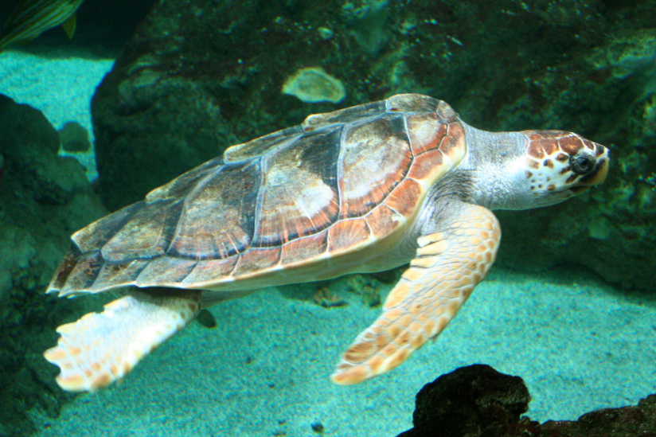
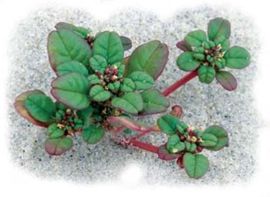
Listed Species in the Mid Atlantic On the Beach
Sea Turtles
Piping Plover
Seabeach Amaranth
Notes:
Sea Turtles – Green, Hawksbill, Kemp’s Ridley, Loggerhead, Leatherback
Marine Mammals – Sperm Whale, Manatee
Fish – Gulf Sturgeon, Pallid Sturgeon, Smalltooth Sawfish,
Corals – Staghorn, Elkhorn
Birds – Piping Plover, Whooping Crane, Northern Aplomado Falcon, Least Tern, Red cockaded woodpecker, Wood stork, Everglades snail kite, Mississippi Sandhill Crane
Reptiles – American Crocodile, American Alligator, Eastern Indigo Snake, Reticulated Flatwood Salamander, Frosted Flatwoods Salamander
Beach Mice – Alabama, Choctawatchee, Perdido Key, St. Andrews, FL Saltmarsh Vole, Silver Rice Rat, Lower Keys Marsh Rabbit, Florida Bonneted Bat
Mammals – Key Deer

Slide 20
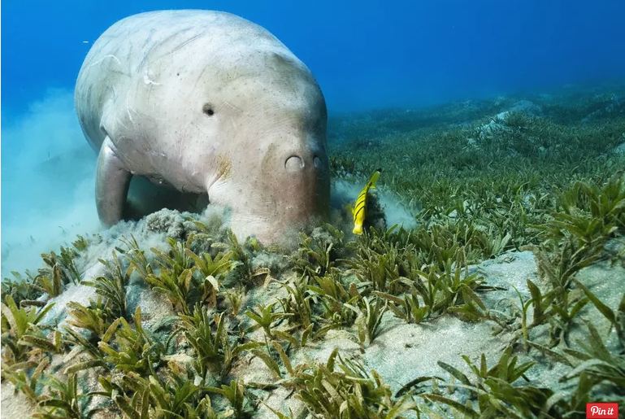
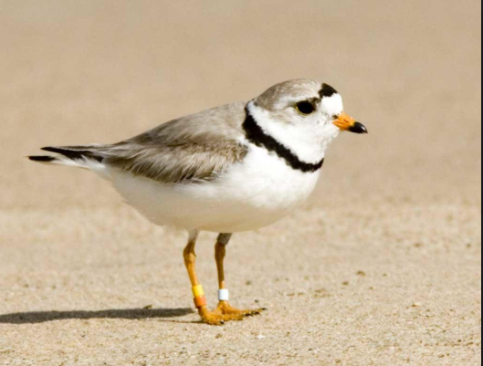

Slide 21
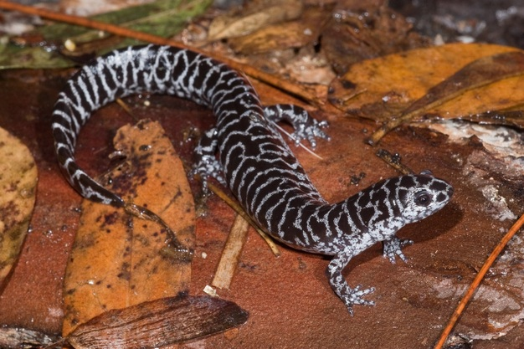
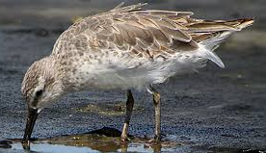
Listed Species in the Mid Atlantic In Wetlands
Frosted Flatwoods Salamander
Red Knot

Slide 22
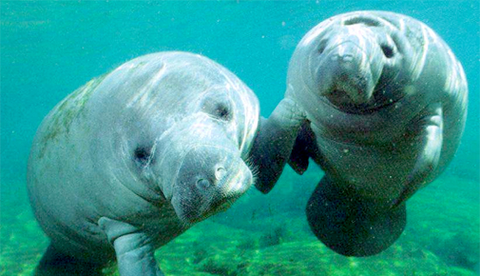
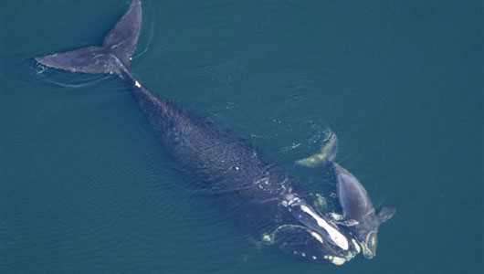
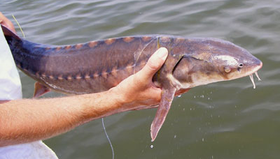
Listed Species in the Mid Atlantic In the Water
West Indian manatee
Sturgeon
Shortnose Sturgeon
North Atlantic Right Whale
Notes:
Other Species in Atlantic Coast and Caribbean
Fish – Atlantic and Shortnose Sturgeon
Whales – Northern right, humpback, fin
Johnson seagrass
Beach mice – Southeastern, Anastasia Island, Key Largo woodrat
Corals!
Birds – Caracara, Cape Sable Seaside Sparrow, Roseate Tern
Reptiles – Atlantic Salt Marsh Snake

Slide 23
Other “Critter” Statutes
Magnuson-Stevens Fishery Conservation and Management Act (MSA) – Essential Fish Habitat
Marine Mammal Protection Act (MMPA)
Bald and Golden Eagle Protection Act
Migratory Bird Treaty Act

Slide 24
2. EFH
Fish and other marine species depend on their habitat to survive and reproduce. Congress improved the nation's primary fisheries law in 1996 to recognize the importance of healthy habitat for commercial and recreational fisheries.
Protecting and restoring Essential Fish Habitat (EFH) has helped to maintain productive fisheries and rebuild depleted fish stocks in the United States. NOAA Fisheries has used EFH authorities to support the $200 billion U.S. fishing industry while protecting more than 800 million acres of habitat. Our economy and fishing industry benefit from sustainable fisheries supported by productive habitats that provide high-quality seafood.

Slide 25
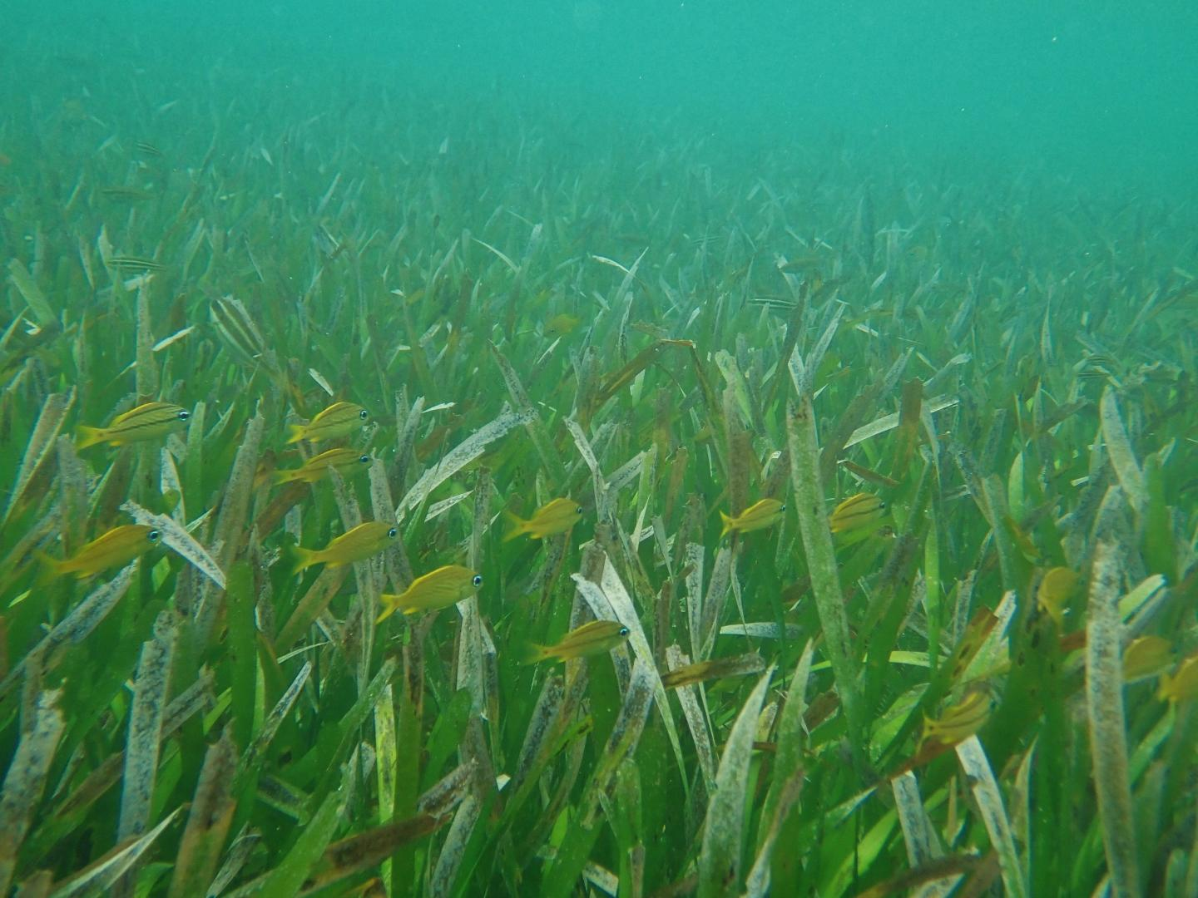
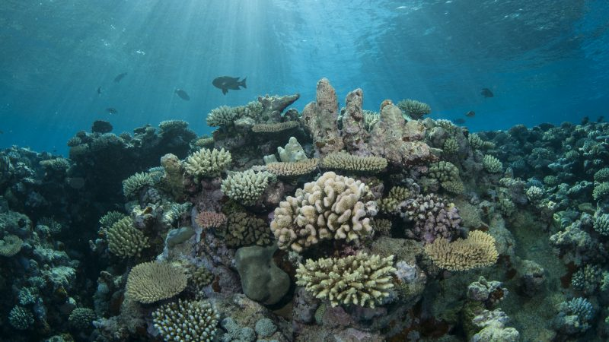

Slide 26
National Historical Preservation Act (NHPA)
Protects historical properties, cultural resources, and artifacts
Under Section 106, Federal agencies must consult on undertakings which might affect historical properties
Consultation is technically with the Advisory Council on Historic Preservation, but in practice carried out with State Historic Preservation Officer (SHPO) or Tribal Historic Preservation Officer (THPO)

Slide 27
Important Notes
Like ESA, there is a Memorandum of Agreement covering emergency consultations for response activities
Many sites are unsurveyed, and/or the specific location is not publically available

Slide 28
3. National Historic Preservation Act, Section 106, Tribal Interests (THPO), NAGPRA
Section 106 requires Federal agencies to take into account the effects of their undertakings on historic properties
and to provide the Advisory Council on Historic Preservation (ACHP) with a reasonable opportunity to comment.
In addition, Federal agencies are required to consult on the Section 106 process with State Historic Preservation
Offices (SHPO), Tribal Historic Preservation Offices (THPO), Indian Tribes (to include Alaska Natives) [Tribes], and
Native Hawaiian Organizations (NHO).
What are historic properties?
Historic properties are any prehistoric or historic districts, sites, buildings, structures, or objects that are eligible
for or already listed in the National Register of Historic Places. Also included are any artifacts, records, and
remains (surface or subsurface) that are related to and located within historic properties and any properties of
traditional religious and cultural importance to Tribes or NHOs

Slide 29
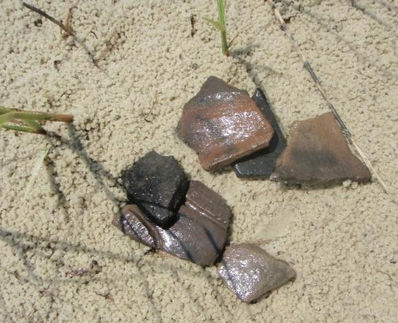
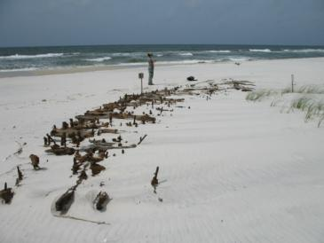
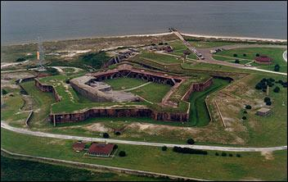
What NHPA Covers
Artifacts
Historical districts or structures
Shipwrecks
Funeral objects or grave sites
Pre-contact sites

Slide 30
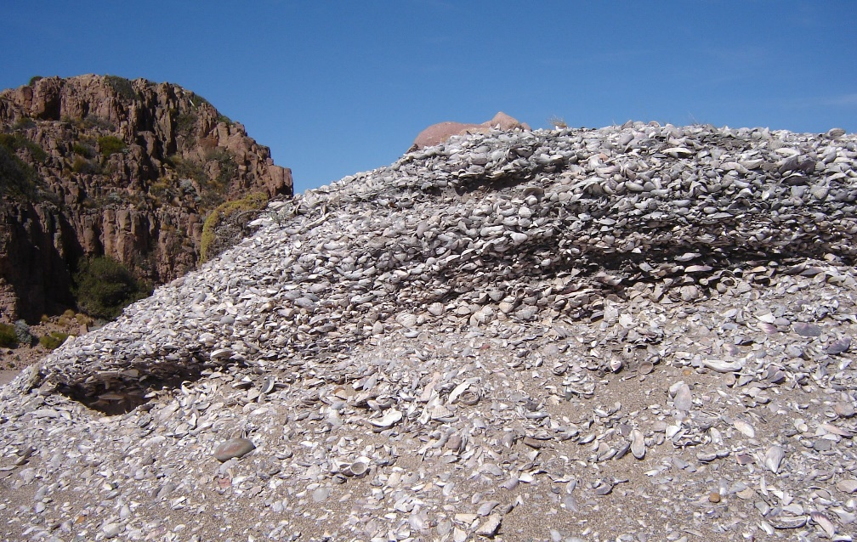
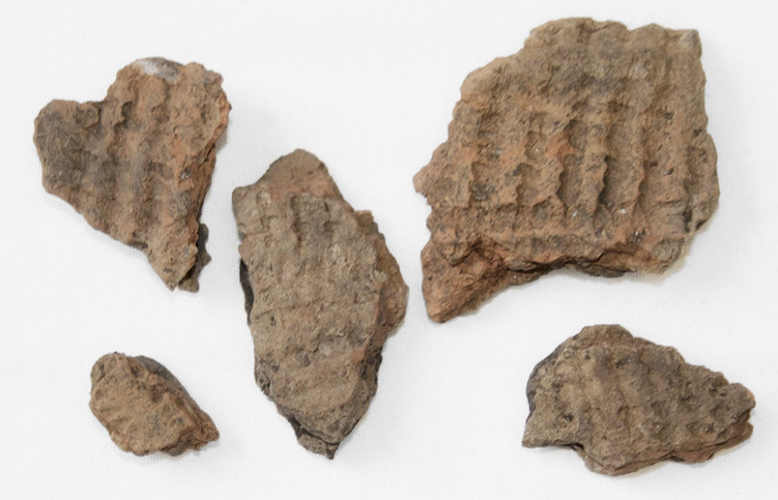
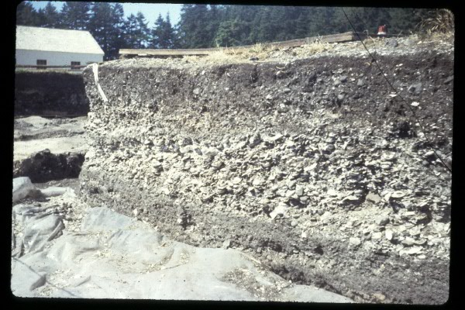
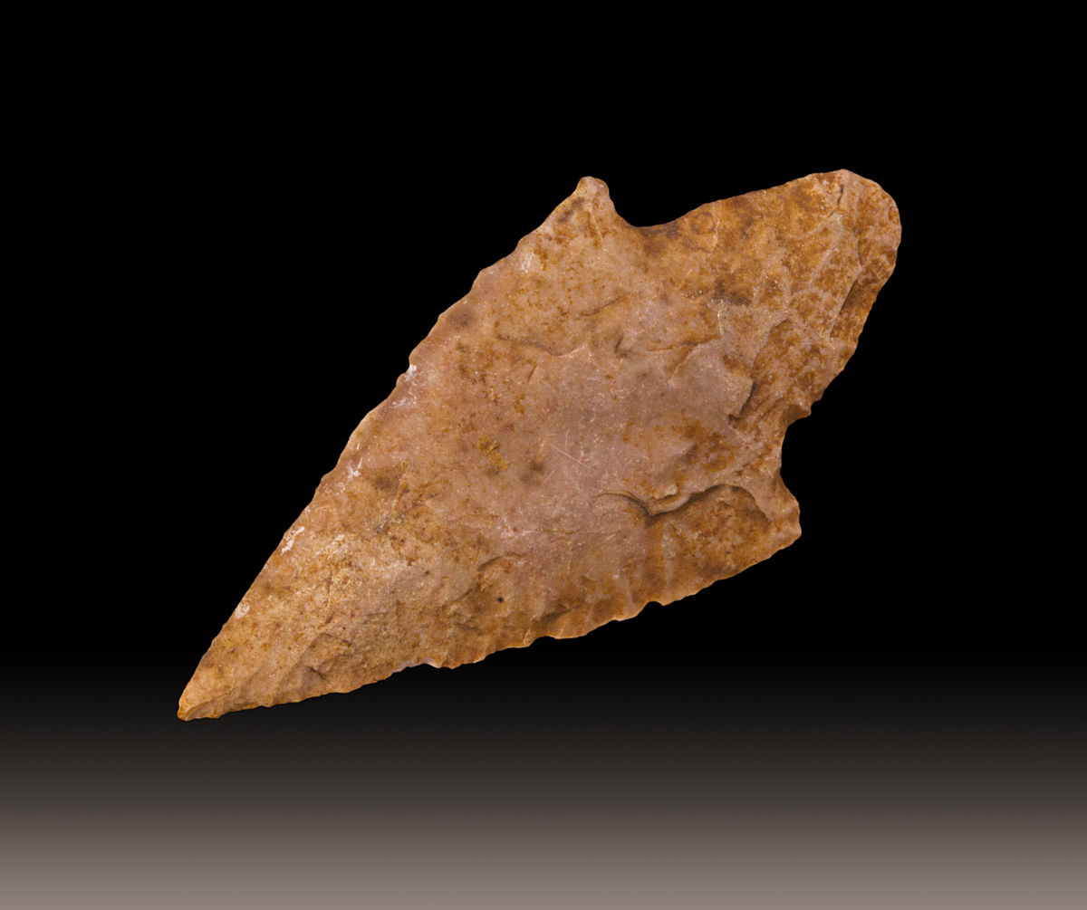
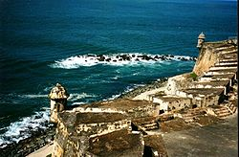

Slide 31
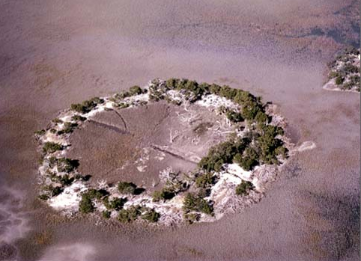
Pre-Contact Sites
Fig Island. Aerial View of Shell Ring. Edisto Island, S.C.
Notes:
Example of pre-contact site in the Florida Everglades

Slide 32
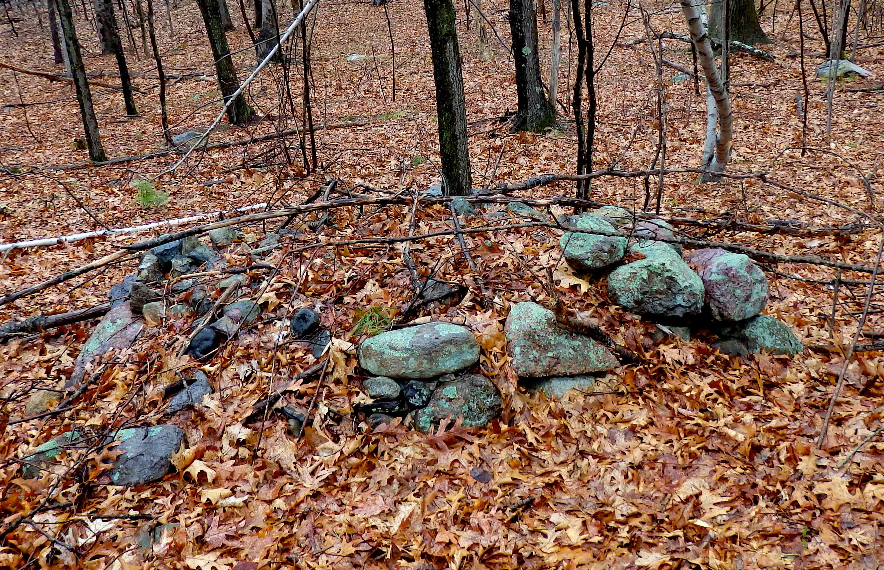

Slide 33
Typical Section 106 Recommendations
No Known Cultural Concern – Work can proceed without monitoring.
Potential Cultural Concern – Archeological survey required before work can proceed.
250 Meter Sensitivity Zone – Work area within 250 m of known cultural resource requires on-site monitoring
If objects not previously known to exist are discovered,
stop work, and report to SCAT Coordinator.

Slide 34
Typical BMPs to Address Historical & Cultural Concerns for SCAT Activities
Specific “no-entry” locations
Limitations on areas where pits or trenches can be dug
Seasonal access restrictions

Slide 35
Tribal Consultations
Interaction with Federally-recognized Tribes is a nation-to-nation interaction
Although Tribes may not currently own or occupy the land, they may still have historical or cultural interests
Currently, no established procedure for coordination during response
DHS Policy – Solicit input, notify, incorporate input, communicate decisions

Slide 36
Authorities
Tribal matters administered by Department of Interior
Federally Recognized Indian Tribe List Act of 1994, 25 U.S.C. 479a
Currently 566 recognized tribes, 2 in South Atlantic coastal areas
FL 2
Administered by several different agencies within Bureau of Indian Affairs

Slide 37
Take Home Messages
Be aware of species and/or artifacts possibly present in survey area
Comply with Best Management Practices (BMPs) if provided
Communicate if BMPs make work unsafe or impractical
Report any new sightings
Document compliance and/or take

Slide 38
EMERGENCY CONSULTATION FOR ENDANGERED SPECIES AND
ESSENTIAL FISH HABITAT
This form is intended for documentation of emergency consultation with the National Marine
Fisheries Service (NMFS) for:
- species listed as endangered RU WKUHDWHQHG under the Endangered Species Act (ESA),
- critical habitat designated under the ESA, and
- fishery habitat designated as essential fish habitat (EFH) under the Magnuson-Stevens Fishery
Conservation and Management Act (MSFCMA).
This form is intended to initiate contact and streamline consultation when emergency spill response
activities may adversely affect ESA listed species or designated critical habitat or habitats
designated as EFH.
Emergency Contact: nmfs.ser.emergency.consult@noaa.gov
­ NMFS ESA and EFH biologists may be contacted by telephone:
For ESA concerns: Protected Resources Division at (727) 824-5312
For EFH concerns: Habitat Conservation Division at (727) 824-5317
NOTE: These numbers are RQO\ staffed GXULQJ RSHUDWLQJ KRXUV.
­ NMFS should be contacted as soon as possible.
­ Consultation may be completed by email or telephone however this document details the
necessary guidance and information to initiate consultation and receive a written response.
­ NMFS will be available for further coordination and consultation as requested.
­ The responding agency should implement any conditions of pre-approved response methods
until NMFS provides further recommendations.

Slide 39
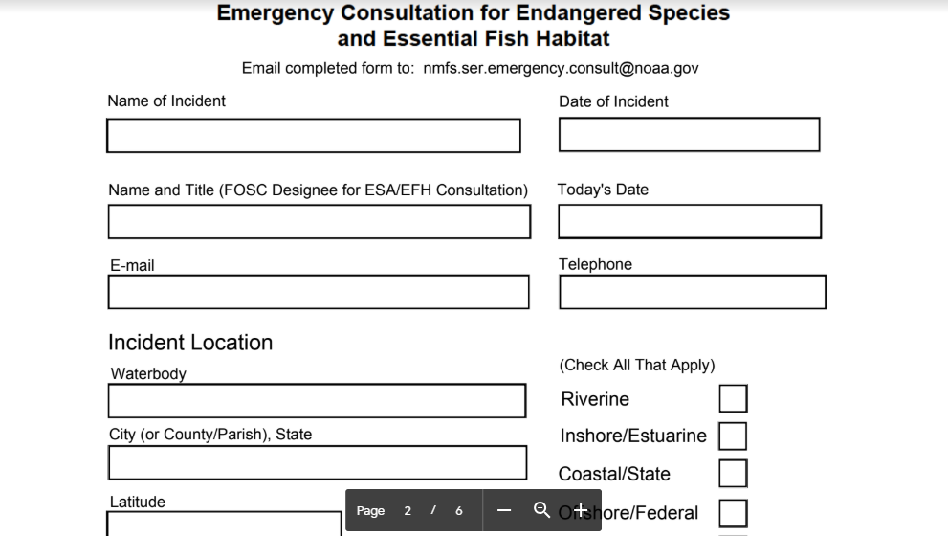

Slide 40
https://www.habitat.noaa.gov/protection/efh/efhmapper
The purpose of this interactive, online mapping application is to provide the public and other resource managers an interactive platform for viewing a spatial representation of EFH, or those habitats that NMFS and the regional fishery management councils have identified and described as necessary to fish for spawning, breeding, feeding or growth to maturity.

Slide 41
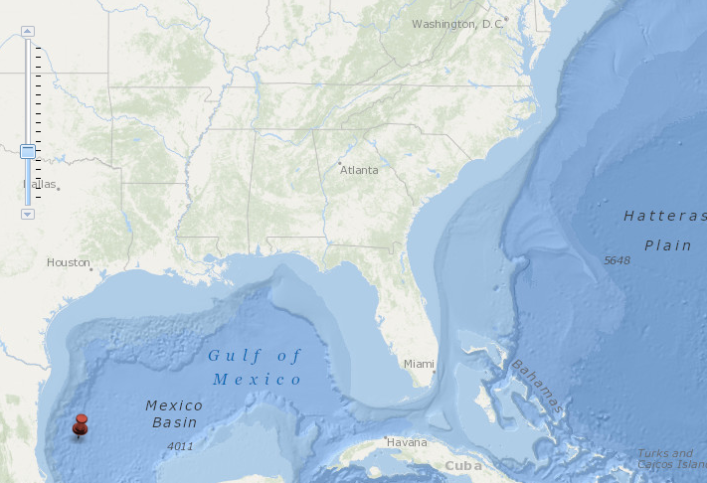
EFH QUERY TOOL

Slide 42
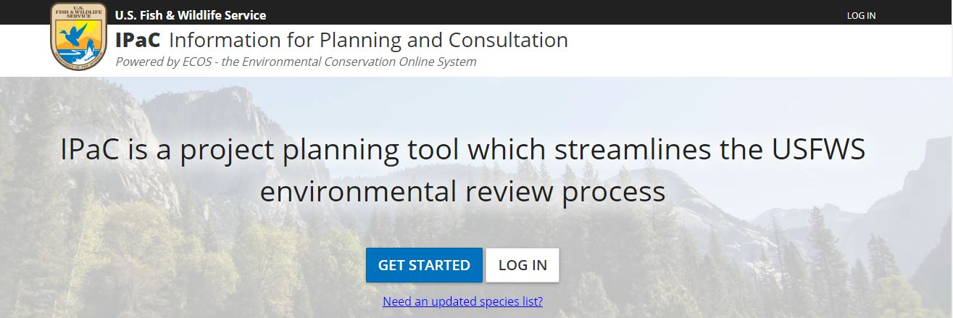

Slide 43
Who does the Consultations?
Consultations are the responsibility of the Federal action agency, as represented by the Federal On-Scene Coordinator (FOSC)
In a response, typically are delegated to the Environmental Unit, with assistance from the SSC
Depending on size of response, appropriate resource agency representatives may be on-scene
REMEMBER: Consultation is for the RESPONSE ACTIONS-NOT the INCIDENT that necessitates a response.

Slide 44
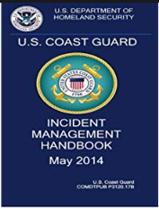

Slide 45
Command Staff.
1. Legal specialist. 2. Senior Enlisted Technical Specialist. 3. Senior CG Auxiliary Technical Specialist. (Recommended when 15 or more CG Auxiliary members/units are activated to support the incident). 4. Chaplain. 5. Sexual Assault Response Coordinator. Volunteer Coordinator. 7. Scientific Support Coordinator. 8. Source Control Support Coordinator. 9. NIMS/National Response Framework (NRF) Technical Specialist.

Slide 46
SSC Role Coordinating Consultations
From IMH
F. Facilitate in the Endangered Species Act consultation process. G. Develop a prioritized list of resources at risk, including threatened and endangered species, in conjunction with Natural Resource Trustee Representatives and the FOSC’s Historical/Cultural Resources THSP

Slide 47
Key Contacts for Coordinating Consultations
ESA-NOAA Trustee Representative (SSC), NMFS protected Species Division
ESA-DOI RRT Representative, USFWS
EFH- NOAA Trustee Representative (SSC), NMFS Habitat Conservation Division
NHPA- DOI RRT Representative, SHPO
THPO & NAGPRA –DOI RRT Representative, Bureau of Indian Affairs, Affected Federally Recognized Tribes

Slide 48
Other Resource Coordination Requirements
Migratory Bird Act
National Marine Sanctuary Act
Marine Mammal Protection Act
Special Managed Areas
etc

Slide 49
Permitting Considerations
USACOE-any impacts to navigable waterways, water bottoms, wetlands
States-Varies, habitat, wetlands impacts, etc
NMS-Impacts to their managed resources/coral, seagrass, wetlands, etc
Other Special Managed Areas, sanctuaries, preserves, parks, etc

Slide 50
CLOSEOUT PROCEDURES
As a conclusion to the consultation process, the FOSC is providing notification that the response was completed in accordance with the emergency consultations (use (a) or (b)).
There were no response associated incidents resulting in a take of protected species or reportable impacts to critical habitat requiring a formal consultation.
The following removal operation(s) resulted in an incident requiring a formal consultation as indicated in the branch specific “Operational Activity Transition Memorandum” and as described below:

Slide 51
For More In Depth Reading on the Subject of Consultations:
Addressing the Uncertainty and Requirements for Oil Spill Response Consultations
A comprehensive paper presented at IOSC 2014
By Benggio et al
https://ioscproceedings.org/doi/abs/10.7901/2169-3358-2014.1.1881

Slide 52
QUESTIONS?

