Slide 1
CSX Hazmat Response
2023

Slide 2
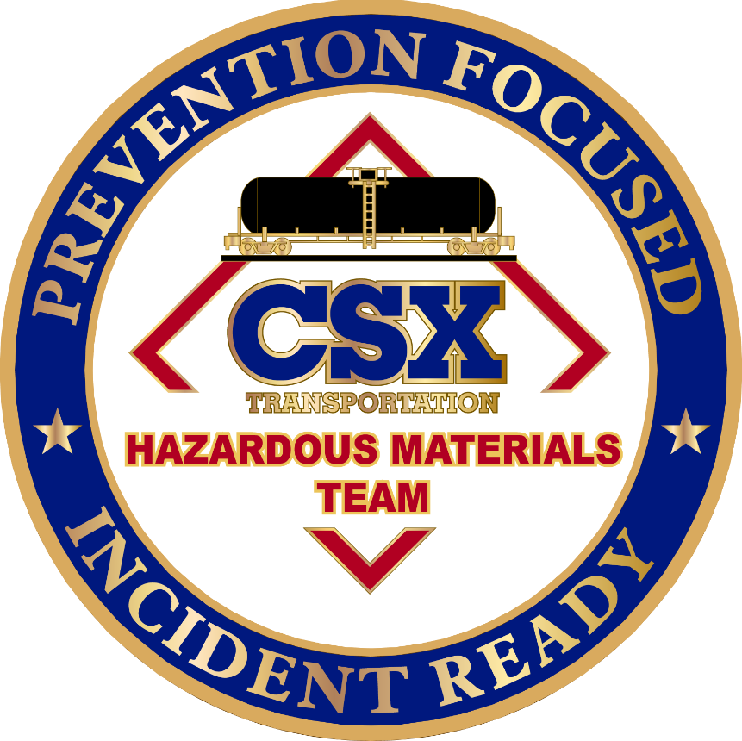
Introduction
Presenter
Ryan Godsey / James Courtney

Slide 3
CSX Network
CSX Network Reaches Nearly Two-thirds of the U.S. Population
Approximately 21,000 route miles across 26 states, including the District of Columbia
Most advanced intermodal terminals in North America
Connection to 240+ short line partners and 70+ port terminals
Reliable service with transparency through Trip Plans
# OF EMPLOYEES
CARLOADS
CAPITAL INVESTMENT
22,500+
3.3M
~$1.8B

Slide 4
Common carrier Obligation
Key Takeaways
The safest way to move hazmat over land, freight railroads are legally required to transport this commodity under a common carrier obligation
Safety efforts have significantly decreased the hazmat accident rate
Railroads have limited control over hazmat transportation decisions
True costs and risks are not fully reflected in shipping rates
Railroads move large quantities of Hazmat, including fertilizers, ethanol, crude oil, refined petroleum and chlorine
Railroad has invested enormous resources to ensure the movement is safe
Aspirations to eliminate accidents and incidents altogether
More than 99.9% of all hazmat reaches its destination without incident.
Source: Association of American Railroads
Notes:
Loads of Chlorine and Ammonia are fewer and fewer each yard
94% of accidents involving hazardous material are on the highway

Slide 5
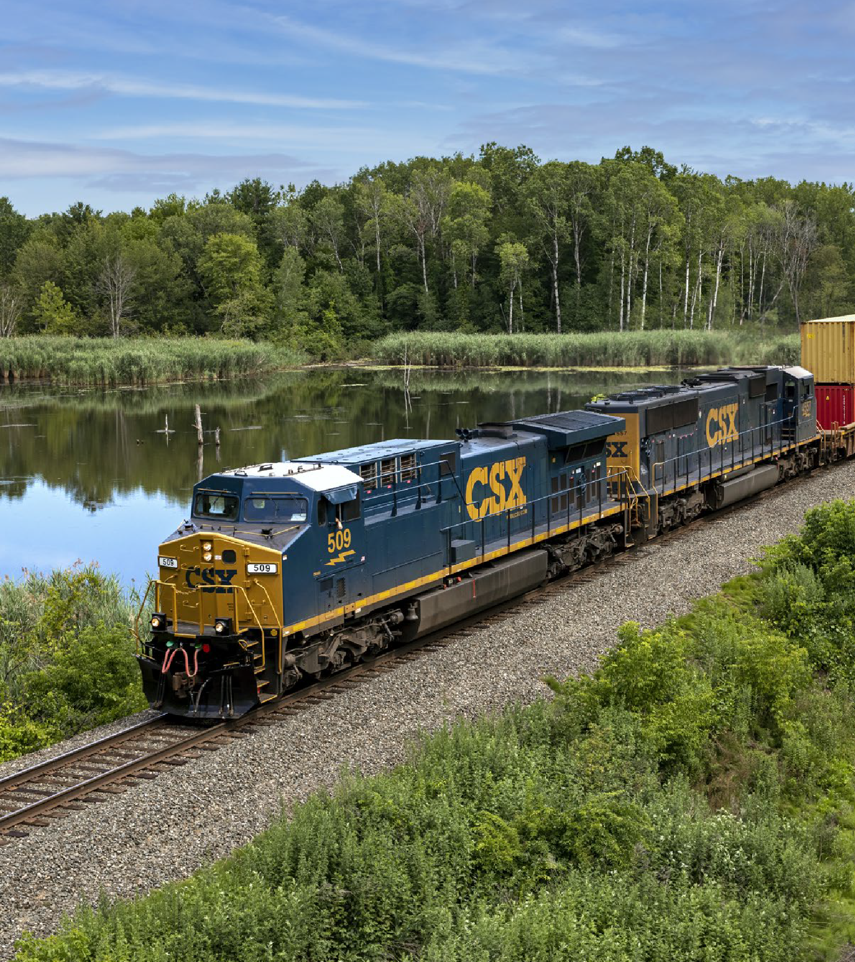
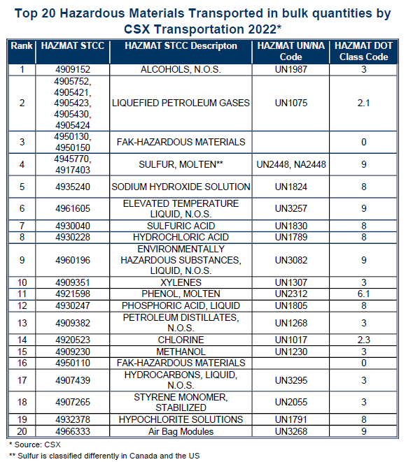
Top 20 Hazmat Materials Moved on CSX Network

Slide 6
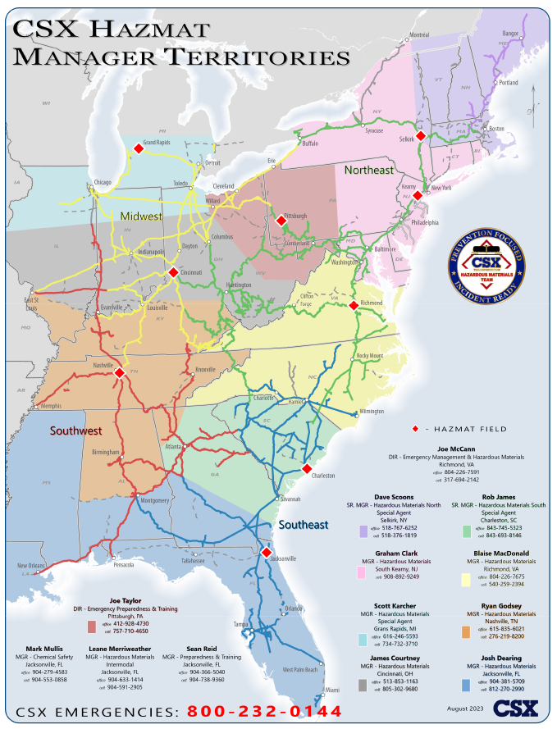
Preparedness
Hazardous Materials Team
11 Hazardous Materials Managers
Actively engages with first responders, emergency managers, and regulatory authorities to perform training & outreach
Respond to incidents
Hazmat railcar compliance
Engage with customers
3 Chemical Safety and Preparedness & Training Managers
“Behind-the-scenes”
Support field-managers
Manage training assets and programs
Regulatory compliance
Notes:
Photo is of Lynchburg, VA 2015

Slide 7
Preparedness
Industrial Hygiene Team
Work with Hazmat Team for TestNet Air Monitoring and Tech Support
Annual training with TestNet contractors
Team is designed to be scalable
Under ICS – Safety Officer (can work parallel with Coast Guard)
Work in tandem with Site Safety Officers
Manages Health and Safety Plans
Prepared to deploy and manage 3rd party Air Monitoring / Toxicology support
Monitor the worksite and community, when needed

Slide 8
Preparedness
Risk Management Team
24 Field Managers
On-call 24/7
Respond to:
Crossing accidents
Trespasser strikes
Derailments and crisis situations
Notes:
Photo is of Lynchburg, VA 2015

Slide 9
Response
Public Safety Coordination Center (PSCC)
800-232-0144 x1 (emergencies)
Initial POC for all railroad personnel & First Responders
Can shut down tracks / Alert Train Dispatchers
Coordinates information sharing among:
Train Dispatchers
911 Operators
First On-scene Personnel
CSX Hazmat Team
CSX Risk Management Team
CSX Corporate Communications
Can provide Train Consist & Car info

Slide 10
Response
Local First Responders
CSX PSCC / Local 911
Will typically get notified first by train dispatchers or citizens
Local 9-1-1
Initiates local responders
Notifies the railroad
PSCC
Gathers any available train information / documentation
Notifies Local 9-1-1
Can provide train consist / standing order
Makes initial internal notifications

Slide 11
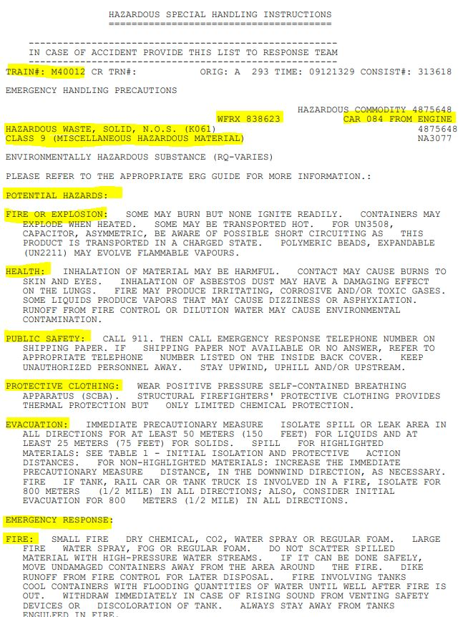
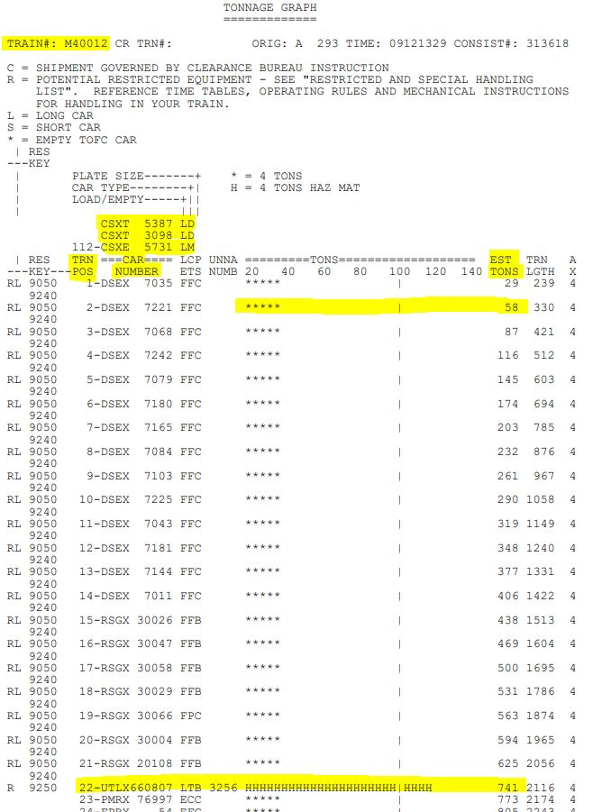
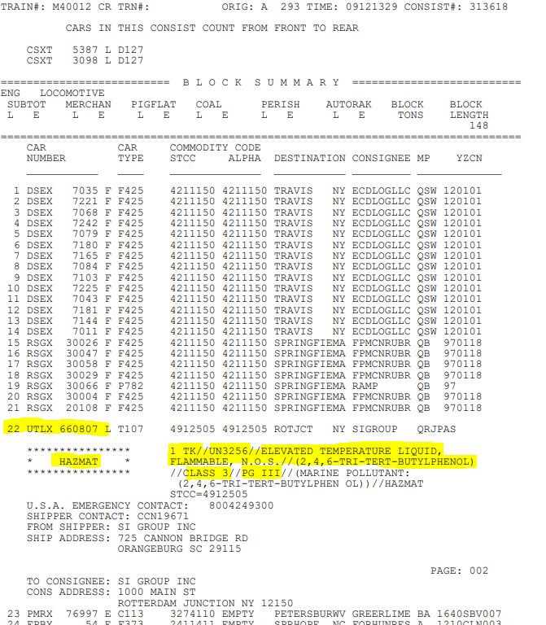
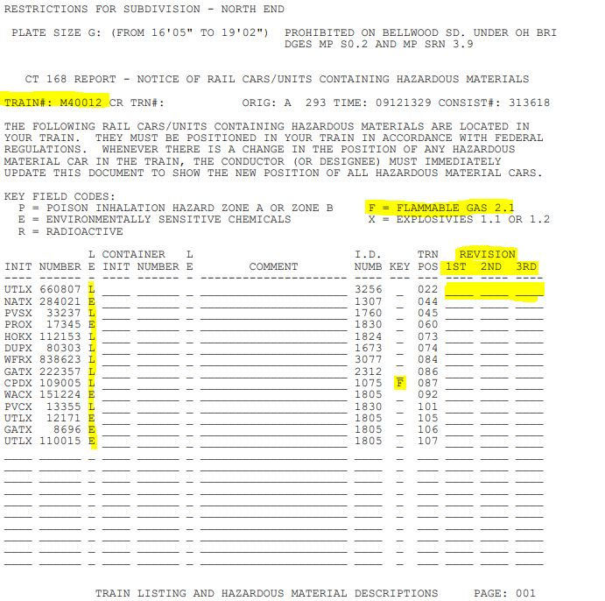
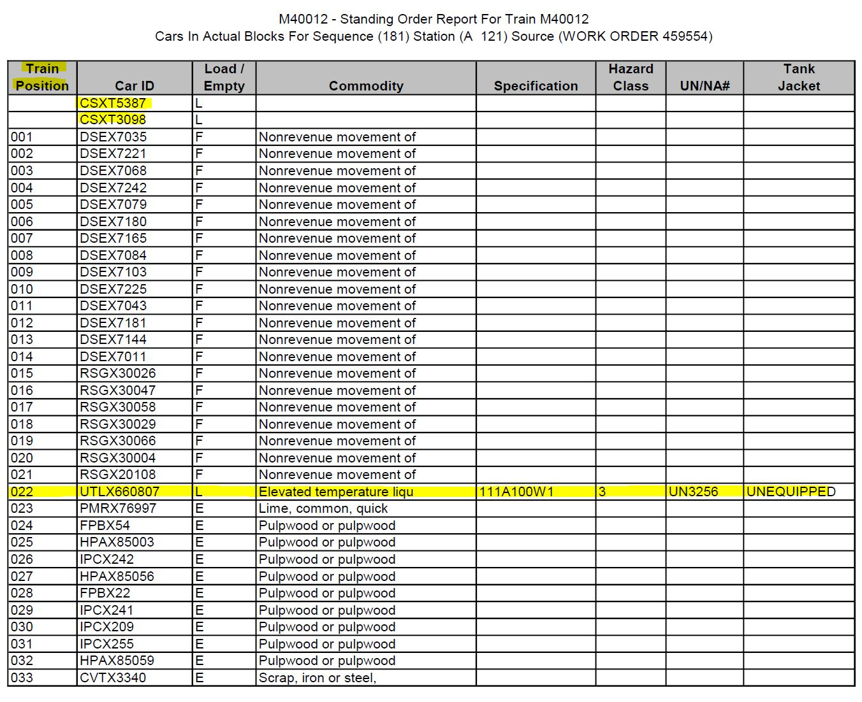
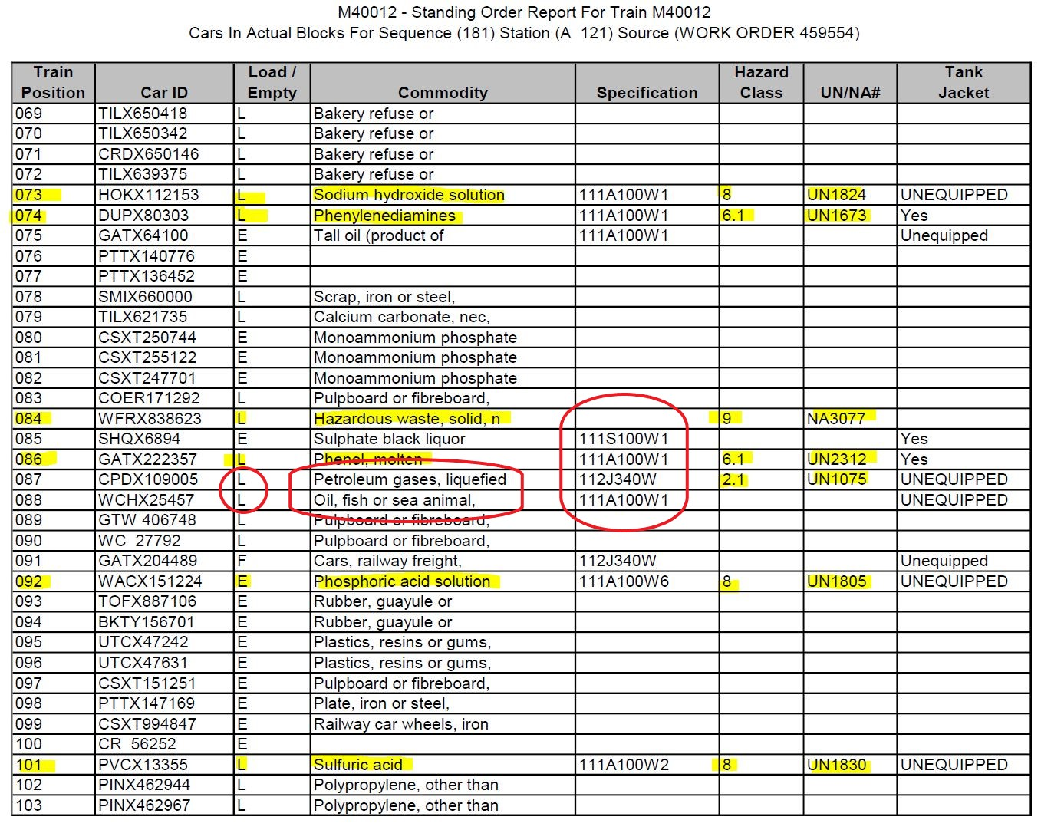
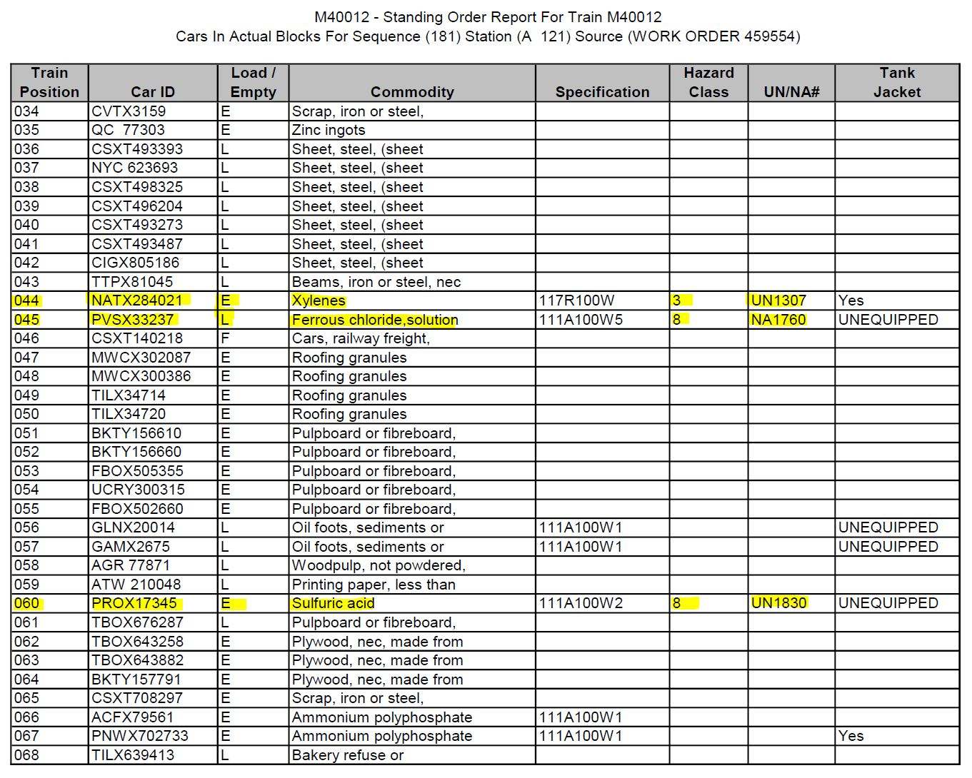
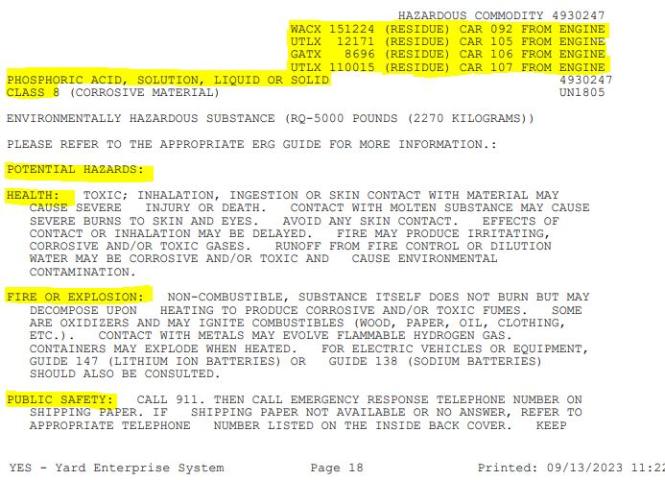
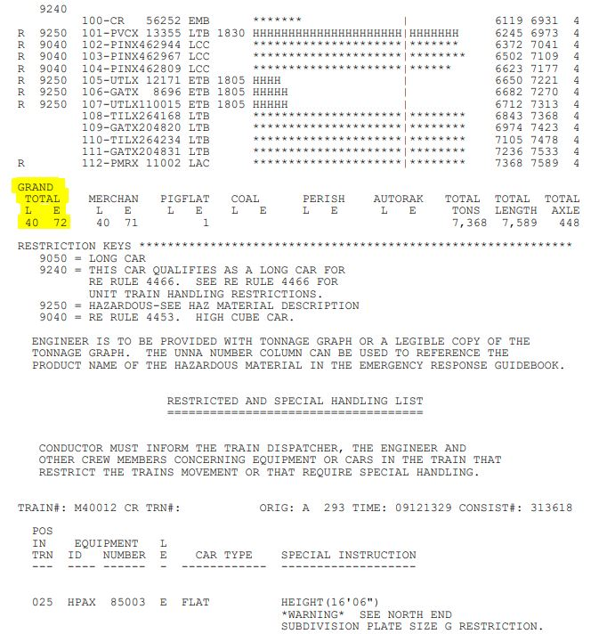
Response
Train Documents
CSX PSCC can provide 911 dispatch with train and car info
Can be Emailed or Faxed
Consist
Electronic record, most recent wheel report of cars & positions in train
Identifies HazMat and safety info
Standing Order
Easy to read list of what is on the train
Lacks HazMat details provided in the consist
Notes:
Consist:
Page 1 – Introduces Train ID, Locomotive ID’s, with DP Loco at position 112, How to tell if loaded/empty, how to identify HM cars
Page 2 – Shows again how to tell if cars are loaded/empty and HM or not. How many loaded/empty cars in consist, and total cars in train
Page 3 – CT 168 report, Key field codes, and shows every HM car and location on the train. Review position revision area
Page 4 – Block summary with Hazmat commodity info for each car
Page 5 – Hazmat Special Handling Instructions for each type of hazmat on the train
Page 6 – Illustrates how there is more than one car carrying the same commodity, and it’s position in train.
Standing Order
Page 1 – Shows basic info in a spreadsheet form
Page 2 – How to identify Hazmat cars among all the others
Page 3 – How to identify a non-haz tank car

Slide 12
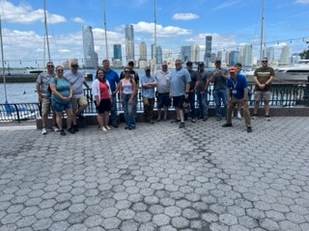
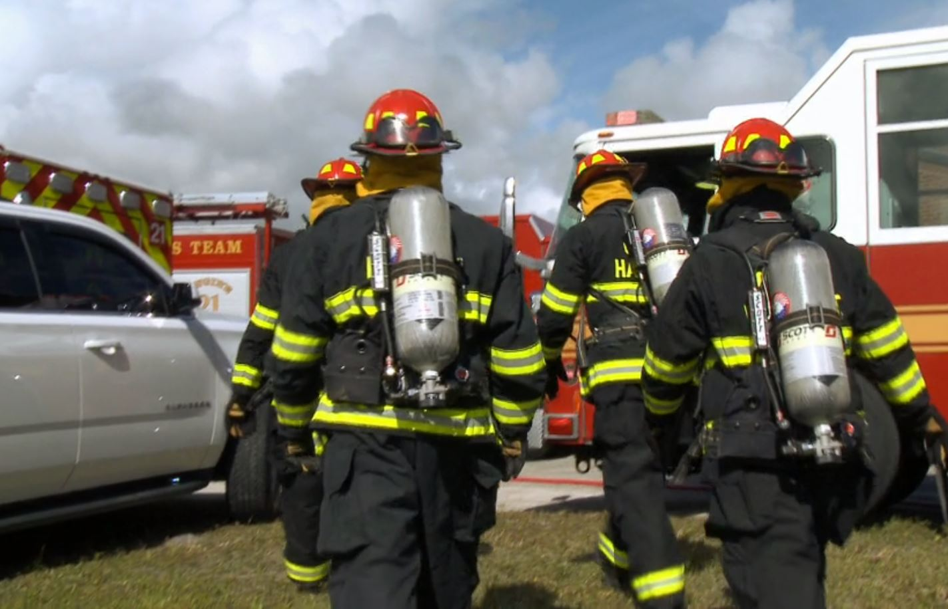
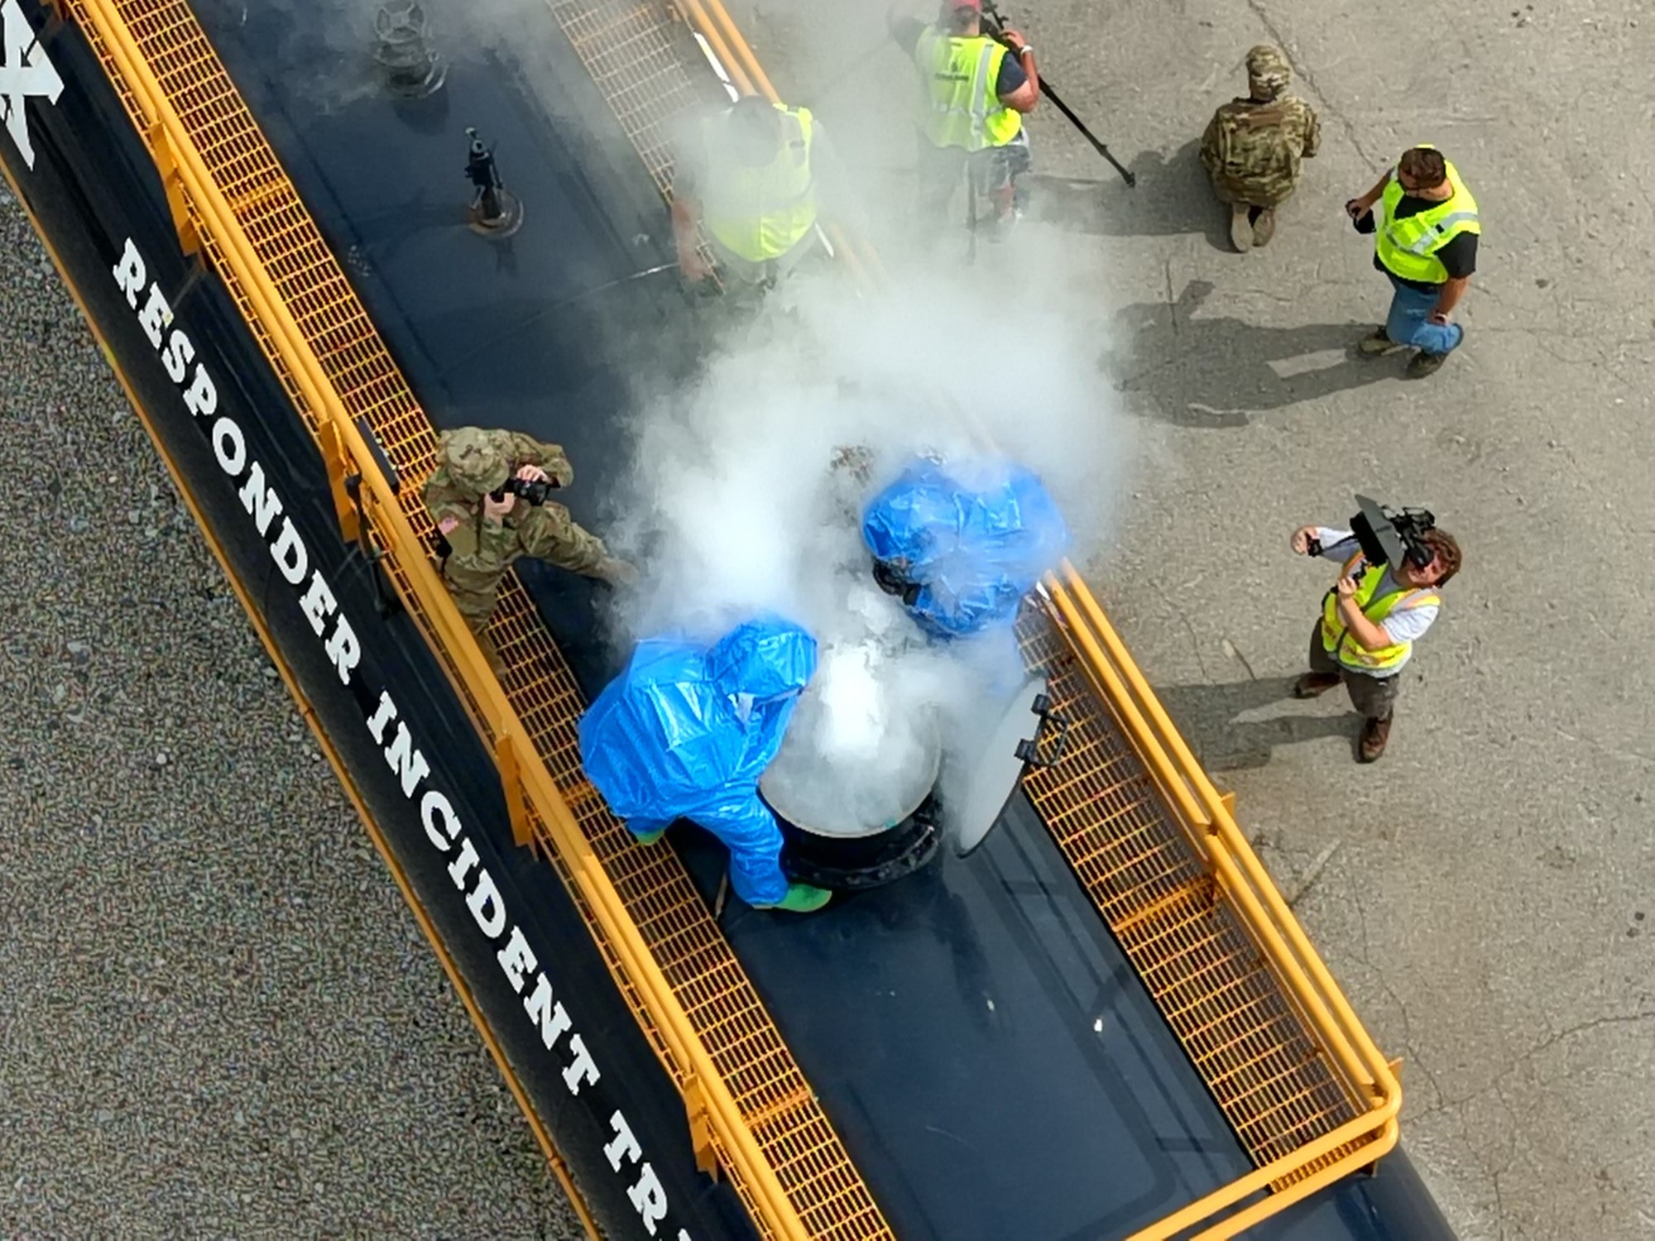
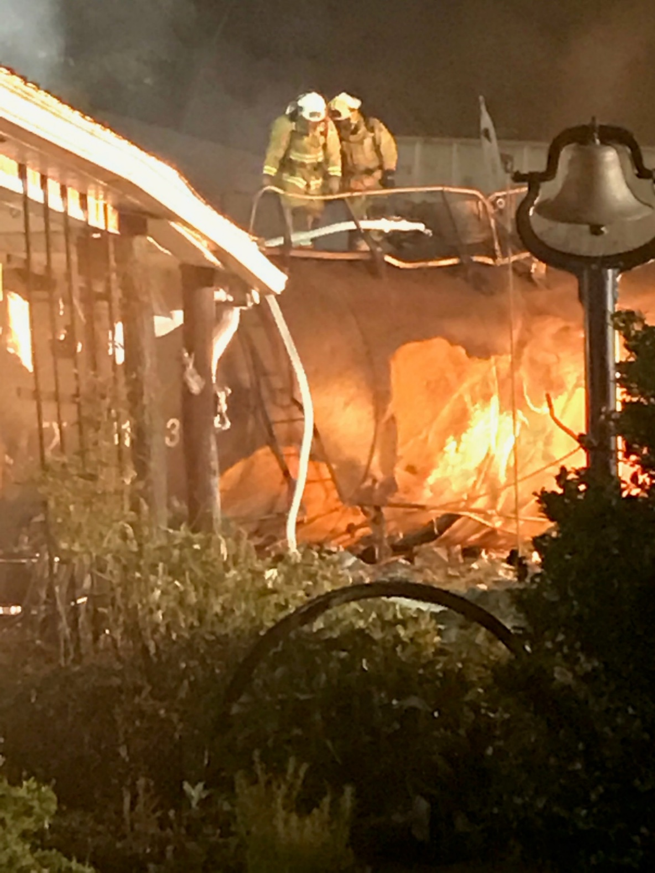
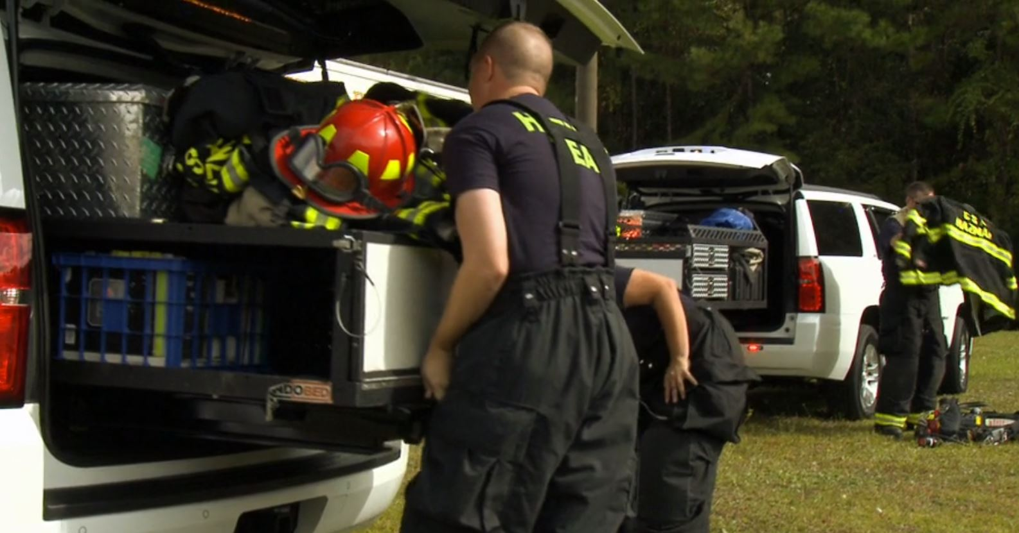
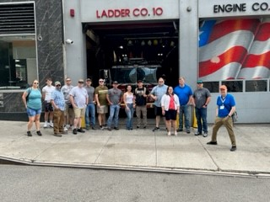
Response
CSX Hazardous Materials Team
Training Qualifications
Minimum of Hazmat Technician
Chemical Specific Training
Chemistry of Hazmat Materials (VDEM)
Advanced Leak and Spill (VDEM)
Tank-Car Specialists
Field Managers
Respond to emergencies
Provide Training
Participate in an LEPC
Assist with pre-planning and checklists

Slide 13
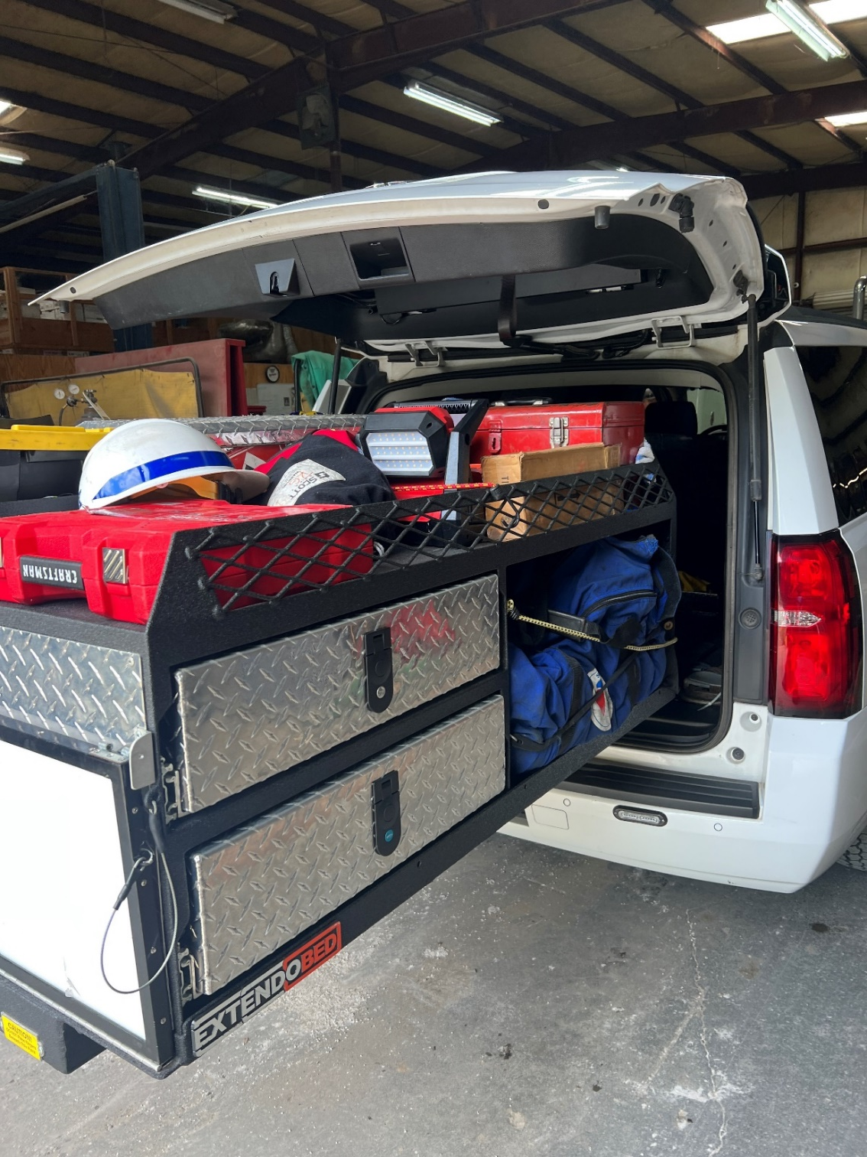
Response
CSX Hazardous Materials Team
Equipment carried on-hand
Responder Vehicles
Turnout Gear, SCBA, other PPE
Thermal Imaging Cameras, Radiation Detectors, 4-gas meters w/ PID, & Color Metric Tubes
Tank Car Manway Gaskets
Partial Midland Kits
Various Tank Car Tools and Materials
MoCC (Mobile Coordination Center)

Slide 14
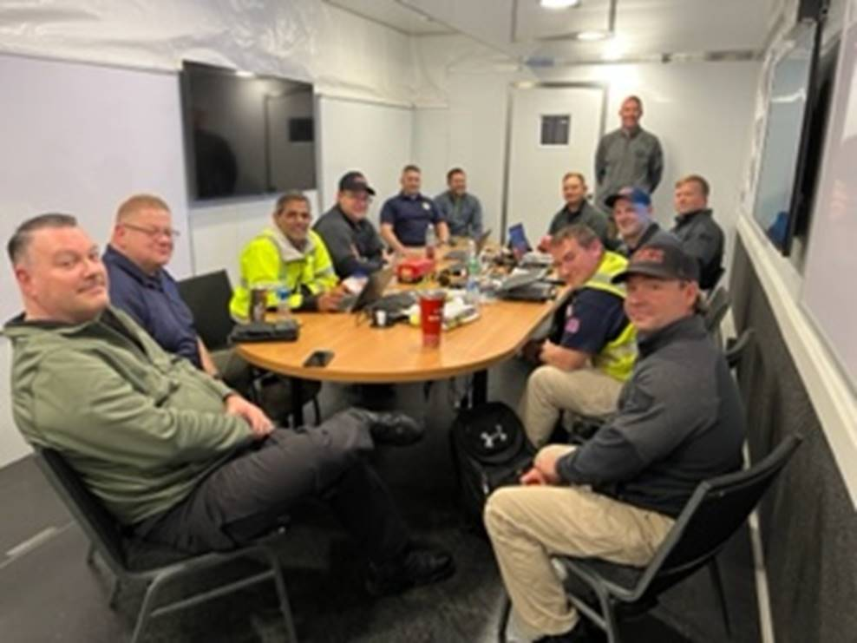
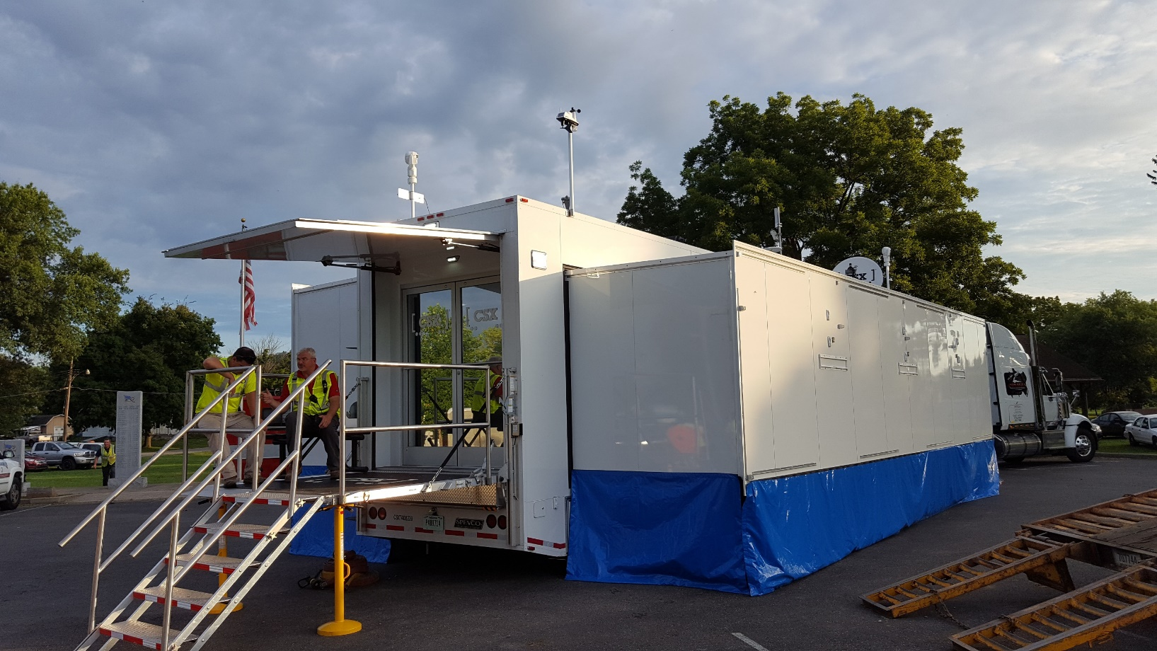
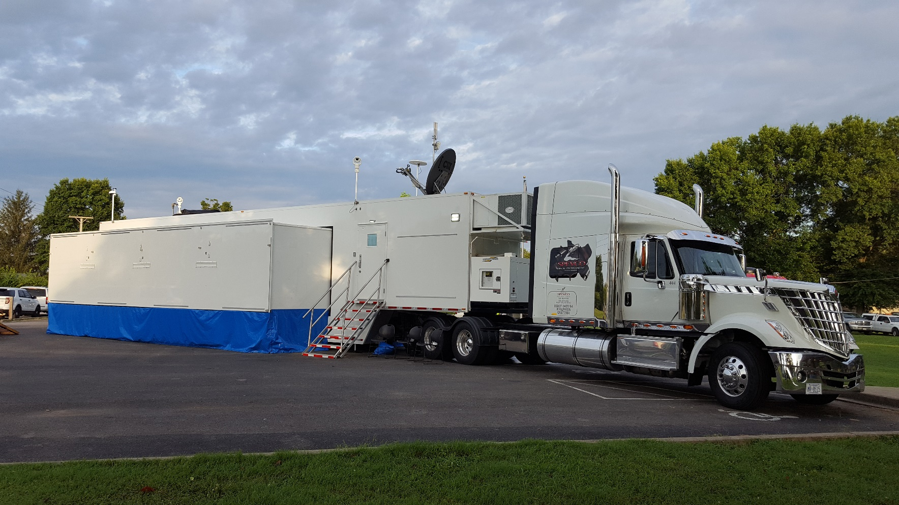
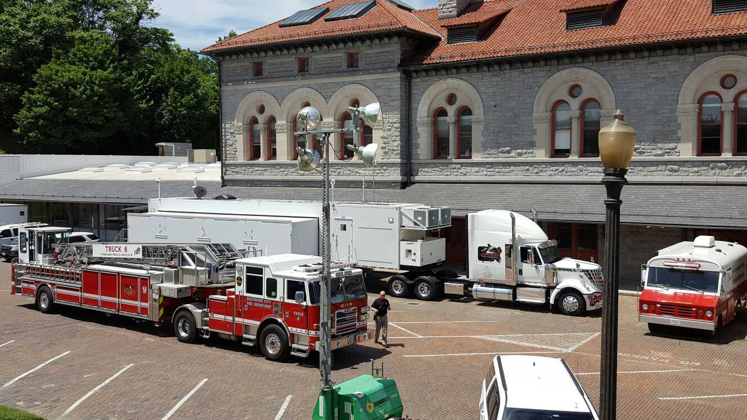
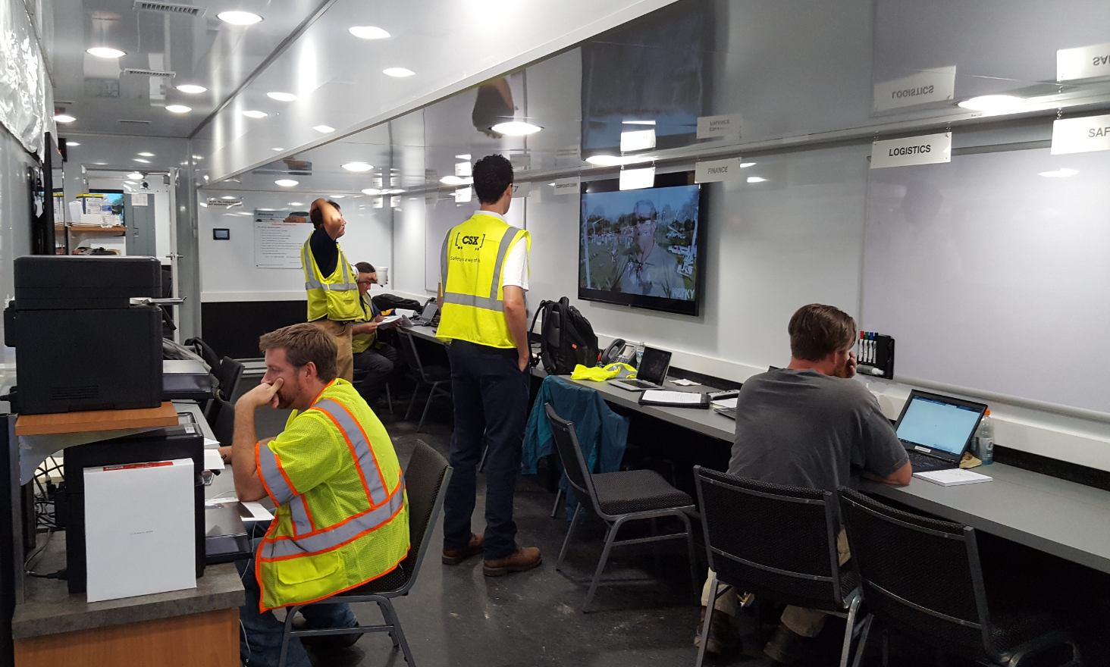
Response
CSX Hazardous Materials Team
MoCC (Mobile Coordination Center)
2 Conference Rooms,
18 Individual Work Areas
Mapping Printer
Radio Bays
Satellite and Cell Internet & Communications Suite
Housed in Winston-Salem, NC
Can be mobilized in under 4 hours
Never had to wait that long

Slide 15
Response
CSX Industrial Hygiene Team
Training Qualifications
Minimum of Hazmat Technician
Air Monitoring / Air Sampling
Certified Industrial Hygienists & Health and Safety Professionals
Equipment carried on-hand
Hand-held direct reading instruments
AreaRae direct reading instrument
FTIR (“Gasmet” brand Google image),
Various air monitoring & sampling capabilities available
Immediately gather SDS for any involved chemicals
For use and development of Health & Safety Plan and Air Monitoring Plan
Avg Response Times, 4< hours

Slide 16
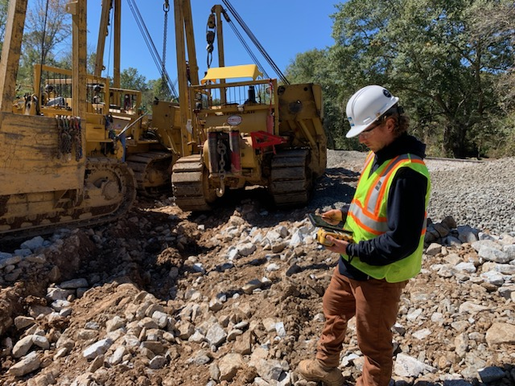
Response
CSX Industrial Hygiene Team

Slide 17
Response
CSX Environmental Remediation Team
Training Qualifications
OSHA 40 hr Hazwoper
RCRA Hazardous Waste Training
Equipment carried on-hand
Water Quality Monitoring Equip.
Field Screening Equip. (PID)
Sample Kits and Containers
Avg Response Times, 4< hours
Evaluate risks to human health and environment
Identify sensitive receptors & Env. Impacts
Develop plans to mitigate, sample, and remediate
Soil, sediment, surface water, & ground water

Slide 18
Response
CSX Hazmat Contractors
Training Qualifications
FOST
Insured, financially stable, safety record, RRW Training, audit compliance, 40-hour Trained, Hazmat physicals, etc.
Equipment carried on-hand
ER Trailers
Vac Trucks
Heavy Equipment
Other info

Slide 19
Response
CSX Hazmat Contractors
Avg Response Times 4< hours
Capabilities
Varies by contractor/consultant
Wrecking
Transfers
Air/soil/water monitoring
Works side-by-side with CSX Hazmat Team and Responders

Slide 20
Response
Other CSX Contractors
Crane Companies
Animal Experts/Biologists
Bee Keepers
Ornithologist
River Restoration Specialists
Barge Companies

Slide 21
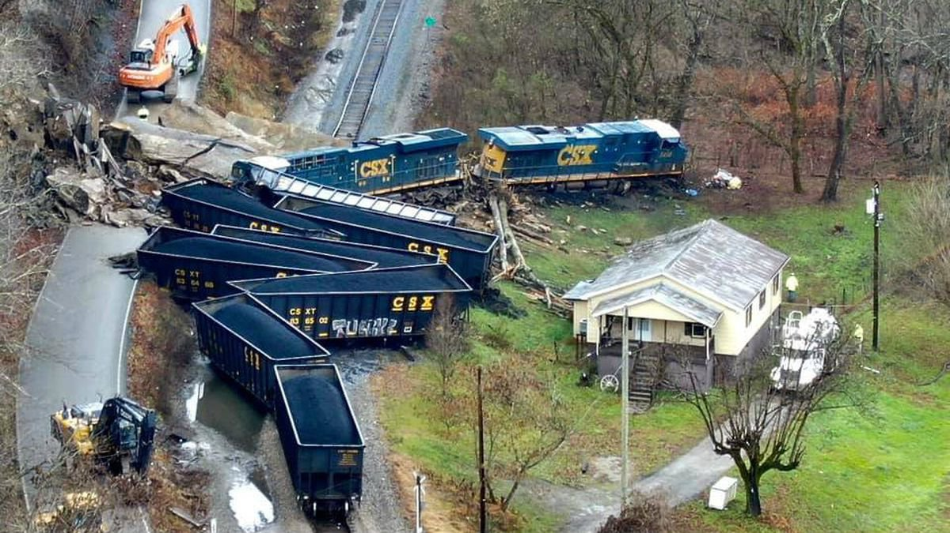
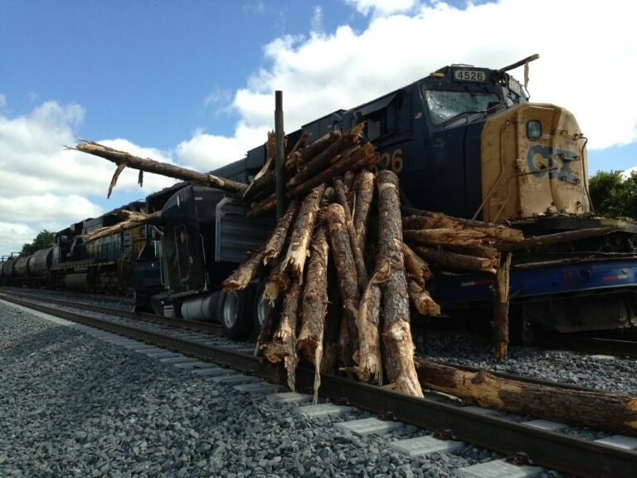
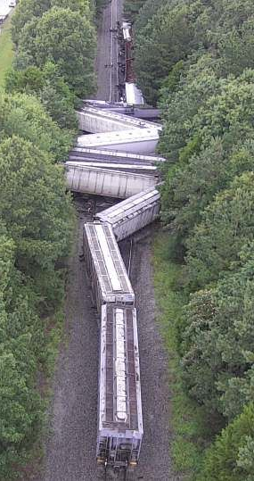
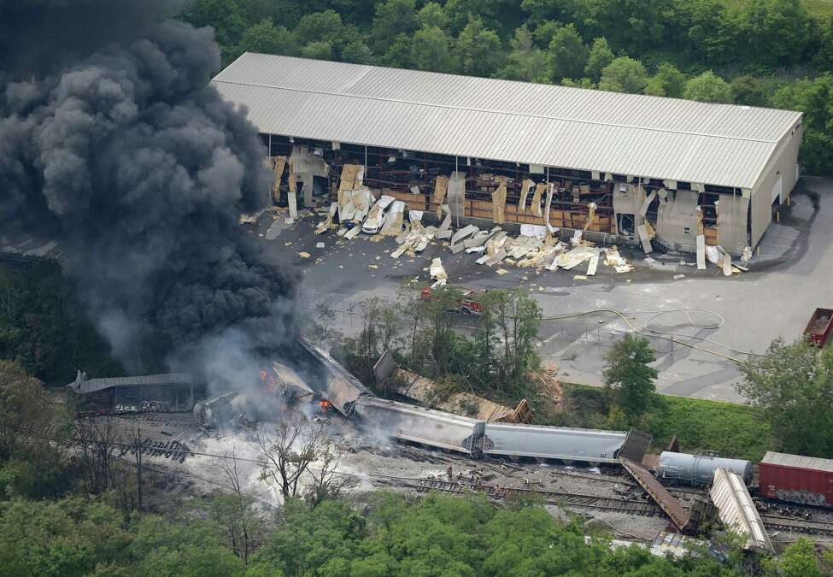
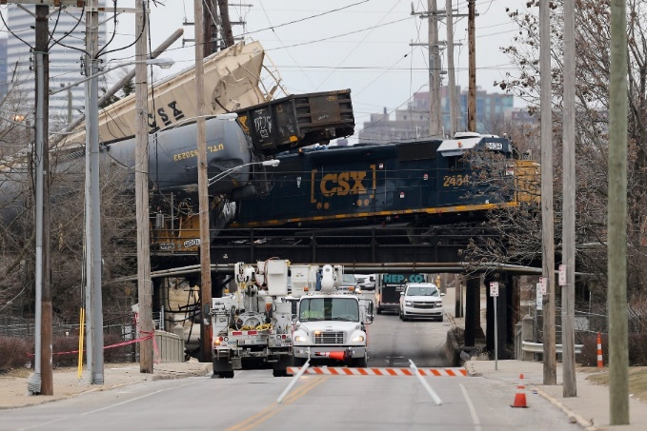
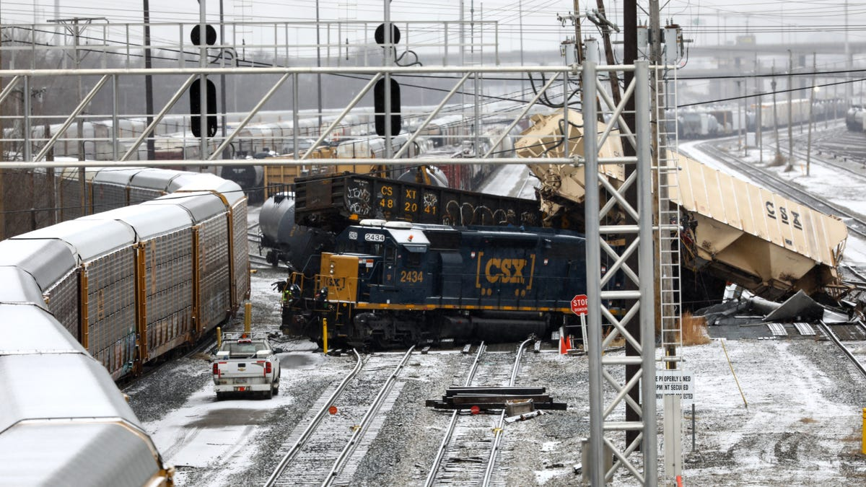
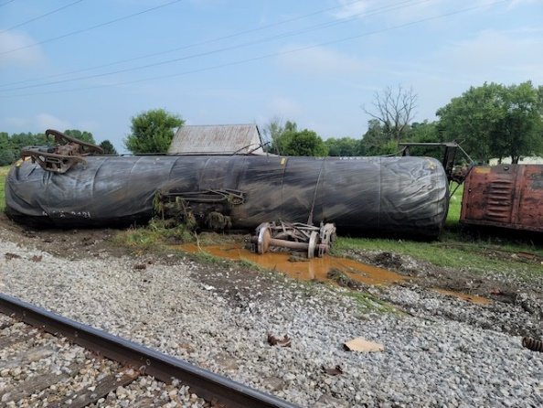
Response
CSX Risk Management Team
Mission:
Address the needs of anyone negatively impacted by CSX operations with diligence, integrity and respect

Slide 22
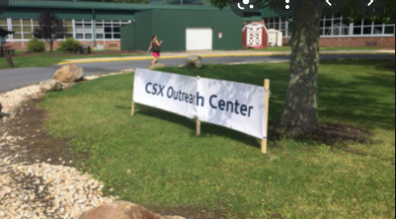
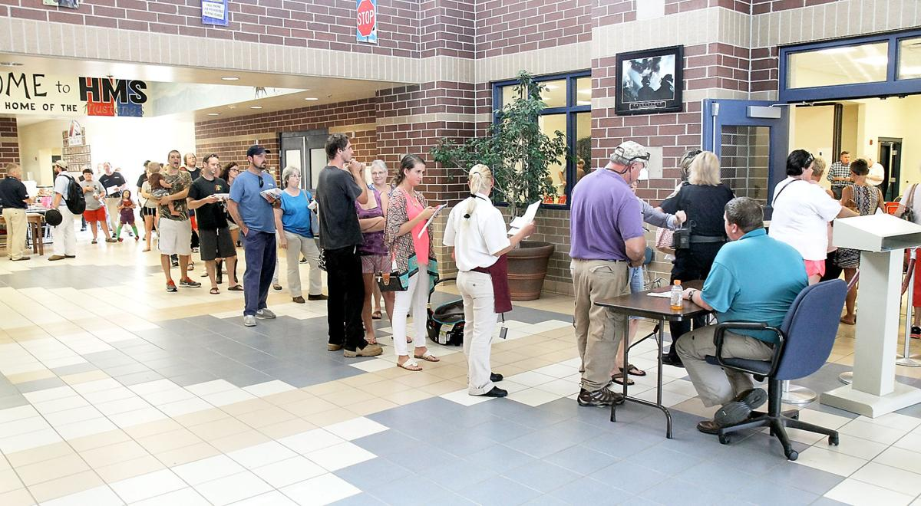
Response
CSX Risk Management Team
Crisis Response
Evacuations can be 10 homes to 1000’s
Secure hotels, restaurants, pharmacies, clothing, etc.
Set up direct billings at hospital for decontamination/chemical exposure complaints, etc.
Animal shelters, boarding, vet care, feeding, etc.
Set up Community Outreach Center
Inconvenience payments, expenses, Property Damage (PD), Right of Entry, personal injury (PI), etc.
Expand response with CSX employee volunteers

Slide 23
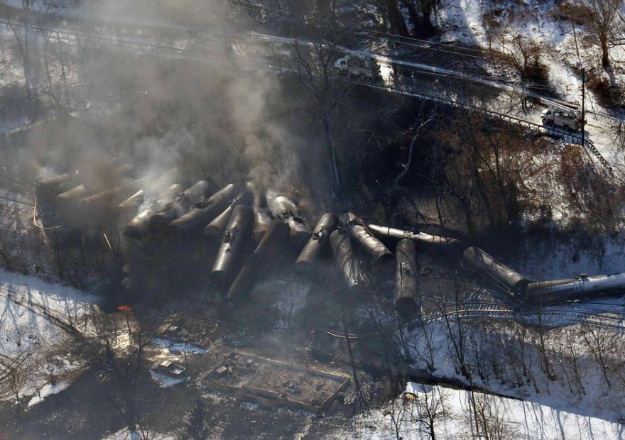
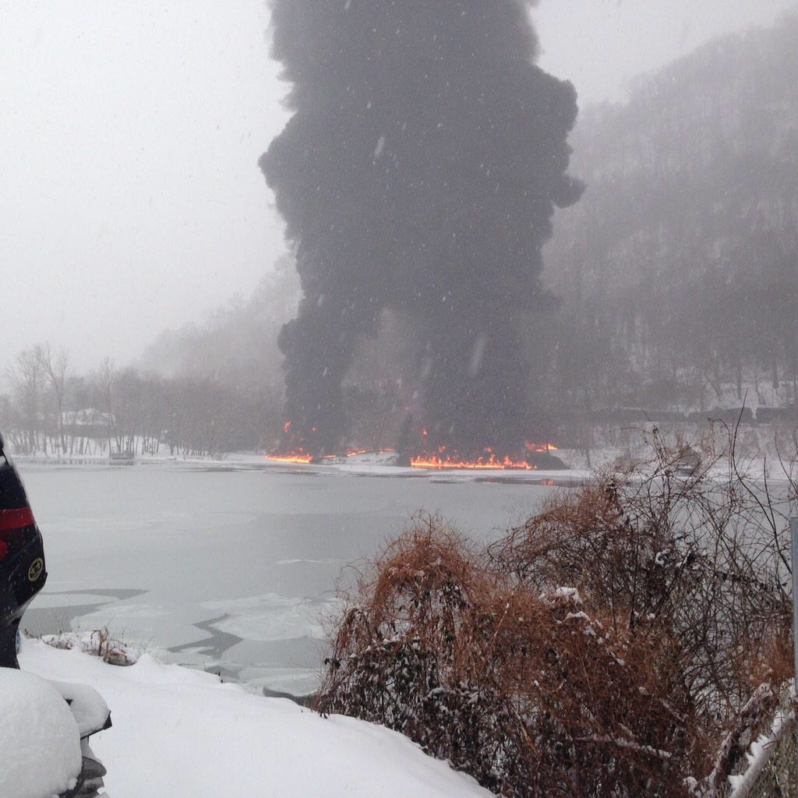
Response
CSX Risk Management Team
Past Incidents
Mt. Carbon, WV – February 16, 2015
Derailment, broken rail, 27 cars, crude oil fire
Only injury to Morris Bounds, house that burned to the ground
Evacuated approximately 1,1000 residents
Most people were out of their homes for 5 days, except for the Bounds Family
Community Outreach Center (COC) open for 2 weeks, then mail-in forms
Inconvenience payments, expenses, PD, Right of Entry, PI

Slide 24
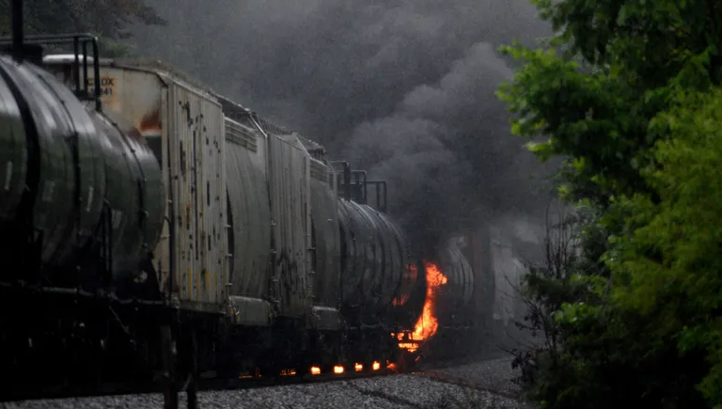
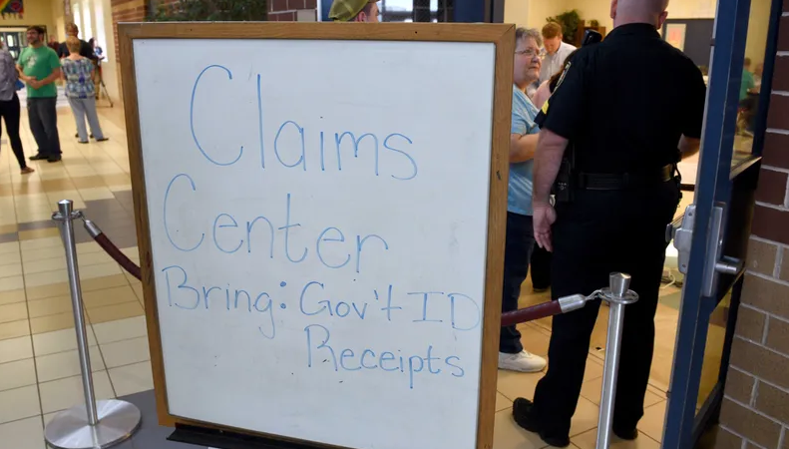
Response
CSX Risk Management Team
Past Incidents
Maryville, TN – July 1, 2015
Derailment, tank car journal fire, acrylonitrile fire
Evacuated approx. 5,000 residents
Significant number of hotels & rooms
Many people sent to hospital for decontamination, burning eyes and respiratory complaints
Early contact with hospital, coordination & direct billing to CSX
COC open for 10 days, then mail-in forms
Inconvenience payments, expenses, PD, Right-of-Entry, PI

Slide 25
Response
CSX Risk Management Team
Past Incidents
Hyndman, PA – August 2, 2017
Derailment, flat spots / build up on rail car from handbrake, 32 cars derailed, fire
Evacuated 1,000 for 3 days, 25 households for 10 days and 2 households for 3 months
Two Homes destoyed and CSX purchased those properties
One legitimate PI, 4 claimed injuries, right-of-entry, PD, inconvenience
COC open for 2 weeks, then mail-in forms

Slide 26
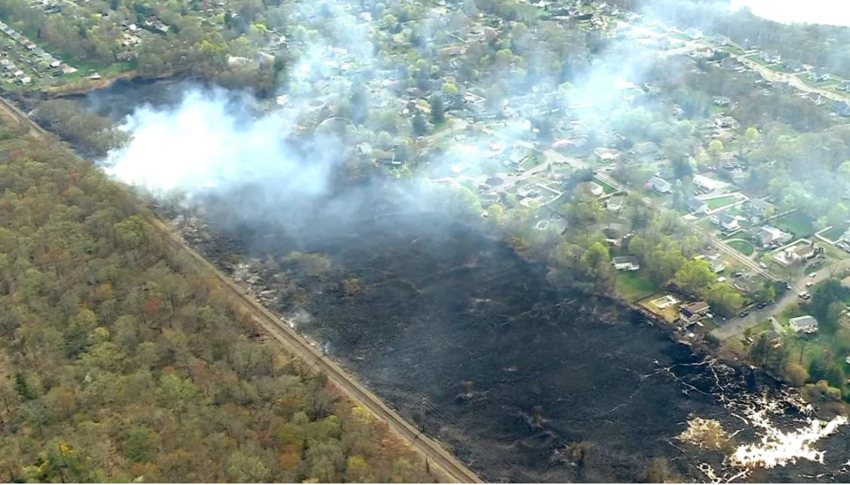
Response
CSX Risk Management Team
Past Incidents
Haverstraw, NY – April 14, 2023
Sparks from CSX train started brush fires
No injuries
Evacuated 25 homes for a few hours
No major structural Damage
PD claims – fence, outbuilding and damaged tree claims

Slide 27
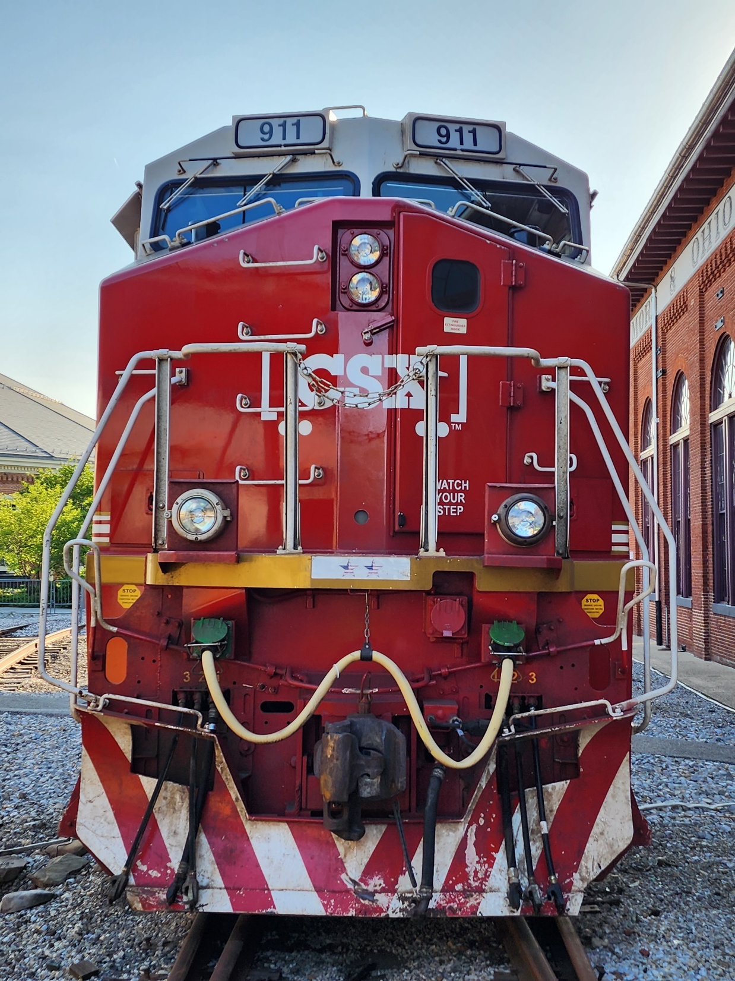
Response
CSX Corporate Communications
Serves as CSX PIO
Handles media inquiries
Contacted by :
1-855-955-NEWS (6397)
MediaTeam@csx.com

Slide 28
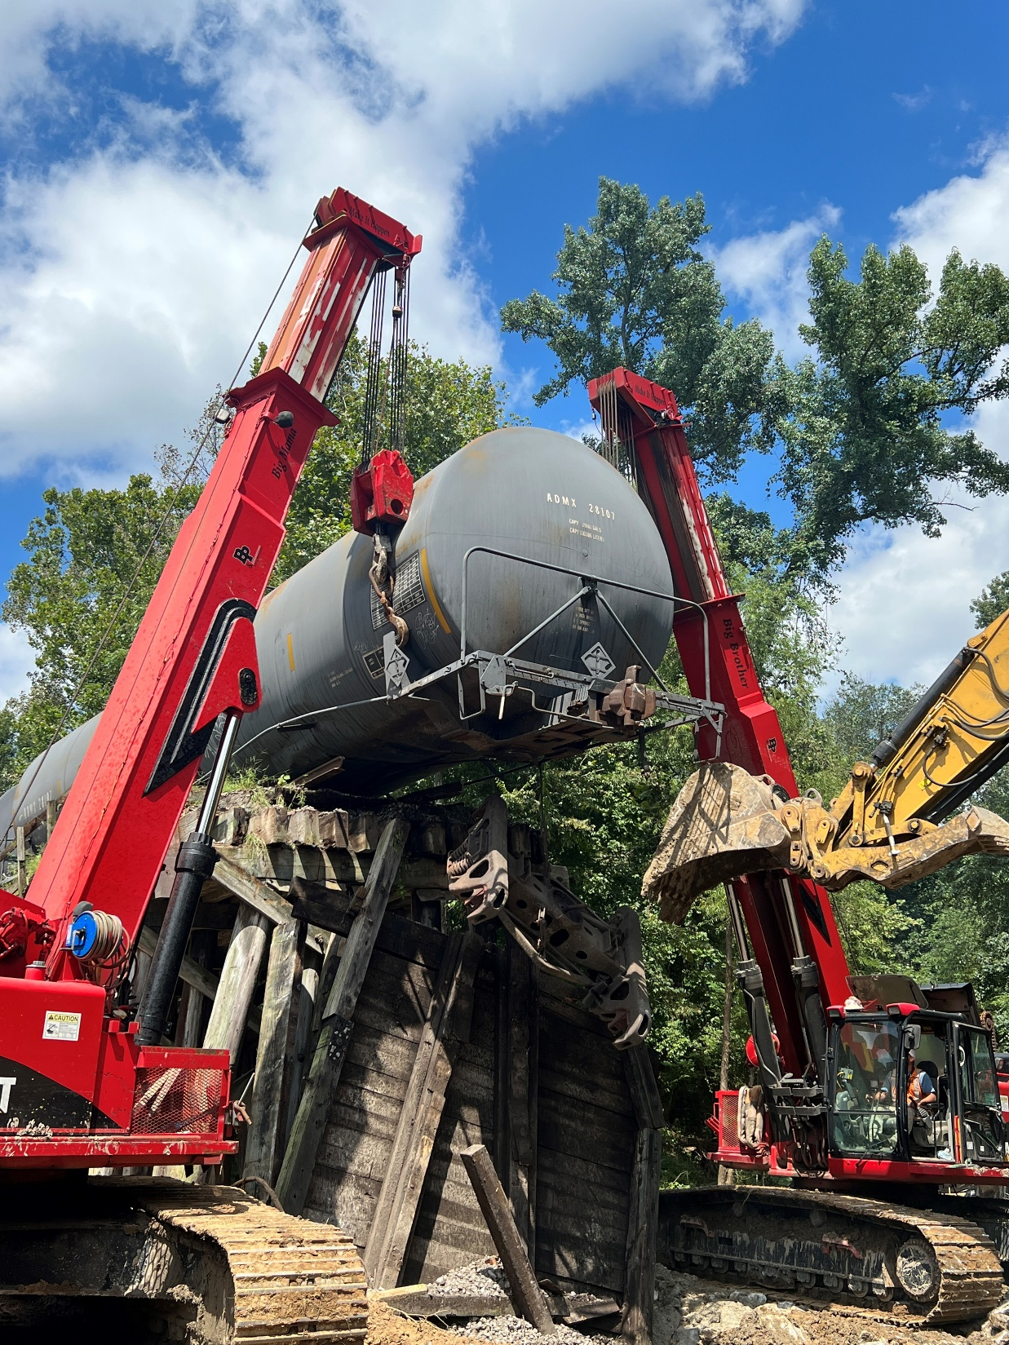
Response
Other Railroad Departments
Engineering
On-site throughout, preparing to route the derailment, track restoration,
Signals
Restoring signals, track equipment
Bridges, Tunnels, & Structures
Mechanical
On-site throughout, re-railing, wreck clearing operations, staging wrecked calls

Slide 29
ICS

Slide 30
Response
Derailment
Hazmat Team Notified
Hazmat Team Responds and Evaluates the Incident
Environmental Group and LEADS Notified and Respond to the Incident
CSXT Derailment Team* Evaluates and Coordinates the Roles and Responsibilities
Senior HM Manager Oversees the Incident Management
Each Group Completes Roles and Responsibilities
Final Disposition/Closure Managed by Environmental Group

Slide 31
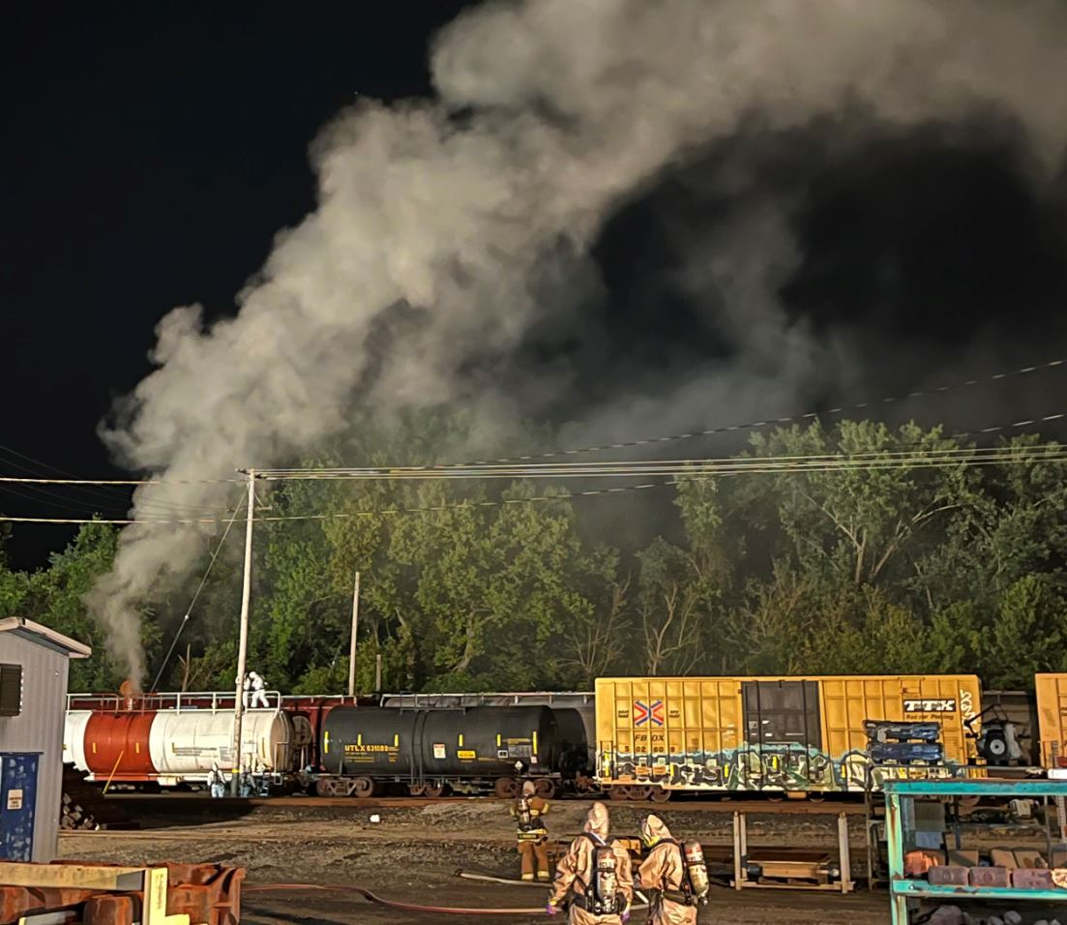
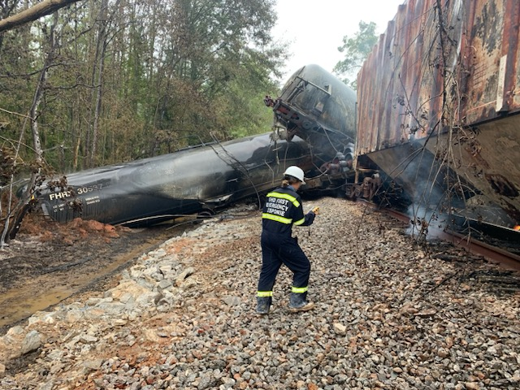
Response
CSX Crews begin to show up – What to Expect? How to work together?
Initial scene size-up
Evaluating Resources
Establishing contact with responders
ICS – Set up Unified Command
Develop a plan
Implement Plan
Directing Resources
Re-evaluate
Repeat

Slide 32
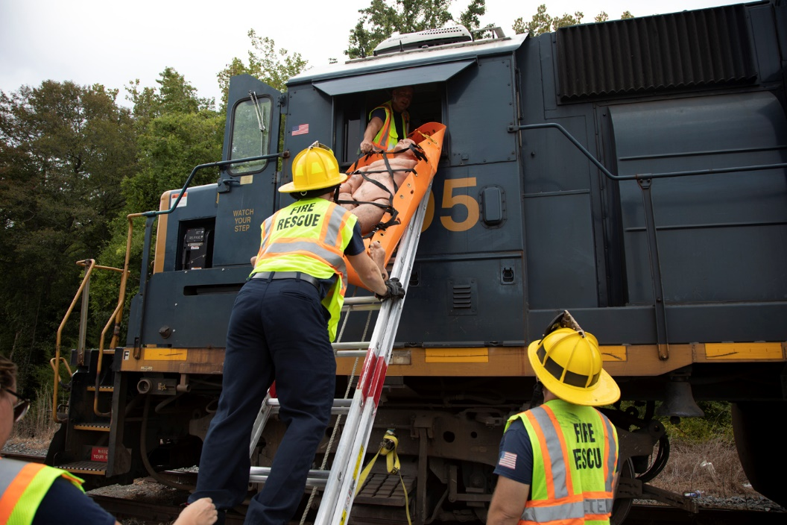
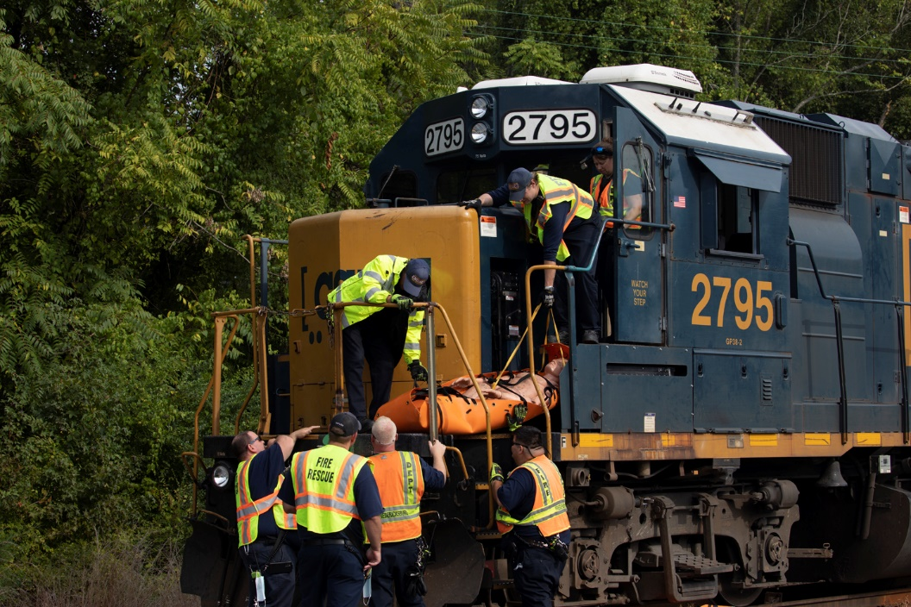
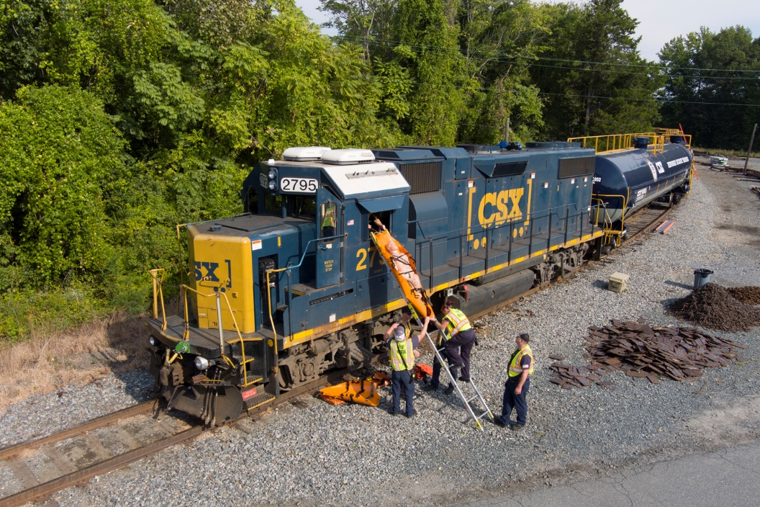
Crew Entrapment
Notes:
Crew Entrapment
What are the unique challenges associated with entrapped crew?
-Different types of locomotives and access points
-Where to cut if need be? How to cut?
-Dangers to First Responders

Slide 33
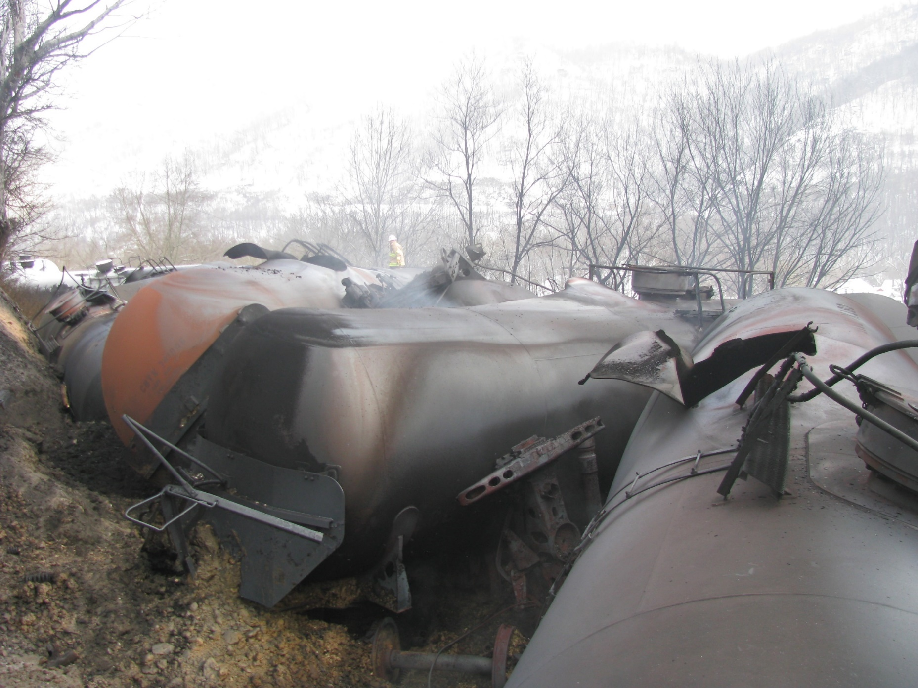
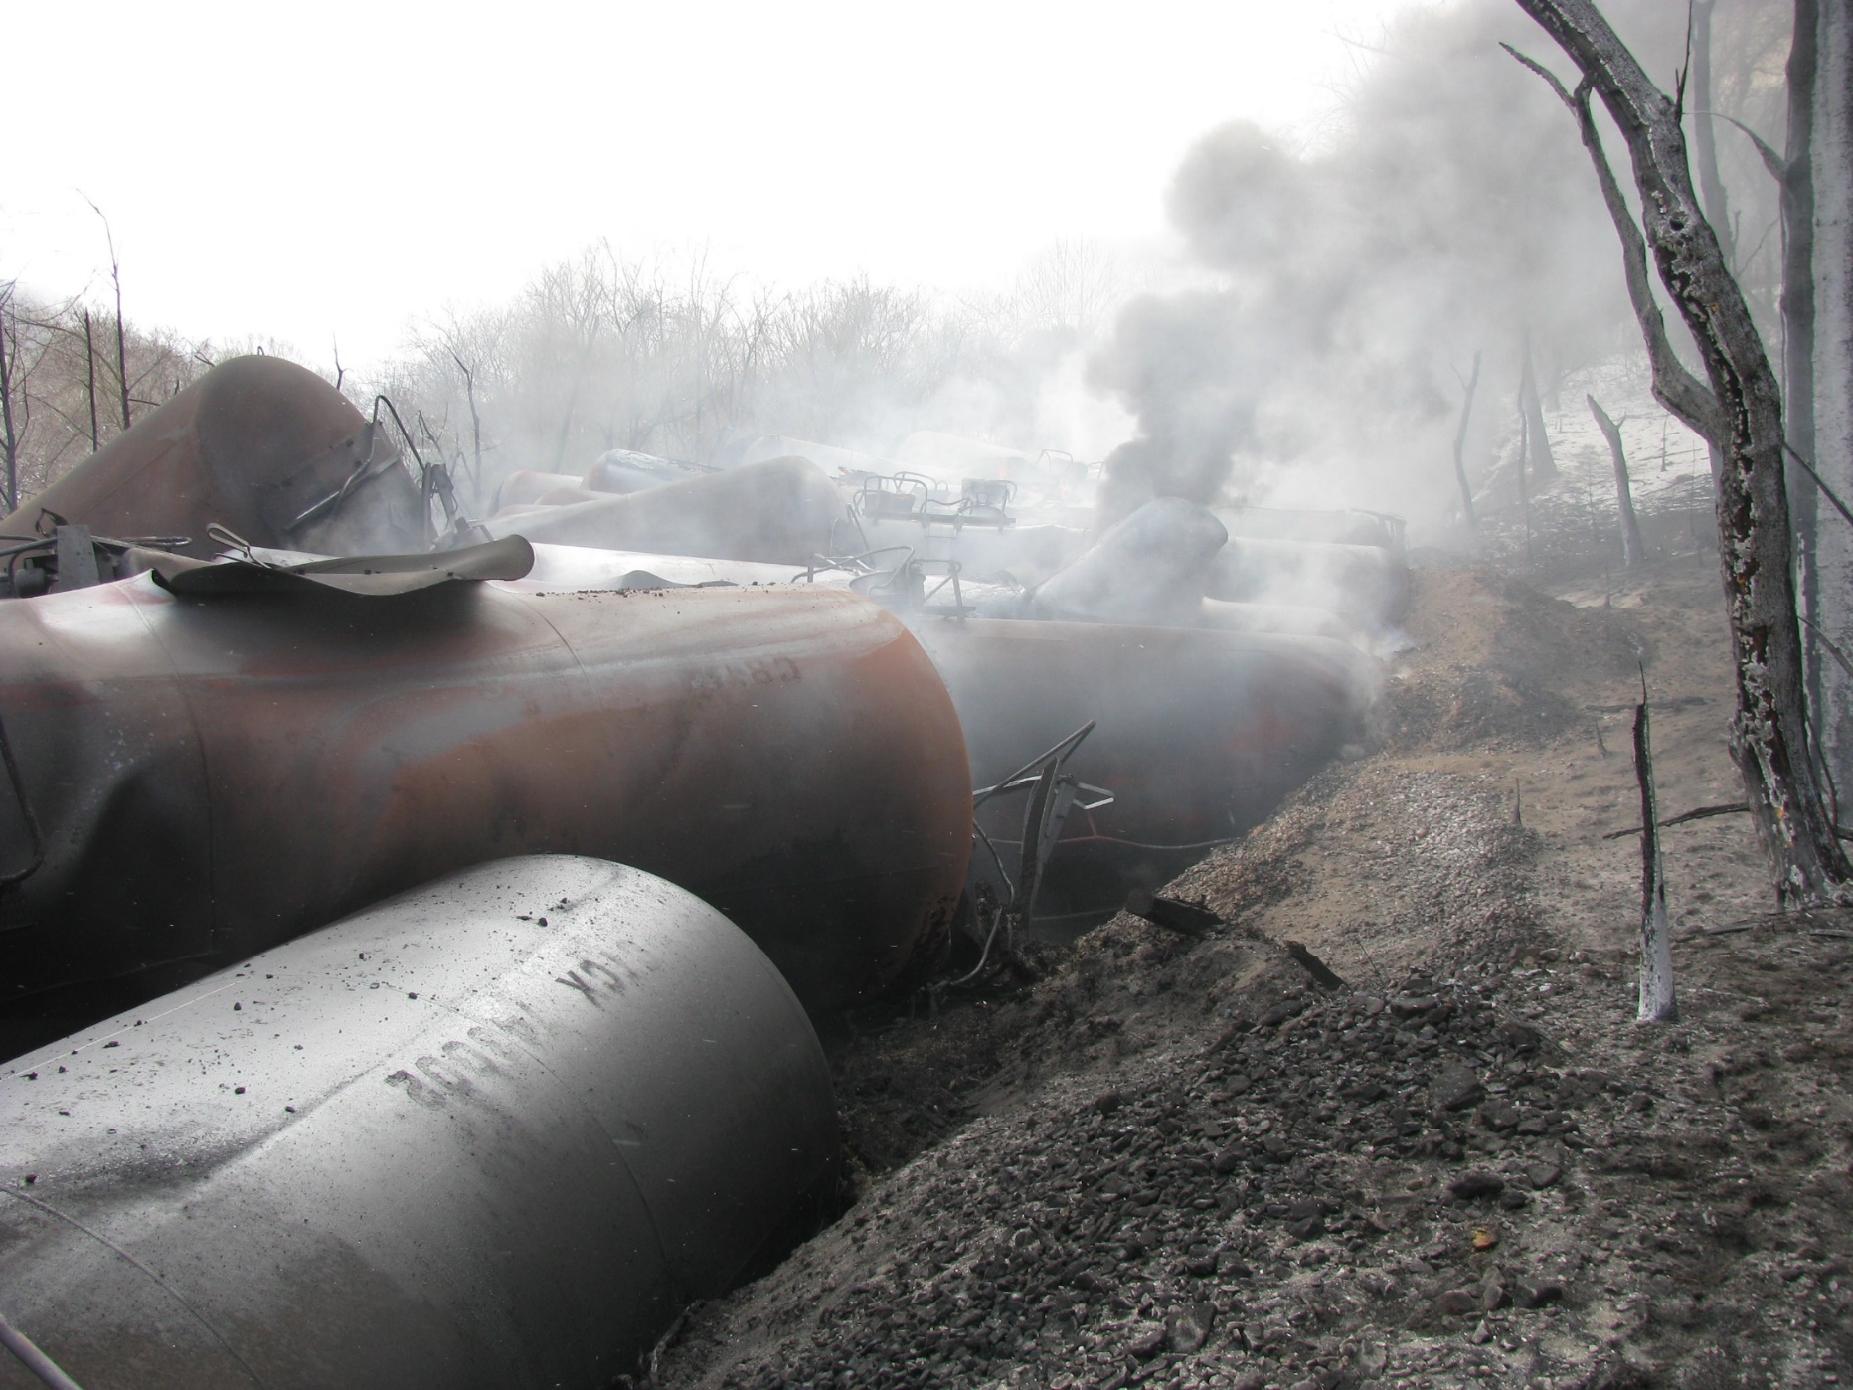
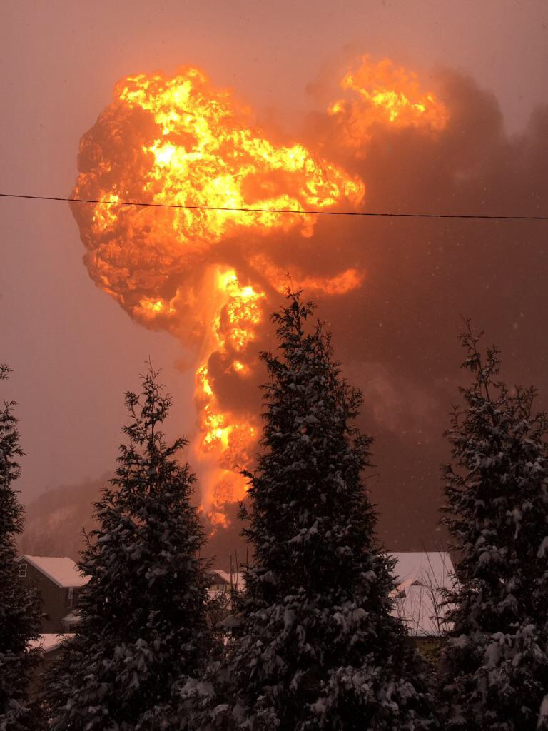
Sights from large Derailments
Notes:
Mt. Carbon, WV – 2015
During the Response Phase where would the responder fit in here?

Slide 34
Incident Photos & Open Discussion

Slide 35
Incident Photos & Open Discussion

Slide 36
Incident Photos & Open Discussion

Slide 37
Incident Photos & Open Discussion

Slide 38
Phase 3 – Response, Incident Photos & Open Discussion

Slide 39
Incident Photos & Open Discussion

Slide 40
Incident Photos & Open Discussion

Slide 41
Phase 4 - Recovery
Site Remediation
Long Term
What happens here?
Cleaning & Wrecking of cars
Environmental remediation and monitoring
Soil & water sampling
CSX Remediation Team
What resources are used
Cranes
Torching Operations
Vac Trucks
Frac Tanks
Where do responders fit in?
Standby Operations

Slide 42
Phase 4 - Recovery
Notes:
Once the Emergency Response Phase is over, now begins the work on damaged / non-compliant rail cars.
Transfers, repairs, etc.

Slide 43
Phase 4 - Recovery
Notes:
Tank Cars being staged for cleaning and purging.
Tracks are open at this point.

Slide 44
Phase 4 - Recovery
Notes:
Waste is being stored for later off-site removal

Slide 45
Phase 4 - Recovery
Notes:
The CSX Remediation Team is on site long-term, handling environmental cleanup and restoration efforts

