Slide 1
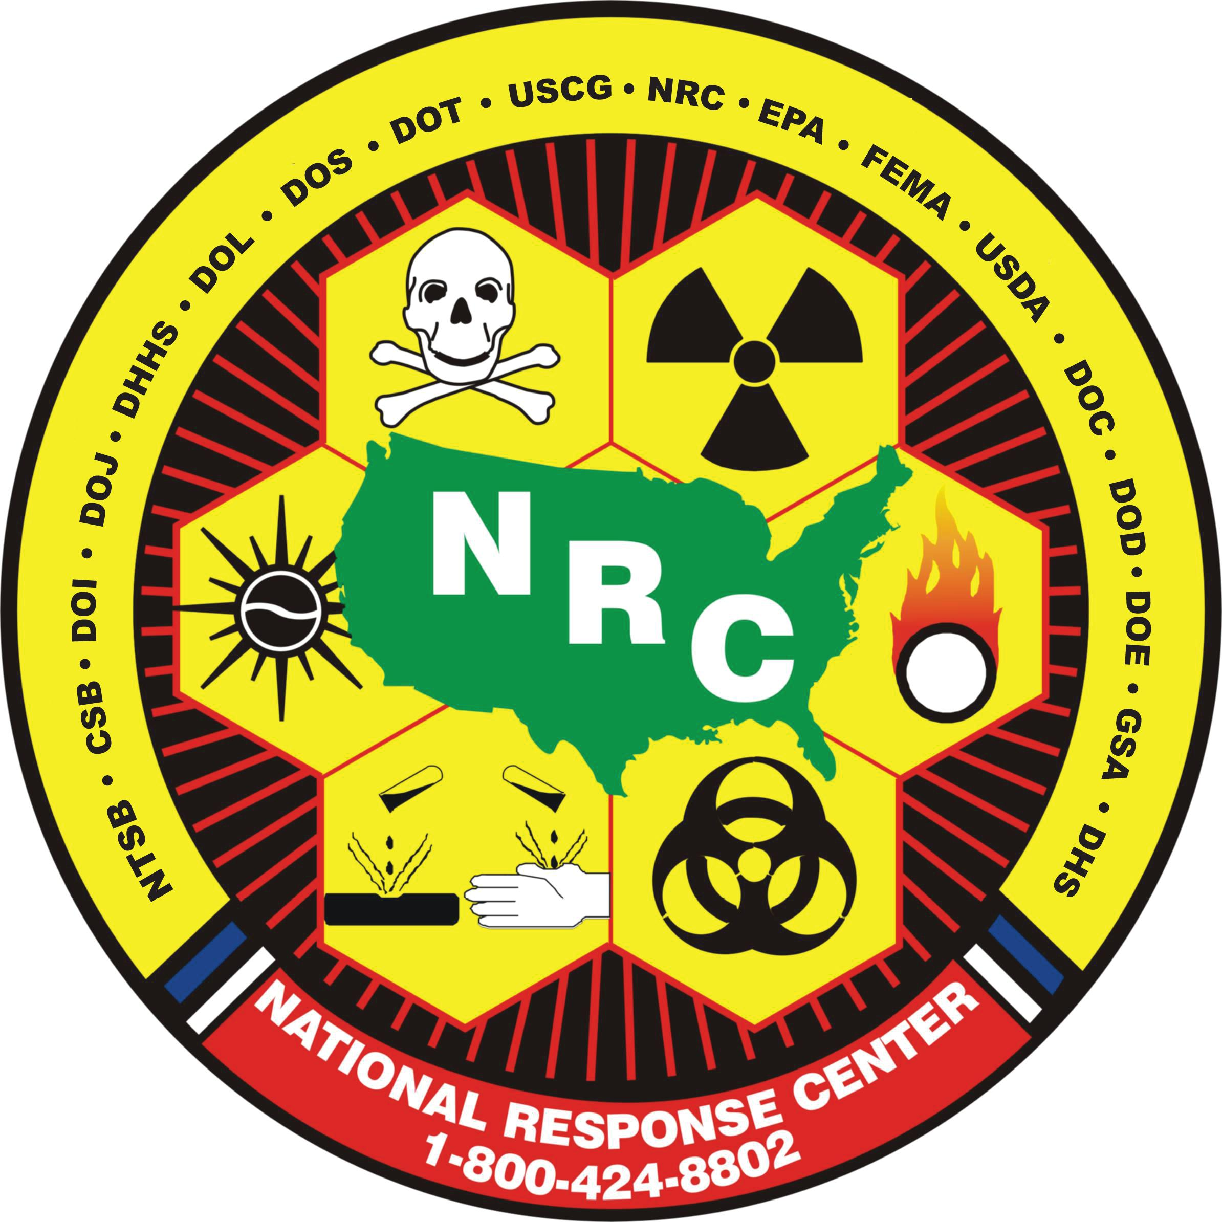
National Response Center
LTJG Joshua Welsh
NRC Operations Officer
2023

Slide 2
Core Function
Established from the FWPCA and NCP to be:
A support entity within the National Response System
The single federal point of contact for all pollution incident reporting
The communications center for the National Response Team (NRT)
The NRC is an independent government entity managed directly by the NRT and is not a Coast Guard unit.
Notes:
The single federal point of contact for all pollution incident reporting & communications center for the National Response Team (NRT) per 40 C.F.R. § 300.125(a)
The NRC is an independent government entity managed directly by the NRT (USCG Legal Office determination, 2013).

Slide 3
Mission
The NRC serves as the initial entry point to the U.S. National Response System for pollution, railroad, and port security response.
The communications center for the NRT
Call center for the reporting of:
Oil/hazmat events in the U.S. and its territories
All railroad incidents (not just oil)
Port security incidents per the Maritime Transportation Security Act (MTSA)
Facilitate NRT agency activation for large national/international events
Notes:
Railroad Incidents
DOT Federal Railroad Administration (FRA) 49CFR219.203 / 49CFR225.9 / 49CFR229.17 / 49CFR230.22 / 49CFR234.7
National Transportation Safety Board (NTSB) 49CFR840.3
Hazardous Material Transportation Incidents
Pipeline and Hazardous Materials Safety Administration (PHMSA) 49CFR171.15 / 49CFR191.5 / 49CFR192.612 / 49CFR195.52 / 49CFR195.413
Maritime Transportation Security Incidents (Suspicious Activity and Breach of Security).
USCG - MTSA and AWW programs. 33CFR101.305
Discuss notifications
The NRC receives and immediately relays telephone notices of discharges or releases to the appropriate pre-designated federal OSC.”
“The telephone report is distributed to any interested NRT member agency or federal entity that has established a written agreement or understanding with the NRC.”
…and other agencies (state, local, and tribal) with whom we have established agreements for reporting incidents of a specific interest.

Slide 4
International Assistance
Cross-Border Spill Coordination
Canada – National Environmental Emergencies Centre (NEEC)
Mexico – National Communications Center (CENACOM)
International pollution reporting & NRT requests for assistance (RFA):
Panama Canal Incidents
Marine Oil Pollution Response in the Arctic (MOSPA)
Any RFA received from the NRT International Assistance Sub-Committee

Slide 5
Structure
NRC
Director
IT Staff
Operations Officer
Civilian Watchstanders
Budget Officer
Independent Duty SK1
The NRC is located at USCG HQ under CG-5RC: Office of Response Policy.
25 permanent personnel
2-10 watchstanders on duty

Slide 6
Notification Procedure
Incoming call to report incident
Watchstander completes report in NRC database (IRIS)
IRIS queues notifications
Email: State, Local, & Tribal Gov’t Agencies
Verbal/Email: On-Scene Coordinator (EPA/USCG)
Verbal/Email: NRT Member Agencies & Federal Agencies w/ MOA
Annual Statistical Data (Avg)
~75,000 phone calls fielded
32,000 reports processed
Agency notifications per report: 23
Report processing time: 12 min.
Total NRC Notifications: 725,000
Notes:
Currently 1,100+ federal, state, local, and tribal government units receive incident notification from the NRC

Slide 7
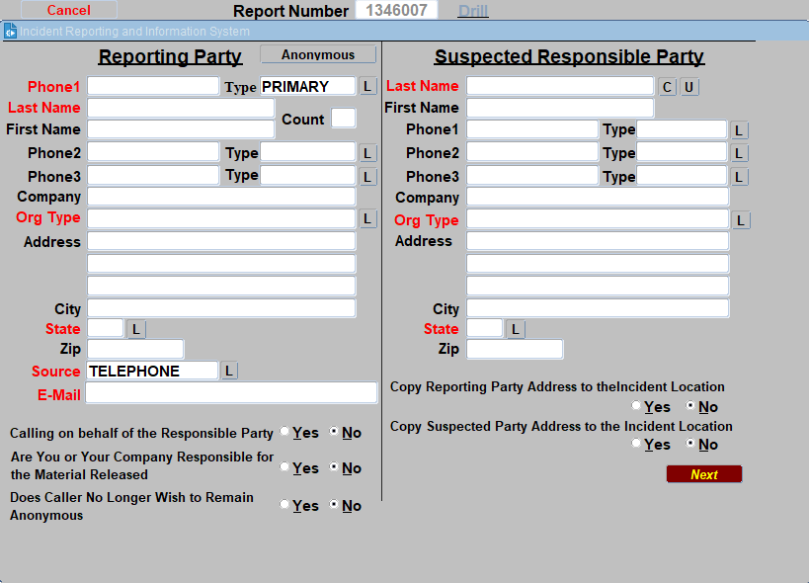

Slide 8
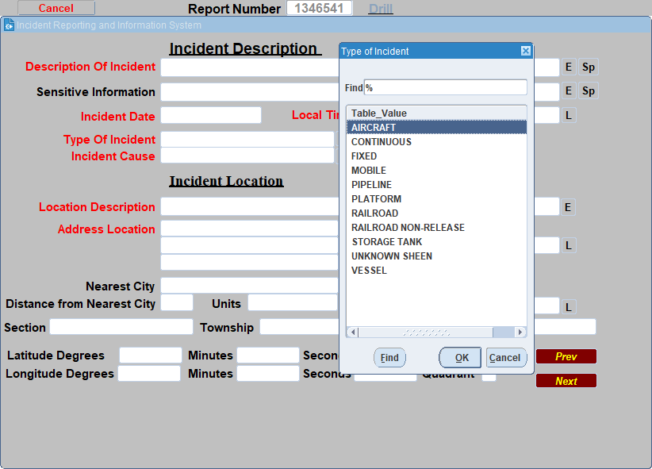

Slide 9
Current Operational Challenges
Continuity of Operations
Staffing
Watchstander Training
Development/modernization of NRC applications

Slide 10
Frequently Asked Questions
How often is NRC website data updated?
Which agencies will receive notifications for incidents in my area?
Why doesn’t the NRC accept reports online or via email?
Why does the NRC only notify government agencies?
Which questions will be asked when I make an NRC report?
Does the NRC take drill reports?
When does the NRC create updated reports?

Slide 11
National Response Center
Contact the NRC 24/7
1-800-424-8802 (National Pollution Hotline)
1-800-424-0201 (Federal Railroad Administration Reporting)
1-877-249-2824 (NRC Port Security Reporting)
(202)-267-4477 (Telecommunication Device for the Deaf - TDD)
Email us at: nrc@uscg.mil
Visit our website: https://nrc.uscg.mil
LTJG Joshua Welsh
NRC Operations Officer
Joshua.j.welsh@uscg.mil
(240) 935-8281

