Slide 1
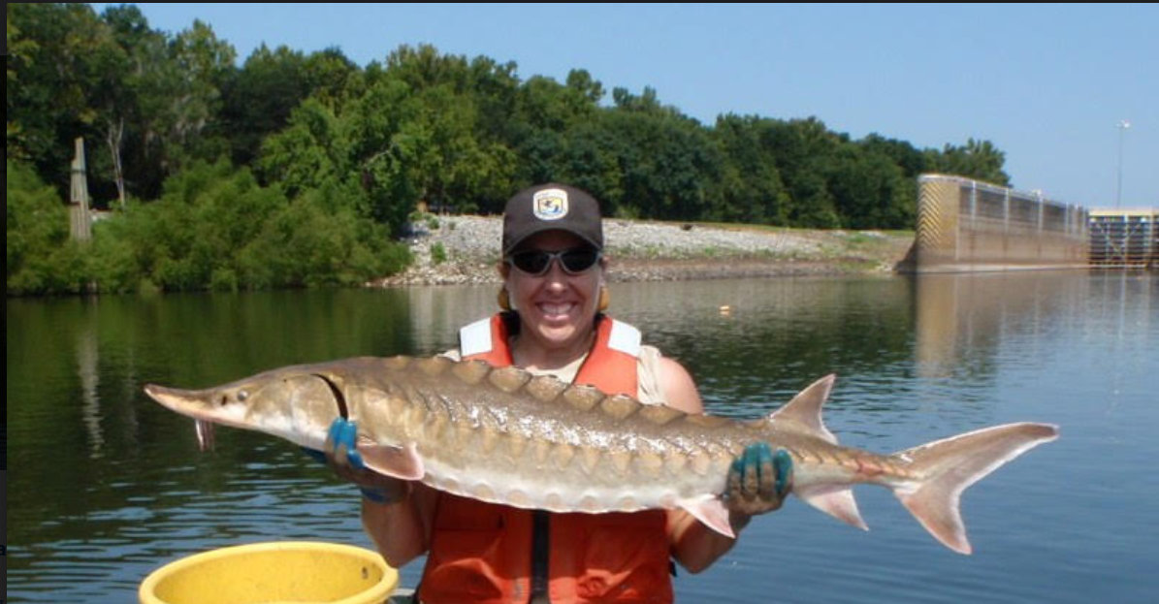
Preauthorization of the Use of Dispersants and In-Situ Burning in Offshore Waters of the Southeast U.S.
Allison Hernandez
NOAA Fisheries
Presentation for
RRT annual meeting
November 1, 2023
Gulf sturgeon

Slide 2
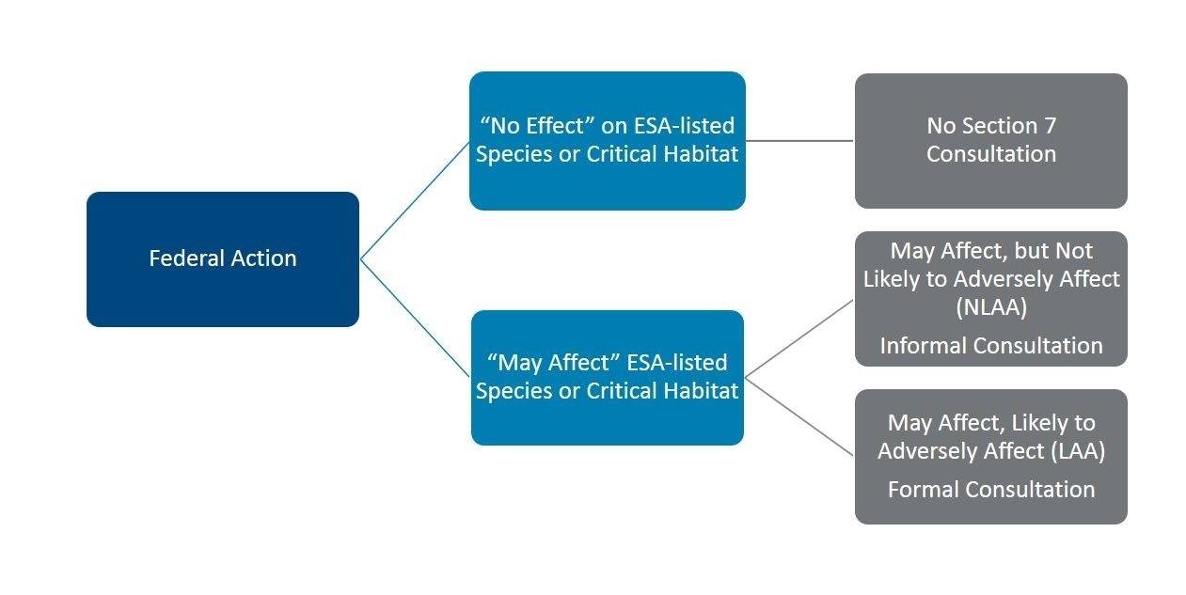
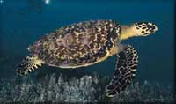
Endangered Species Act Section 7 Consultation Overview (16 U.S.C. §1531 et seq.)
Hawksbill turtle
Notes:
Section 7 of the ESA is about interagency cooperation. This paraphrased section identifies 1) the federal nexus that establishes an action agency, 2) the roles of the action agency and NMFS, and 3) the ultimate requirements the Endangered Species Act places on federal agencies that undertake actions that may affect listed species and our division, which is tasked with consulting with those agencies to insure their action is not likely to Jeopardize listed species or destroy or adversely modify critical habitat.

Slide 3
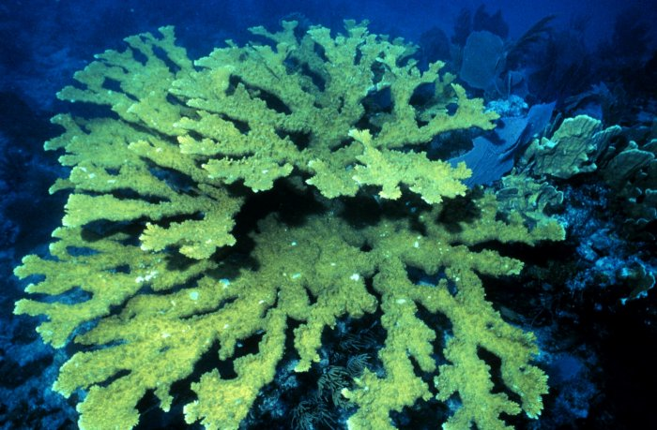
Consultation History
2014
Regional Response Team IV began discussions with NMFS Southeast Regional Office, which provided technical assistance.
2015
RRTIV requested reinitiation from NMFS Southeast Regional Office
2017
Consultation transferred from NMFS’ Southeast Regional Office to the NMFS’ Headquarters Office of Protected Resources (OPR) in Maryland
2019
RRT IV provided NMFS a supplemental biological assessment (BA)
August 2020
NMFS’ OPR requested a final list of data/information needs for the consultation
Elkhorn coral
October 2020
RRT IV provided remaining information and revised BA
November 2020
RRTIV reviewed draft description of the proposed action
December 2020
RRTIV decided to conference on proposed critical habitat for corals
March 4, 2021
Final Biological and Conference Opinion

Slide 4
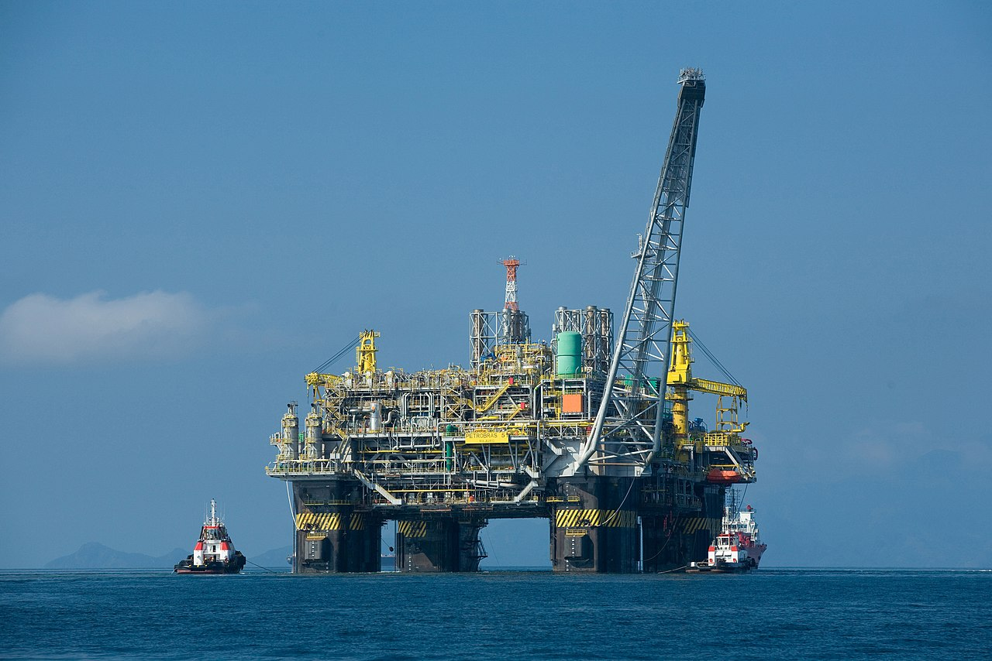
Project Overview
Action Agencies: U.S. Coast Guard (lead) Districts 5, 7, and 8 and Regional Response Team IV
ACTIONS COVERED:
Preauthorized green zones for dispersant use and in-situ burning (ISB)
Conditionally (time-restricted) pre-authorized green zones for dispersant use and ISB
NOT COVERED:
Yellow zones not pre-authorized
Oil platform
Biological and Conference Opinion available at: https://www.fisheries.noaa.gov/resource/document/biological-and-conference-opinion-use-dispersants-and-situ-burning-united-states
Notes:
Why– Endangered Species Act section 7 consultation?
Role of Action Agency
Provide best scientific and commercial data available
Active participant in the consultation
May designate non-Federal Representative
Request species lists, conduct informal consultation, prepare BA/BE, initiation package, provide information
Role of Services
Use best scientific and commercial data available
Active participant in the consultation
Advise on regulatory, policy, and biological information
Discuss the potential effects of the action on listed species or critical habitat
Discuss measures to reduce or avoid those effects

Slide 5
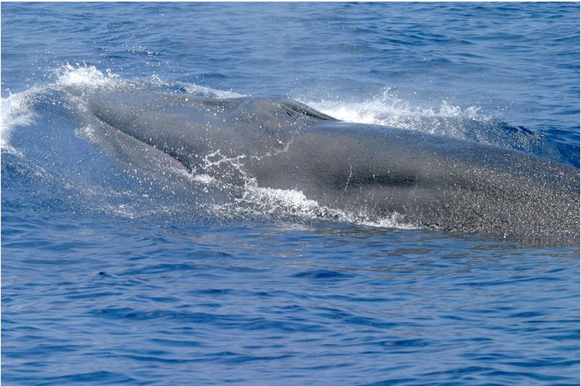
Biological Assessment and associated documents
https://response.epa.gov/rrtivscienceandtech
Revised Biological Assessment
In-Situ Burning Plan
Dispersant Use Preauthorization Plan
https://www.nrt.org/Main/Resources.aspx?ResourceType=Endangered%20Species%20Act%20(ESA)%20Section%207&ResourceSection=2
2001 MOA regarding oil spill planning and response activities
ESA/EFH Emergency Consultation Guidance and Form
Species Matrix
2019 ESA Process for pre-spill planning
Rice’s whale

Slide 6
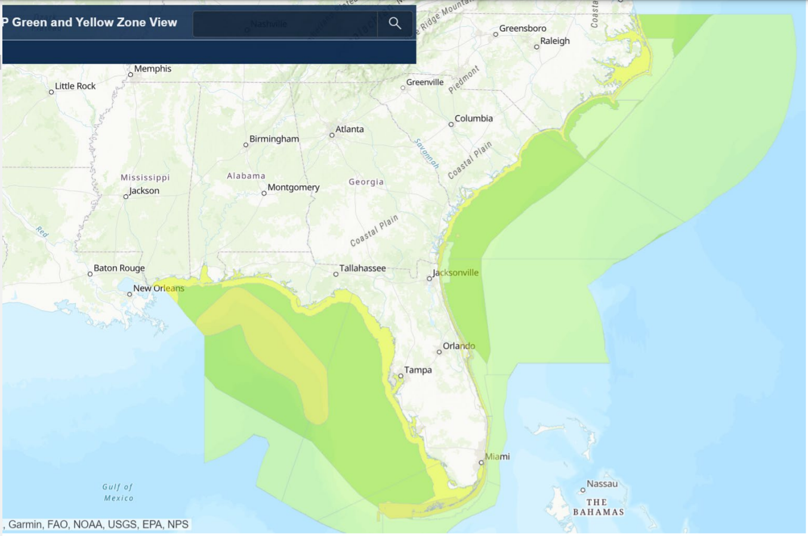
Action Area
Notes:
Green zone- pre authorized for dispersant use or in-situ burning- the decision to apply dispersants rest solely with the USCG FOSC- while implementing PDCs
Additionally, per the 2001 MOA, the FOSC must notify the RRT, which then notifies the NOAA Science Support Coordinator (SSC) when a spill occurs. The FOSC must also notify the NMFS Southeast Regional Office at the start of the spill response.
Light Green zone- areas conditionally pre-authorized---seasonal, under special jurisdiction or conditionally authorized, heightened awareness of:
Loggerhead Sea Turtle Northwest Atlantic DPS- off NC April to June through Sept to Nov for migratory habitat- and Nov-Apr for winter management- Sargassum habitat requires emergency consultation before these responses could be used;
NARW winter calving critical habitat off NC, SC, GA, FL for Nov-Apr;
Yellow zone- not pre-authorized for dispersant use or ISB
State waters out to 3 nautical miles (nm) from any shoreline and 9 nm from Florida’s
Gulf Coastline.
• Non-seasonal Critical Habitat- Emergency consultation is required for the following areas
that are established critical habitats:
Elkhorn and Staghorn Corals
Rice’s whale core distribution area

Slide 7
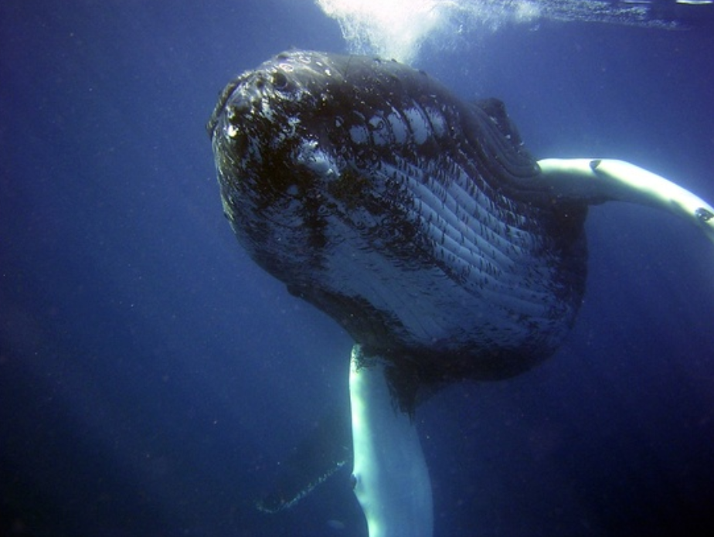
Action
DUPP: Surface application only during daylight hours.
Dispersants are chemicals that reduce surface tension between oil and water, leading to oil droplet formation, so that the oil will more readily disperse into the water column. They typically contain surfactants and solvents and are used to entrain oil in the water column to protect shorelines from floating oil, but in turn, increase exposure to underwater organisms.
ISBP: In-situ burning of oil in offshore waters can prevent the potentially more devastating impacts of oil in sensitive environments inshore. Effective implementation of ISB requires herding accessible quantities of oil on water to a thickness sufficient to sustain combustion; due to the action of natural dispersion and currents, there may be a limited window of opportunity for in-situ burning to be feasible. This plan covers protocols under which appropriate burning agents are preauthorized for use by the USCG OSC in state and federal ocean waters. The preauthorization for burning agents in the ISBP is in effect for the predesignated USCG FOSC only.
humpback whale

Slide 8
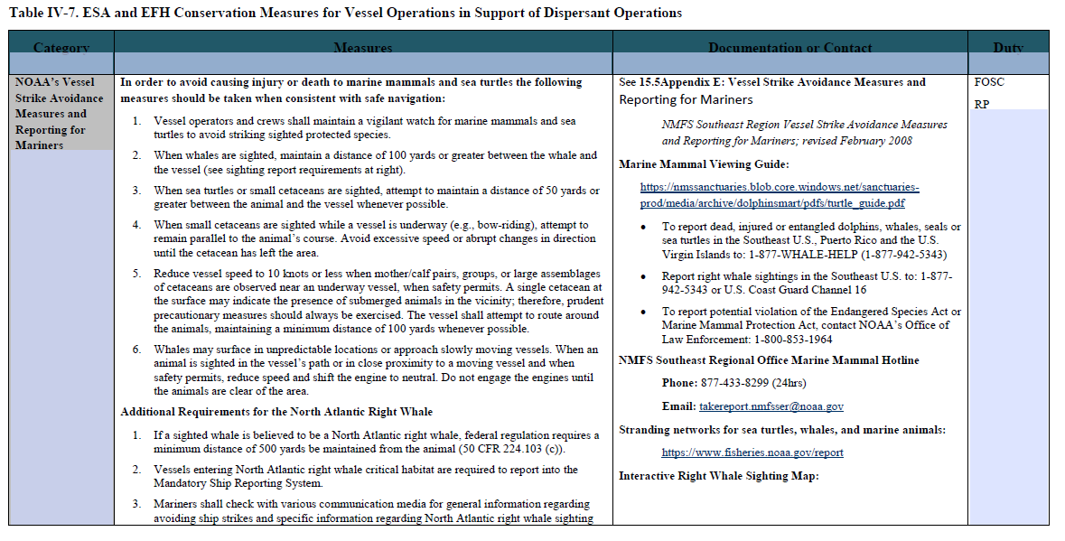
Proposed Action: Project Design Criteria
Non-discretionary measures identified to limit environmental effects of the action, also called best management practices or conservation measures
The protocols in the Appendices of the biological opinion cover the conservation measures that were discussed during consultation as part of the action:
Appendix A- Conservation measures (RRT protocols) for protection of ESA listed species and designated critical habitat
Appendix B- Emergency Consultation procedures for SER
Appendix C and D- DUPP and ISBP
Appendix E- Vessel Strike Avoidance Measures
Appendix F- NMFS-approved qualifications for offshore wildlife observer
Appendix G- Marine Species Observation Form
Appendix H- Marine Turtle Observation Form
Appendix I- Sea Turtle handling and resuscitation requirements
Appendix J- Sea Turtle retrieval protocols
Tables of protocols
Notes:
The pre-authorized response activities in the Green Zone will include required conservation measures/protocols or Project Design Criteria agreed to under this consultation for the FOSC and response personnel to follow.
Dispersant Use Preauthorization Plan (DUPP) contains protocols which must be followed as part of the conditions for preauthorization. These requirements can be regarded as initial control measures developed in consideration of a dispersant operation. These control measures are then augmented by the conservation measures developed in consideration of the potential biological impacts.
The ISBP contains protocols which must be followed as part of the conditions for preauthorization. These requirements can be regarded as initial control measures developed in consideration of an in-situ burn operation. These control measures are then augmented by the conservation measures developed in consideration of the potential biological impacts.

Slide 9
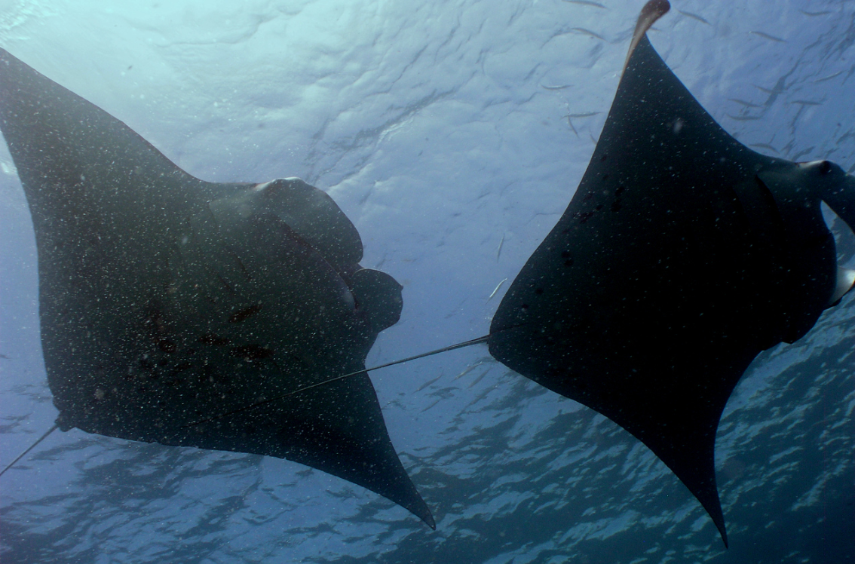
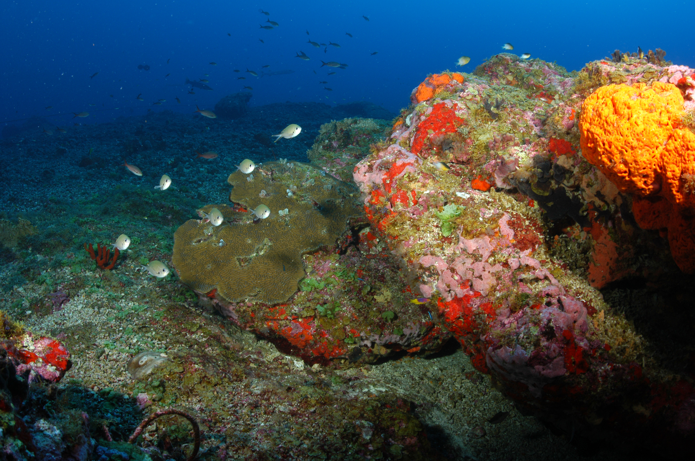
Species considered in the BiOp
Sea turtles
Kemp’s ridley
Loggerhead
Hawksbill
Green- North and South Atlantic DPS
Leatherback
Whales
Blue whale
Fin whale
North Atlantic right whale
Sei whale
Sperm whale
Rice’s whale
Fish
Atlantic sturgeon- Carolina and South Atlantic DPS
Gulf sturgeon
Shortnose sturgeon
Largetooth sawfish
Smalltooth sawfish- US portion of range
Giant manta ray
Nassau grouper
Scalloped hammerhead shark- Central and Southwest Atlantic DPS
Oceanic whitetip shark
Invertebrates
Elkhorn coral
Staghorn coral
Lobed star coral
Boulder star coral
Mountainous star coral
Pillar coral
Rough cactus coral
Plants
Johnson’s seagrass (no longer listed)
Manta rays
Live bottom reef

Slide 10
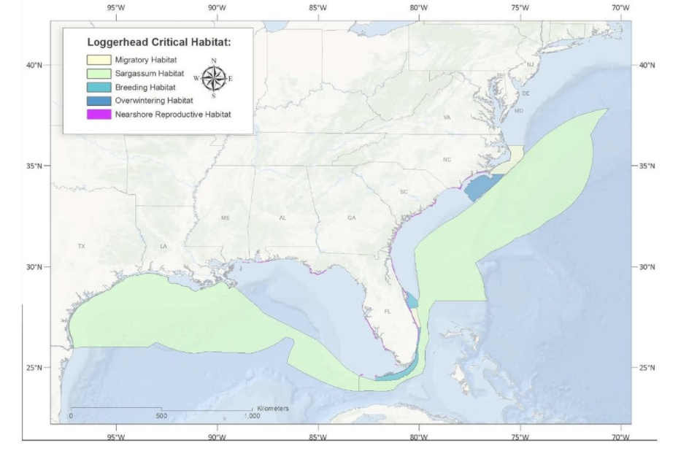
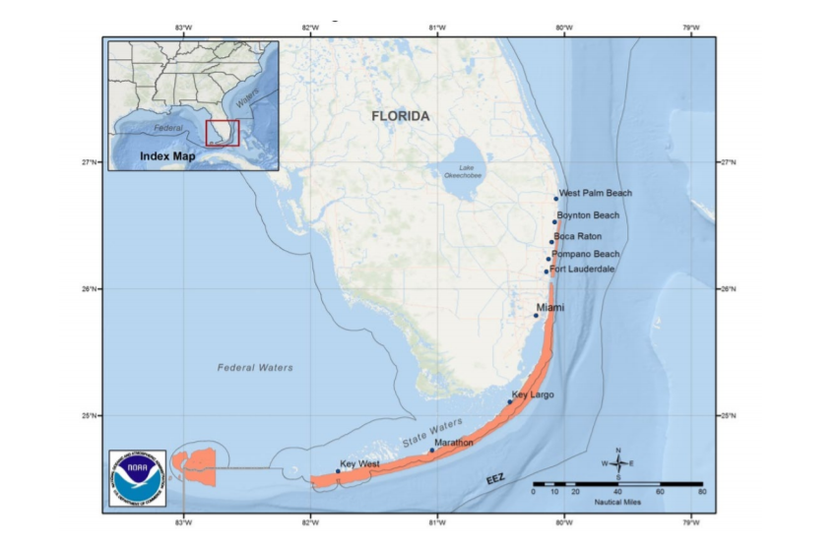
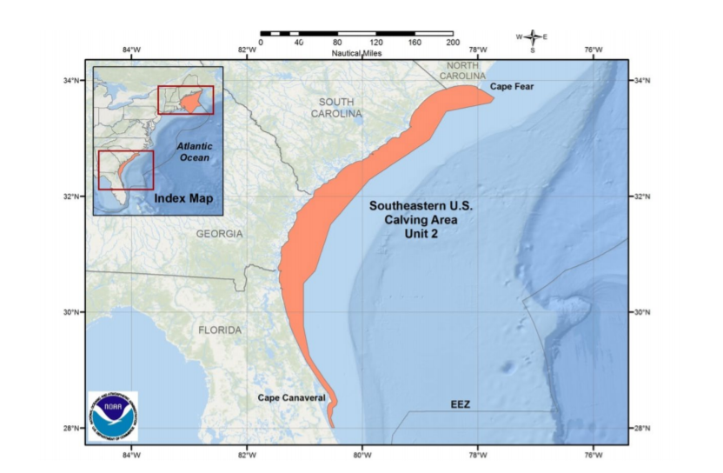
Designated Critical Habitat
Loggerhead
North ATL right whale
Elkhorn and
Staghorn
coral

Slide 11
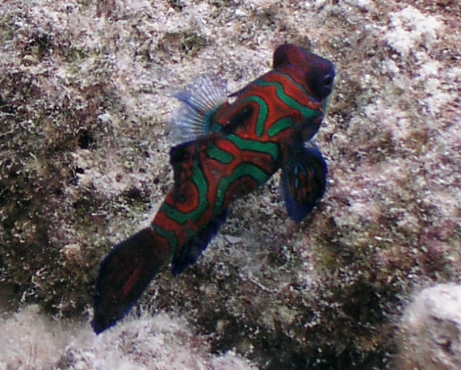
Stressors Analyzed (Effects analysis)
Effects of oil (we discuss this because response methods would not be proposed but for the oil spill event)
Dispersant application
In-situ burning
Potential for sea turtle take associated with in-situ burning (take covered under other regulatory regimes and not under incidental take statement)
Many of the effects to species and habitats were found to be insignificant or discountable given the application of the conservation measures, and most other potential effects are minimized or avoided.
Mandarinfish

Slide 12
Conclusions
Not likely to jeopardize the continued existence of loggerhead, Kemp’s ridley, hawksbill, leatherback, or green (North and South Atlantic DPS) sea turtles. Additionally, it is NMFS’ biological opinion that the action is not likely to destroy or adversely modify designated critical habitat for the NWA DPS of loggerhead sea turtle.
Notes:
Because we do not anticipate a significant reduction in numbers or reproduction of this species as a result of the action, a reduction in the likelihood of survival for sea turtles in the wild is not expected.
We believe the proposed action is not reasonably expected, directly or indirectly, to appreciably diminish, the value of designated critical habitat for the NWA DPS loggerhead sea turtles.
Hence, the effects of the proposed action would not rise to the level of destruction or adverse modification of critical habitat.
No incidental take of ESA-listed species is anticipated or authorized because the take that will occur was authorized under the STSSN consultation and/or would be covered under 50 CFR 223.206 (b).

Slide 13
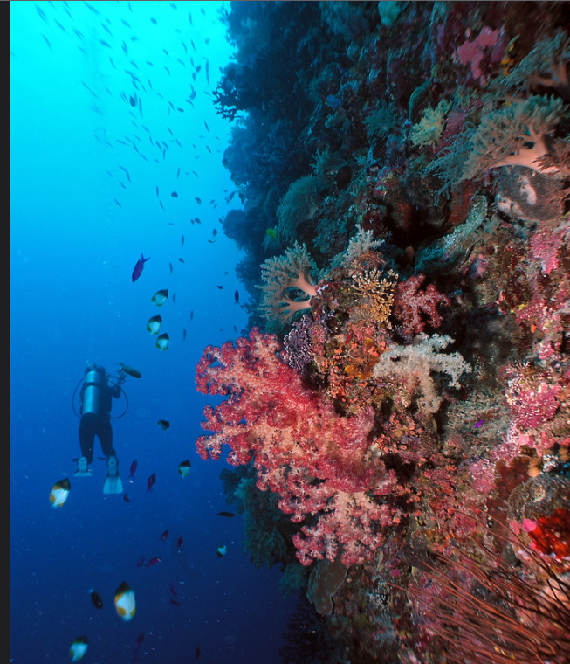
Implementation phase
BiOp currently under implementation
Annual activity reviews may be conducted during RRT IV annual meetings
Listing/Delisting of ESA species and designated critical habitat
Contacts verification and updates
Discuss what is working/not working under ESA- adaptive management
Discuss conservation measures as they relate to operations
Other reference/guidance updates
Image courtesy of D.Burdick
Notes:
Sometimes there is a lag time to full awareness and implementation
Annual notices are reported for any case where dispersant use or in-situ burn is applied.

